Slide 1
WP1
Improving seasonal long range forecast skill of risks for hazardous weather and climate events
Lead: Johanna Baehr (UHAM) and Jens Hesselbjerg Christensen (NORCE/DMI)
Presenter: Jens Hesselbjerg Christensen (NORCE/DMI)

Slide 2
Impacts in progress
Contribute to a robust and reliable forecasting framework that can help meteorological and climate services to deliver better predictions, including at sub-seasonal and seasonal time scales
Improve capacity to predict the weather and climate of the Northern Hemisphere, and make it possible to better forecast extreme weather phenomena
Improve the professional skills and competences for those working and being trained to work within this subject area
WP1 establishes a robust and reliable forecasting framework for probabilistic predictions of extreme weather phenomena at subseasonal-to-seasonal (s2s) time scales and beyond. Key to this is a development of innovative, process-oriented description of the weather systems in which extremes are likely to form, building on assessment and quantification of empirical relationships between large-scale atmospheric and lower boundary (ocean surface, sea ice) drivers.

Slide 3
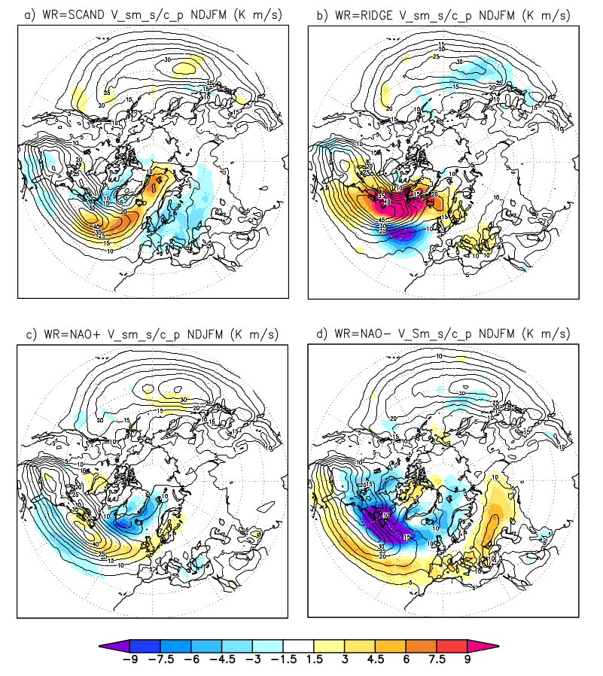
Process‐oriented diagnostic of weather systems Blocking, jet stream position and eddy heat transport
Storminess for the four weather regimes
Eddy heat flux at 850 hPa is used as a proxy for storminess
In association with weather regime, storm extremes are geographically predestinated:
Scandinavian blocking: the eddy activity is intensified over the Nordic Seas
Atlantic Ridge: extra-tropical regions surrounding the anticyclone, Labrador, Greenland and Nordic Seas
NAO⁺: British Isles and Scandinavia
NAO⁻: Mediterranean and eastern Europe
Scandinavian blocking
Atlantic Ridge
NAO⁺
NAO⁻
Ruggieri et al., 2020
Notes:
Task 1.2 Process-oriented diagnosis of weather systems
Contribution to Deliverable 1.1
Work based on reanalysis.
Relationship with heat transport extremes on synoptic frequencies

Slide 4
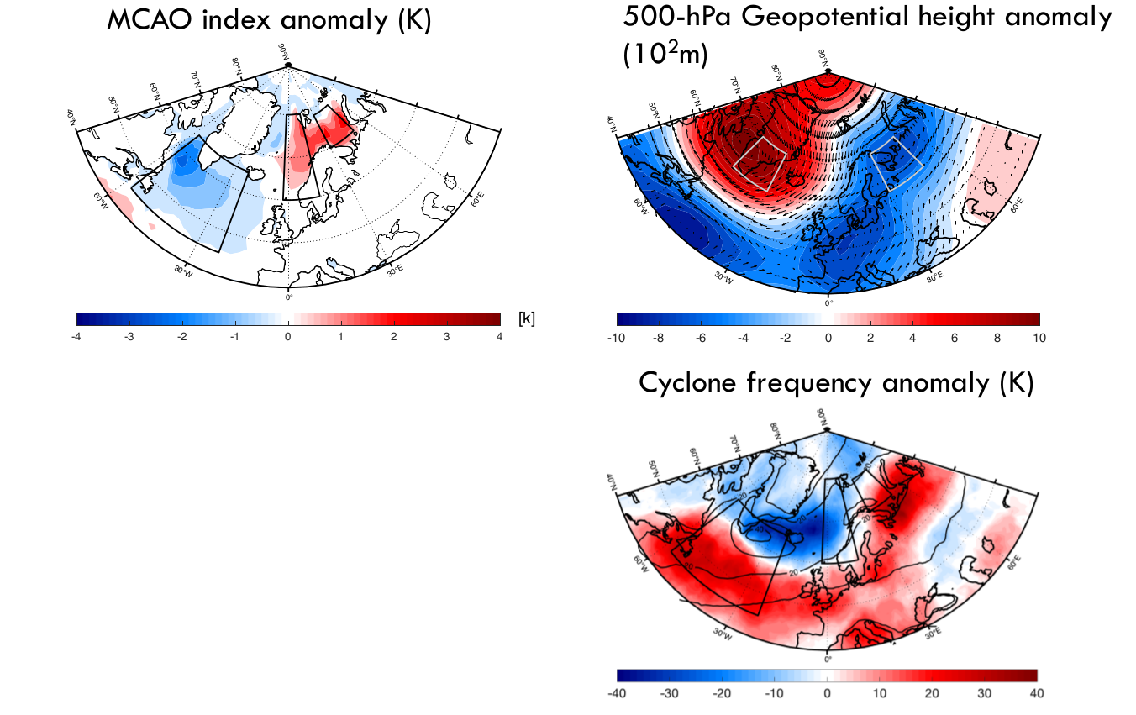
Process‐oriented diagnostic of weather systems: Effect of the sudden stratospheric warming (SSW) events on Marine Cold-Air Outbreaks MCAOs
33% of SSWs are followed by enhanced MCAOs in the Nordic Seas
SSWs are associated with an enhanced dipole pattern of geopotential height anomaly and strong northerly winds
SSWs result in a decrease of MCAO intensity and frequency in the Labrador Sea and an increase in the Nordic Seas
Afargan-Gerstman et al., in prep.

Slide 5
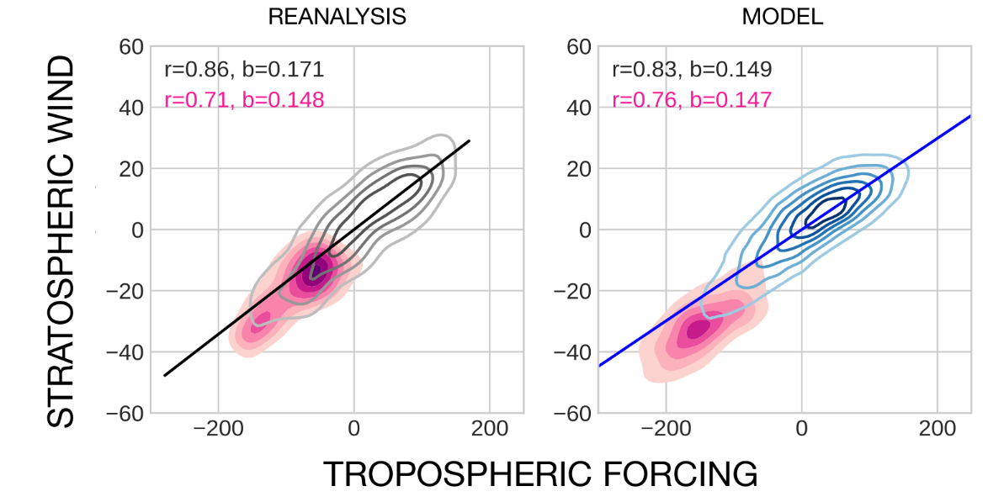
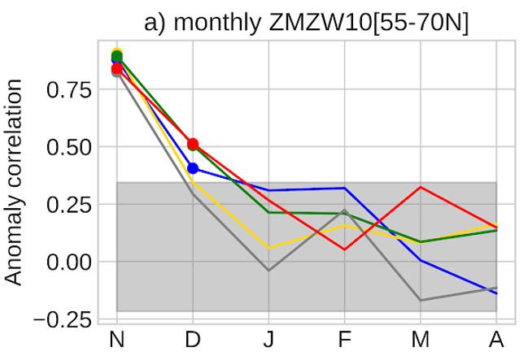
Analyze weather systems in seasonal prediction systems: Predictability of winter stratospheric circulation from upward troposphere-stratosphere coupling
all days
SSW days
all days
SSW days
tropospheric-stratospheric link is a part of the mechanism for setting up CAOs/MCAOs
for predicting CAOs/MCAOs, it is crucial that models capture the mechanism (which seems to be the case in this example)
stratospheric winds can be predicted two months ahead
Prediction skill for stratospheric winds
different models
Portal et al., in prep.
Notes:
Assessment of predictive skill for the extratropical stratosphere flow in seasonal forecast models.
Work based on reanalysis and C3S
Seasonal Forecast.
-Development of a method to characterize variability and extremes of stratospheric extratropical circulation
-Evidence of valuable predictive skill
Aligned with future work on MCAO
Presented with a talk in a WCRP workshop

Slide 6
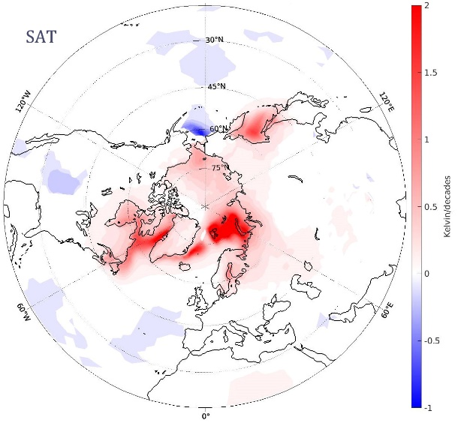
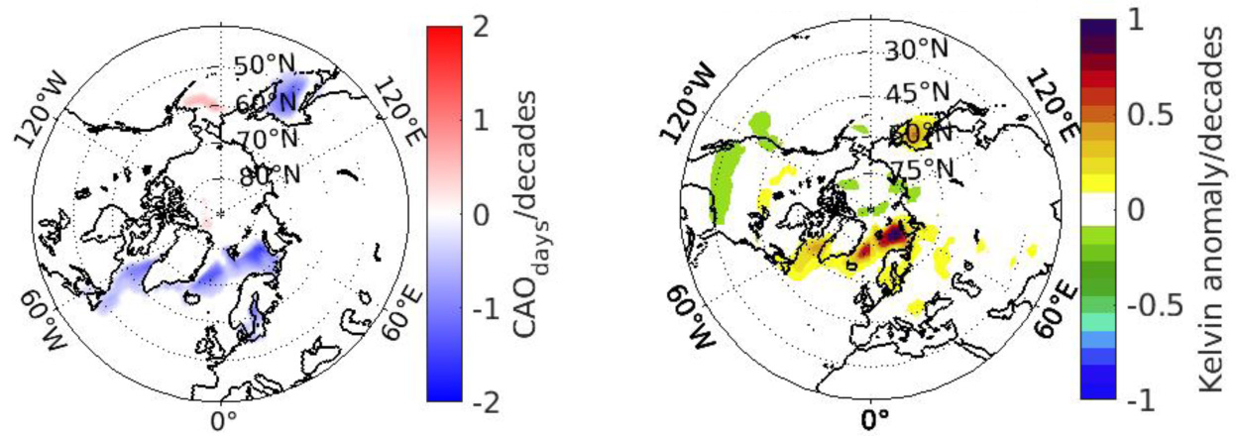
Detection and attribution of weather systems and extremes: Sea ice loss effect on CAO/MCAO frequency and intensity
Linear trend in SAT
trends in CAO frequency and intensity near the sea ice edge reflect their shrinkage
no significant change in winter CAO frequency and intensity over the continents
sea ice loss slightly increases CAO averaged temperature
CAO frequency CAO intensity due to sea ice loss
Claude Frankignoul and Guillaume Gastineau
Notes:
New CAO index: Monthly average of the square of the daily T2m anomalies when they are negative

Slide 7
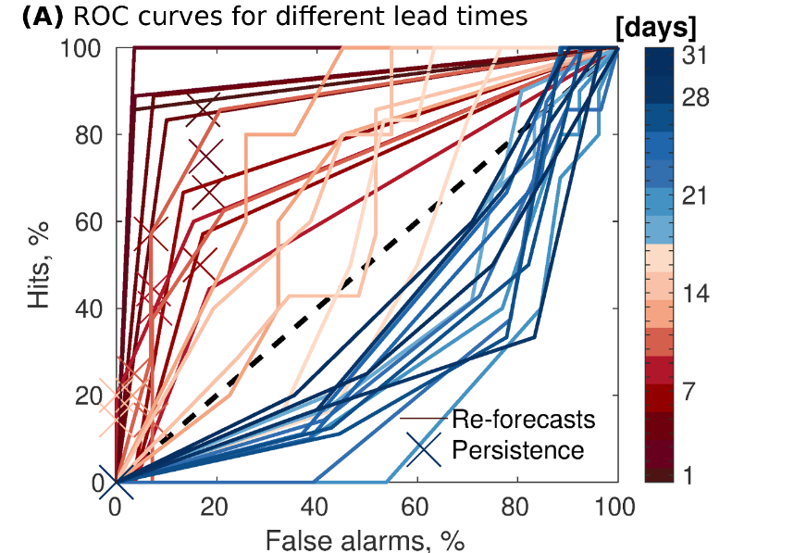
Extremes in seasonal prediction systems: Prediction system is able to forecast MCAOs up to one month ahead
Individual MCAO events can be skillfully predicted about two weeks ahead
Probabilistic prediction skill
Frequency of MCAOs per month and extreme MCAOs within a month can be predicted one month ahead
Prediction skill
Examples for the Barents Sea and November initialization from Polkova et al., 2019

Slide 8
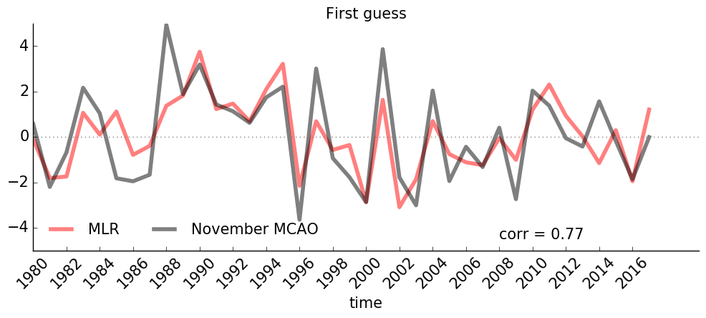
Weather systems and extremes in seasonal prediction systems: MCAO prediction for November based on predictors from October
Statistical prediction for the Barents Sea MCAOs (red curve)
Knowing predictors as proposed by WP1 partners (state of the atmosphere, ocean and sea ice) allows to develop a statistical model for MCAOs
Statistical model based on MCAO predictors
This statistical model can be further used in statistical-dynamical forecasting of MCAOs (in progress)
Select members that capture the MCAO environment setup
User-relevant products about MCAOs
Polkova et al., in prep.
8

Slide 9
Contributions to ”Expected Impacts”
Improve capacity to predict the weather and climate of the Northern Hemisphere, and make it possible to better forecast extreme weather phenomena
Improve the capacity to respond to the impact of climatic change on the environment and human activities in the Arctic, both in the short and longer term
Improve the capacity of climate models to represent Arctic warming and its impact on regional and global atmospheric and oceanic circulation
Improve the uptake of measurements from satellites by making use of new Earth observation assets
Lead to optimised observation systems for various modelling applications
Contribute to a robust and reliable forecasting framework that can help meteorological and climate services to deliver better predictions, including at sub-seasonal and seasonal time scales
Improve stakeholders’ capacity to adapt to climate change
Contribute to better servicing the economic sectors that rely on improved forecasting capacity (e.g. shipping, mining)
Contribute to the Year of Polar Prediction (YOPP) and IPCC scientific assessments, and to the Copernicus Climate Change (C3S) services
Improve the professional skills and competences for those working and being trained to work within this subject area

Slide 10
Identified research gaps
Process‐oriented diagnostic of weather systems
Blocking, jet stream position and eddy heat transport
Stratosphere-troposphere interactions
Non-identified modes of variability
Systems not related to modes of variability
Troposphere-stratosphere interactions

Slide 11
Thank you!
The Blue-Action project has received funding from the European Union’s Horizon 2020 research and innovation programme under grant agreement No 727852
Twitter: @BG10Blueaction
Zenodo: https://www.zenodo.org/communities/blue-actionh2020
www.blue-action.eu

