Slide 1
WP4
Enhancing the capacity of seasonal-to-decadal prediction in the Arctic and over the Northern Hemisphere.
Lead: Daniela Matei and Noel Keenlyside

Slide 2
Main Findings’ Contribution to the Project´s Expected Impacts (EI)
We have demonstrated skill in predicting key variables and events (EI1):
North Atlantic Blocking and Sudden Stratospheric Warming frequency, on multi-year timescales based on the North Atlantic and Pacific variability
The 2015 cold blob and its impacts on European heatwaves, through multi-model experiments
We have better understood, through extensive prediction experiments (EI1,3):
The driving forces for the 2015 cold blob and sources of forecast error
The role of ocean and sea ice initialisation for predictability in the North Atlantic sector on seasonal to multi-year time scales
Role of oceanic linkages between NA – Arctic for high-latitude predictability and change
Notes:
Explain how your main findings contribute to the expected impacts of the project so far.
Please check the list of Expected Impacts in call text and what you declared in your WP report
https://code.mpimet.mpg.de/projects/bg10/wiki/Second_progress_report
And what we declared in the Management report
https://docs.google.com/document/d/10mdpUX_Kor8gI1Sy5fw8_iCSVxhWHxHaEVew2rApLRg/edit
Expected Impacts (EI)
I1: Improve capacity to predict the weather and climate of the Northern Hemisphere, and make it possible to better forecast of extreme weather phenomena
I2: Improve the capacity to respond to the impact of climatic change on the environment and human activities in the Arctic, both in the short and longer term
I3: Improve the capacity of climate models to represent Arctic warming and its impact on regional and global atmospheric and oceanic circulation
I4: Improve the uptake of measurements from satellites by making use of new Earth observation assets
I5: Lead to optimised observation systems for various modelling applications
I6: Contribute to a robust and reliable forecasting framework that can help meteorological and climate services to deliver better predictions, including at sub-seasonal and seasonal time scales
I7: Improve stakeholders’ capacity to adapt to climate change
I8:
Greenland Ice Sheet Melt shown important for North Atlantic decadal variability (I1)
Demonstrated predictability on decadal timescales of NA Blocking and SSW frequency (I1)
Improved understanding of oceanic linkages between NA – Arctic in prediction systems (I3)
Improved understanding of predictability of 2015 cold blob and its impacts on European heatwaves in multi-model experiments and decadal linked to ocean initialisation, as well as atmospheric variability
Contribution of decadal prediction experiments to CMIP6/IPCC
System development contributing to improved capabilities (I1,i4)
New initialisation approaches (anomaly approach, coupled DA and likelihood function sea ice assim)
Development of eddy resolving and permitting versions of prediction systems
We have delivered data to WP5 marine ecoystem case study

Slide 3
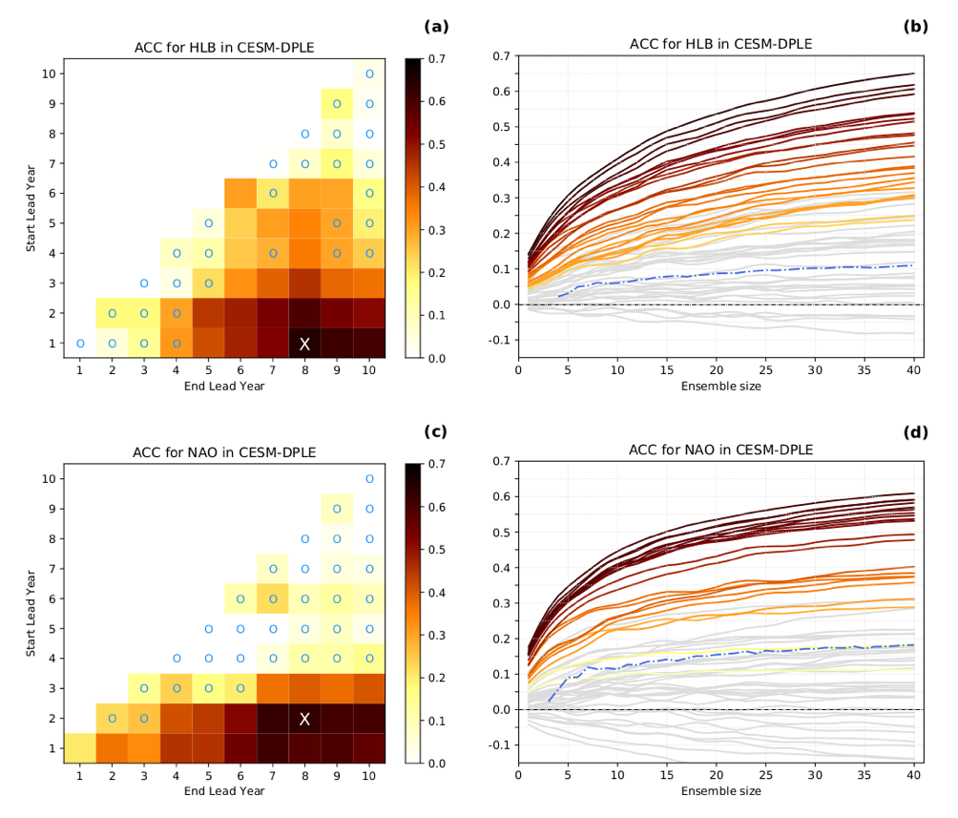
Decadal predictability of North Atlantic atmospheric anomalies
Athanasiadis et al., 2020, revised for NPJ Climate and Atmospheric Science

Slide 4
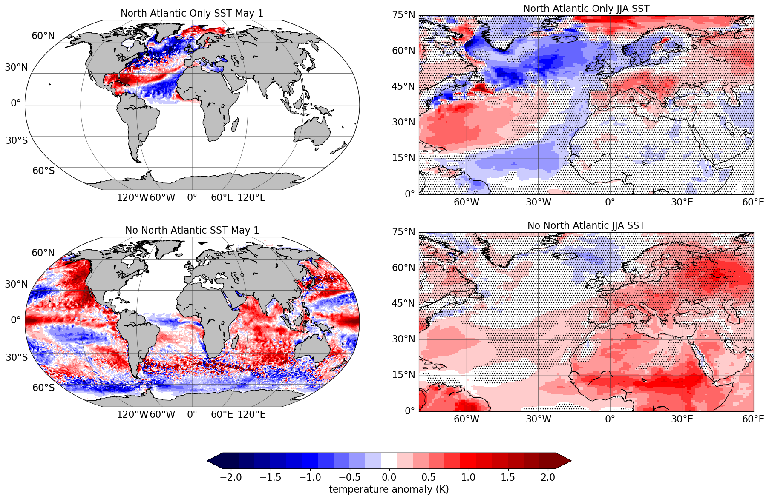
The 2015 cold blob and its impacts on European heatwaves
Mecking et al., 2019

Slide 5
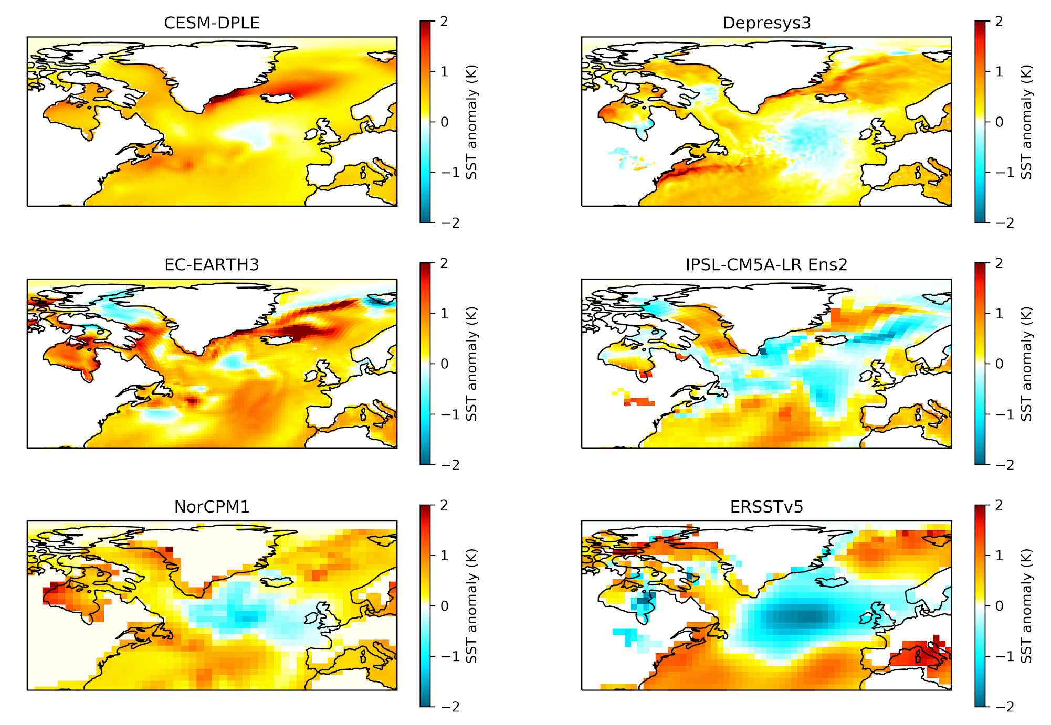
Predictability of the 2015 North Atlantic Record Cold Blob
Maroon et al., 2020 , in prep.

Slide 6
Main Findings’ Contribution to the Project´s Expected Impacts (EI)
Coordinated prediction experiments, developed new prediction systems (EI1,4,5):
Contribution of decadal prediction experiments to CMIP6/IPCC
New initialisation approaches for sea ice and high-resolution models (anomaly approach, coupled Data Assimilation and likelihood function sea ice assimilation)
Development of eddy resolving and permitting versions of prediction systems
We have delivered data to WP5 marine ecosystem case study (EI2,7)
Notes:
Explain how your main findings contribute to the expected impacts of the project so far.
Please check the list of Expected Impacts in call text and what you declared in your WP report
https://code.mpimet.mpg.de/projects/bg10/wiki/Second_progress_report
And what we declared in the Management report
https://docs.google.com/document/d/10mdpUX_Kor8gI1Sy5fw8_iCSVxhWHxHaEVew2rApLRg/edit
Expected Impacts (EI)
I1: Improve capacity to predict the weather and climate of the Northern Hemisphere, and make it possible to better forecast of extreme weather phenomena
I2: Improve the capacity to respond to the impact of climatic change on the environment and human activities in the Arctic, both in the short and longer term
I3: Improve the capacity of climate models to represent Arctic warming and its impact on regional and global atmospheric and oceanic circulation
I4: Improve the uptake of measurements from satellites by making use of new Earth observation assets
I5: Lead to optimised observation systems for various modelling applications
I6: Contribute to a robust and reliable forecasting framework that can help meteorological and climate services to deliver better predictions, including at sub-seasonal and seasonal time scales
I7: Improve stakeholders’ capacity to adapt to climate change
I8:
Greenland Ice Sheet Melt shown important for North Atlantic decadal variability (I1)
Demonstrated predictability on decadal timescales of NA Blocking and SSW frequency (I1)
Improved understanding of oceanic linkages between NA – Arctic in prediction systems (I3)
Improved understanding of predictability of 2015 cold blob and its impacts on European heatwaves in multi-model experiments and decadal linked to ocean initialisation, as well as atmospheric variability
Contribution of decadal prediction experiments to CMIP6/IPCC
System development contributing to improved capabilities (I1,i4)
New initialisation approaches (anomaly approach, coupled DA and likelihood function sea ice assim)
Development of eddy resolving and permitting versions of prediction systems
We have delivered data to WP5 marine ecoystem case study

Slide 7
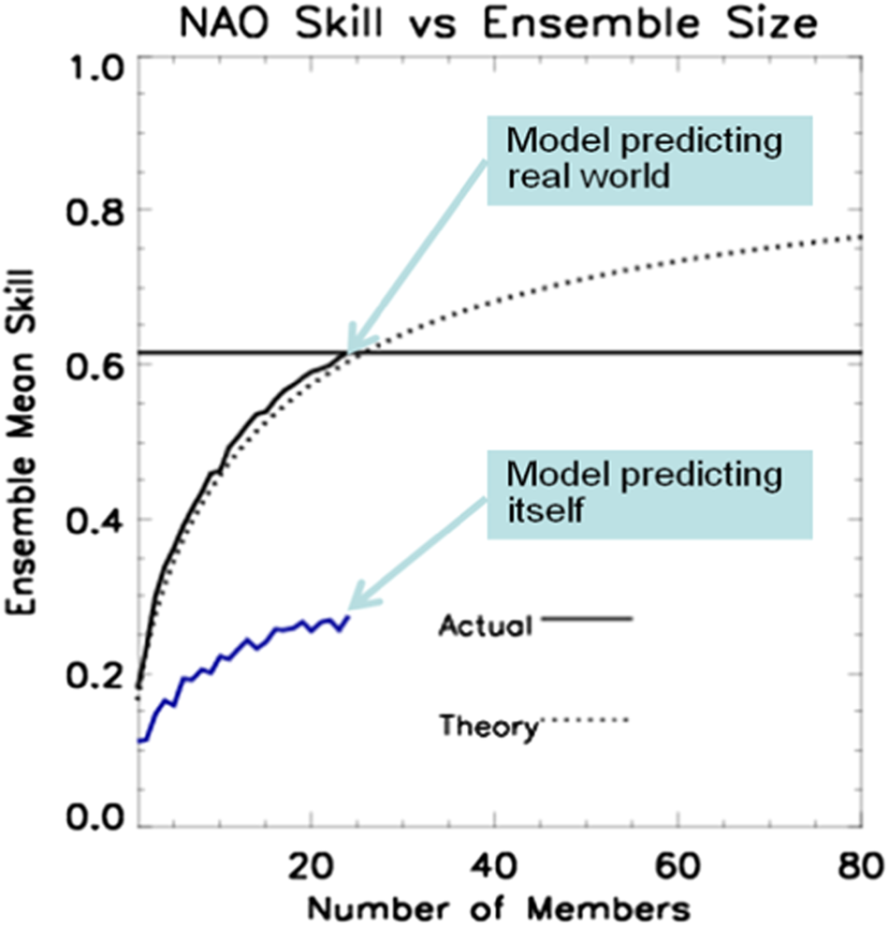
A signal-to-noise paradox in climate science
Scaife and Smith, 2018

Slide 8
Research Gaps
Climate variability in the North Atlantic Sector is more predictable than models imply. We need to understand why and how to improve models.
More research required on generating optimal ensemble predictions in terms of size and models, and how to best extract predictable signals
Notes:
Research gaps gaps still present in your research field that need to be still explored/funded (these are key inputs to policy-relevant discussion later

Slide 9
Research Gaps
More advanced data assimilation methods are required that account for the different scale interactions in the climate system
Improved understanding of key physical processes, to reduce key model errors
We need to integrate new observations for verifying and developing high-resolution models
We need to develop capacities to utilize next generation of super computers for high-resolution model applications
Notes:
Research gaps gaps still present in your research field that need to be still explored/funded (these are key inputs to policy-relevant discussion later

Slide 10
Thank you!
The Blue-Action project has received funding from the European Union’s Horizon 2020 research and innovation programme under grant agreement No 727852
Twitter: @BG10Blueaction
Zenodo: https://www.zenodo.org/communities/blue-actionh2020
www.blue-action.eu

