Slide 1
WP6 and WP8
Clustering, Communication, Dissemination, Engagement & Exploitation
Presenters: Steffen Olsen, Hannah Grist

Slide 2
Clustering, Dissemination & Engagement Outlook 2020 - 2021
Clustering with other projects
Dissemination of high-impact outputs from scientific progress
Focus on key messages to target audiences
Building on previous success stories
Working collaboratively to increase reach and impact
Notes:
Our focus over the remainder of the project is to:
Focus on sharing the cutting-edge science coming from our research, and ensuring it reaches the right audiences
Highlight the right audiences and target our messaging effectively.
Using our knowledge of and feedback from previous events to deliver successful activities
Work collaboratively within clusters for dissemination

Slide 3
Clustering with the scientific community
Our clustering activities include:
Meetings and knowledge sharing with projects
e.g. EU Climate Modelling Cluster, Spring 2021
Knowledge exchange on specific topics/outputs
e.g. ProSnow, Med-Gold
Shared dissemination events
e.g. EGU online 2020, Arctic Science Summit Week 2020
Shared crossover events – science/policy
e.g. Arctic Science Ministerial (ASM3), Arctic Futures Symposium 2020 (IPF), UN Ocean Decade Arctic Workshop 2020.

Slide 4
Clustering priorities 2020
Arctic Workshop, UN Ocean Decade
Steering group, indigenous perspectives, YOPP
Arctic Futures Symposium
Panel on Climate resilience, sustainable development
Oct
Nov
Dec
Proposed session on Polar amplification at EO4Polar Science workshop
with SO-CHIC and European Polar Board
Workshop on
Changing Patterns of Climate: Understanding Uncertainties? with CLIVAR, CORDEX, GEWEX, Grand Challenges (DCPP)

Slide 5
Clustering priorities 2021 (so far)
ECRA GA on Extreme Events
With ECRA and APPLICATE
UN Ocean Decade, Kick-off Berlin
tbc
Jan
March
May
Arctic Frontiers. Advanced Prediction Capabilities for the Arctic Region and Beyond
With YOPP, APPLICATE, Nansen Legacy, SALIENSEAS, Alertness
Arctic Science Summit Week, Lisbon
tbc

Slide 6
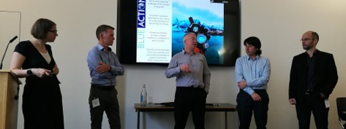
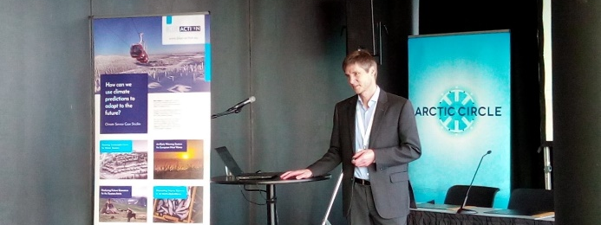
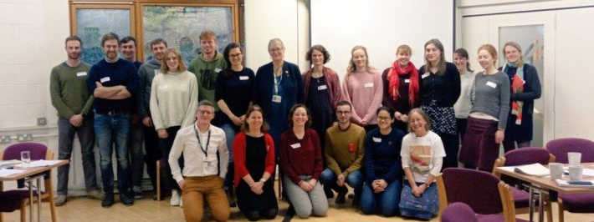
Highlights from previous period
For policy-makers:
Briefing on the Slowing Gulf Stream with SEARICA
For societal engagement: Briefing on ocean observations and predictions
For businesses:
Case studies dissemination roadshow
For professional development:
Workshops on engaging with policy
Notes:
Deliverables linked to these activities (past deliverables):
Briefing on Slowing Gulf Stream (D8.11) https://zenodo.org/record/1408097#.XrF7k6hKiM8
Briefing on ocean observations and predictions (D8.8) https://zenodo.org/record/3559484#.XrGN6KhKiM8
Case studies dissemination roadshow (D8.13) https://zenodo.org/record/3559496#.XrGOM6hKiM8

Slide 7
Professional development
Delivering scientific communication training for early-career partners
Online webinars from experts
Planned in-person summary workshop
Pitch training from Climate-KIC for case study partners
Climate-KIC MOOC and one-to-one pitch coaching sessions
Talks by partners at targeted conferences/meetings using developed skills
Evaluation workshop in 2021

Slide 8
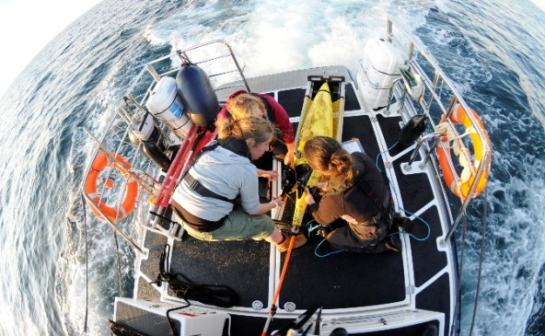
Public/wider societal engagement
New publications:
e.g. ”Ocean observations to predictions”, and ”Polar processes to global climate.”
Website, blog, & social media
to engage non-specialists in project outputs.
Articles and guest blogs:
e.g. Arctic Yearbook, Journal of North Atlantic and Arctic, Polar Prediction Matters
Public outreach events
e.g. Pale Blue Dot exhibition,
Greenland Science week, COP26 Physics Festival
Notes:
Blue-Action blog: http://www.blue-action.eu/index.php?id=5269&L=242

Slide 9
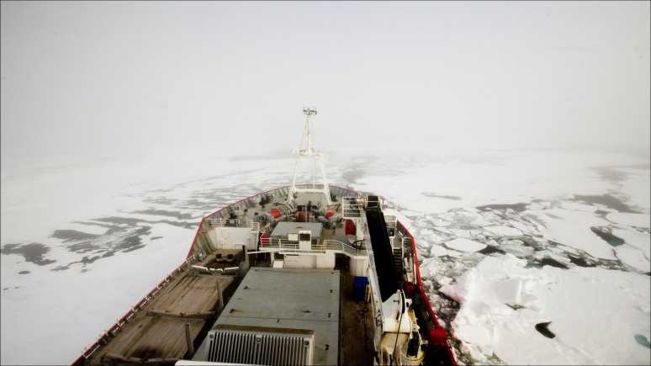
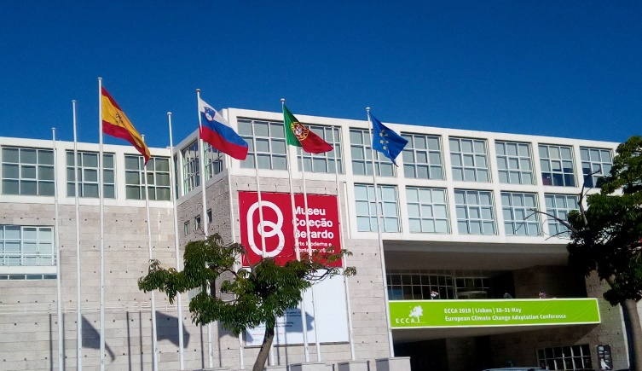
Business sector engagement
February 2021
Industry-science panel discussion
Arctic Frontiers
DTU Aqua, DNV, CKIC, SRSL
2020 -2021
Case studies pitches dissemination
International Conference on Climate Services (ICCS7)
European Climate Change Adaptation Conference (ECCA)

Slide 10
Engagement with policy-makers
October 2020
Policy briefing on Extreme Events at the European Parliament
In collaboration with European Parliament Intergroup on Climate Change, Biodiversity and Sustainable Development, and European Climate Research Alliance.
Nov 2020
Policy briefing on Fisheries Forecasts at the European Parliament
In collaboration with European Parliament Intergroup on Climate Change, Biodiversity and Sustainable Development, KDM and DTU Aqua

Slide 11
Support from DG RTD requested
Help us identify DG RTD (and other DG participants) to contribute to our:
Policy briefing on Extreme Events, at the EP, Oct 2020
Policy briefing on Fisheries Forecasts, at the EP, Nov 2020
Involve us in joint EC/H2020 activities at key high-level events such as:
ASM3 Edition 21-22 Nov 2020 Japan
UN Oceans Conference 202x
European Climate Change Adaptation Conference (ECCA)
Arctic Science Summit Week
Arctic Circle

Slide 12
Thank you!
The Blue-Action project has received funding from the European Union’s Horizon 2020 research and innovation programme under grant agreement No 727852.
www.blue-action.eu
@BG10Blueaction
https://www.zenodo.org/communities/blue-actionh2020
Notes:
Website: www.blue-action.eu
Blog: http://www.blue-action.eu/index.php?id=5269
Twitter: @BG10BlueAction

