Slide 1

Heat transport to the Arctic
Blue Action Kick-Off Meeting
Berlin, January 2017
GERARD MCCARTHY
with thanks to
Marius Arthun, Sheldon Bacon, Bee Berx, Tor Eldevik, Wilco Hazeleger, Steve Yeager

Slide 2
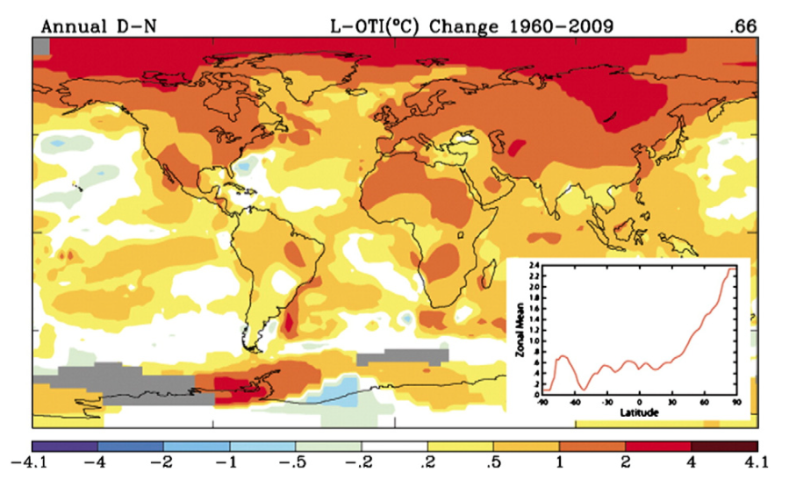
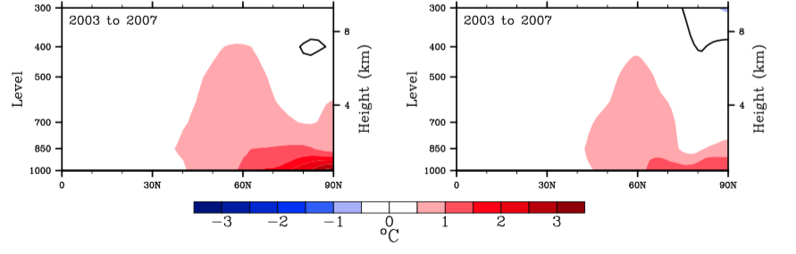
Serreze and Barry, Processes and impacts of Arctic amplification: A research synthesis. Global and Planetary Change 2011
Serreze et al, The emergence of surface-based Arctic amplification. The Cryosphere 2009
The Arctic is warming twice as fast as lower latitudes
This is a surface intensified process

Slide 3
Sea ice decline is possibly the most obvious effect of this warming
Sea ice decline itself plays a role in its own demise via ice albedo feedbacks and cloud/moisture feedbacks

Slide 4
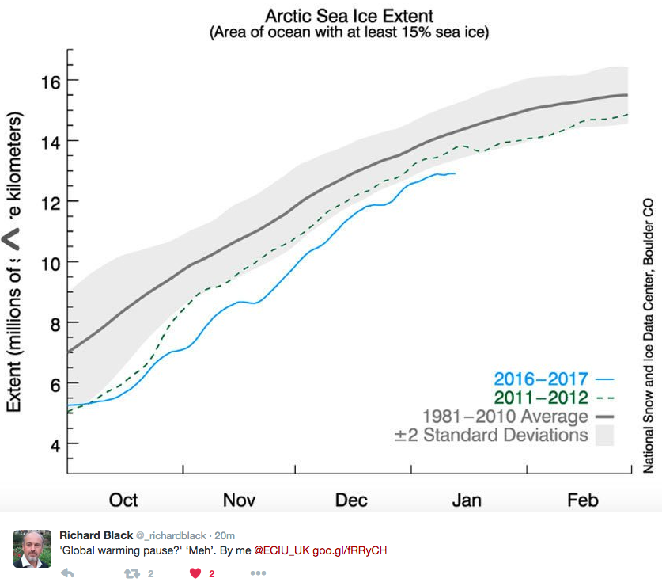
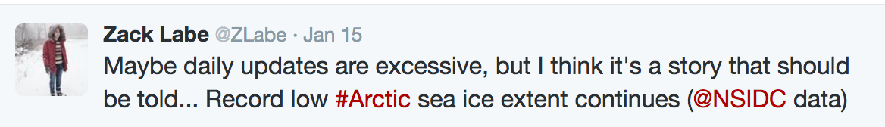
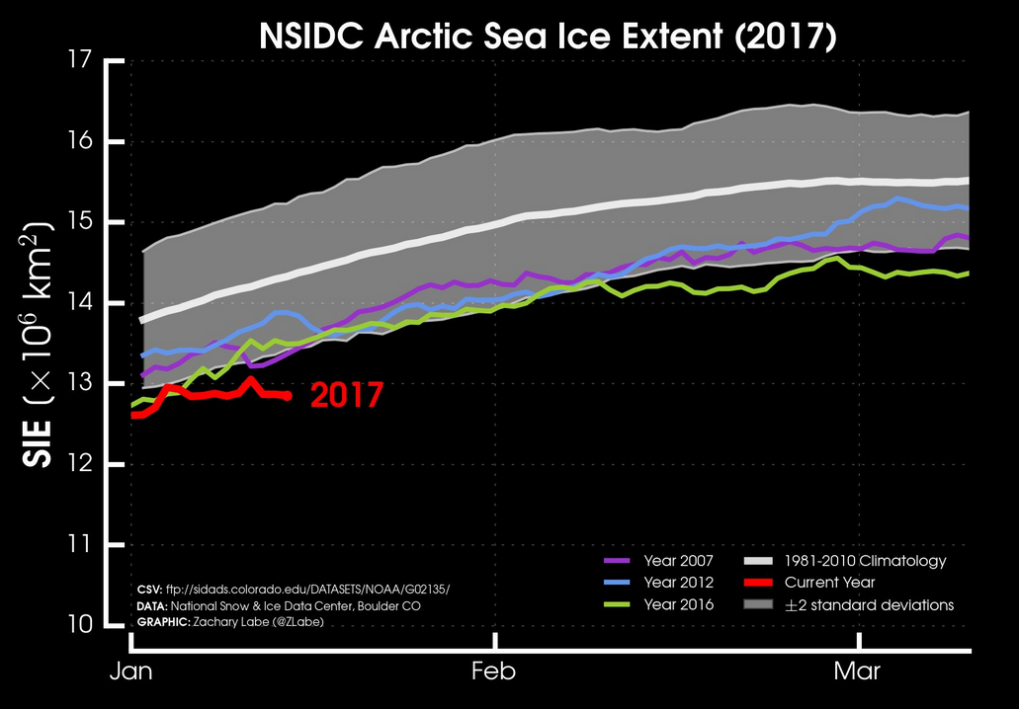
The changes in the Arctic are extreme and happening right now
A number of contemporary sources have picked up on the slow start to 2017 of sea ice growth

Slide 5
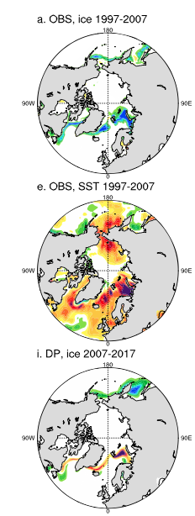
Reduced ocean heat transport to the Arctic could cause a slowdown in sea ice loss
This has been predicted by a number of studies
The Atlantic sector around the periphery of the Barents Sea is a key area
Yeager et al., Predicted slowdown of Atlantic sea ice loss. GRL, 2015
Zhang, Mechanisms for low frequency variability of summer sea ice extent. Proc. Nat. Ac. Sci., 2015

Slide 6
WP2: Lower latitude drivers of Arctic change
Task 2.1 Assessment of key lower latitude influences on the Arctic and their simulation
Task 2.2 Pathways and interactions sustaining Arctic predictability
Task 2.3 Optimization and coordination of existing TMA systems, improved data delivery for predictions and identification of gaps
Heat transport towards the Arctic
Focus on the ocean

Slide 7
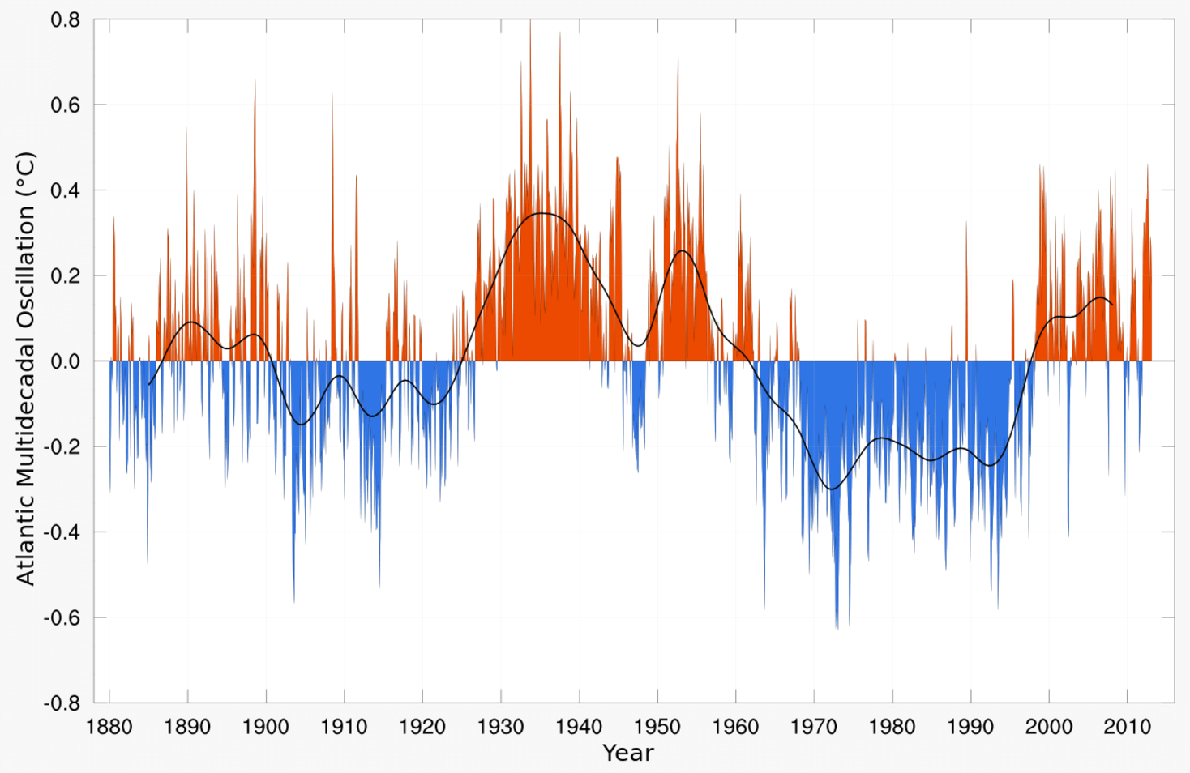
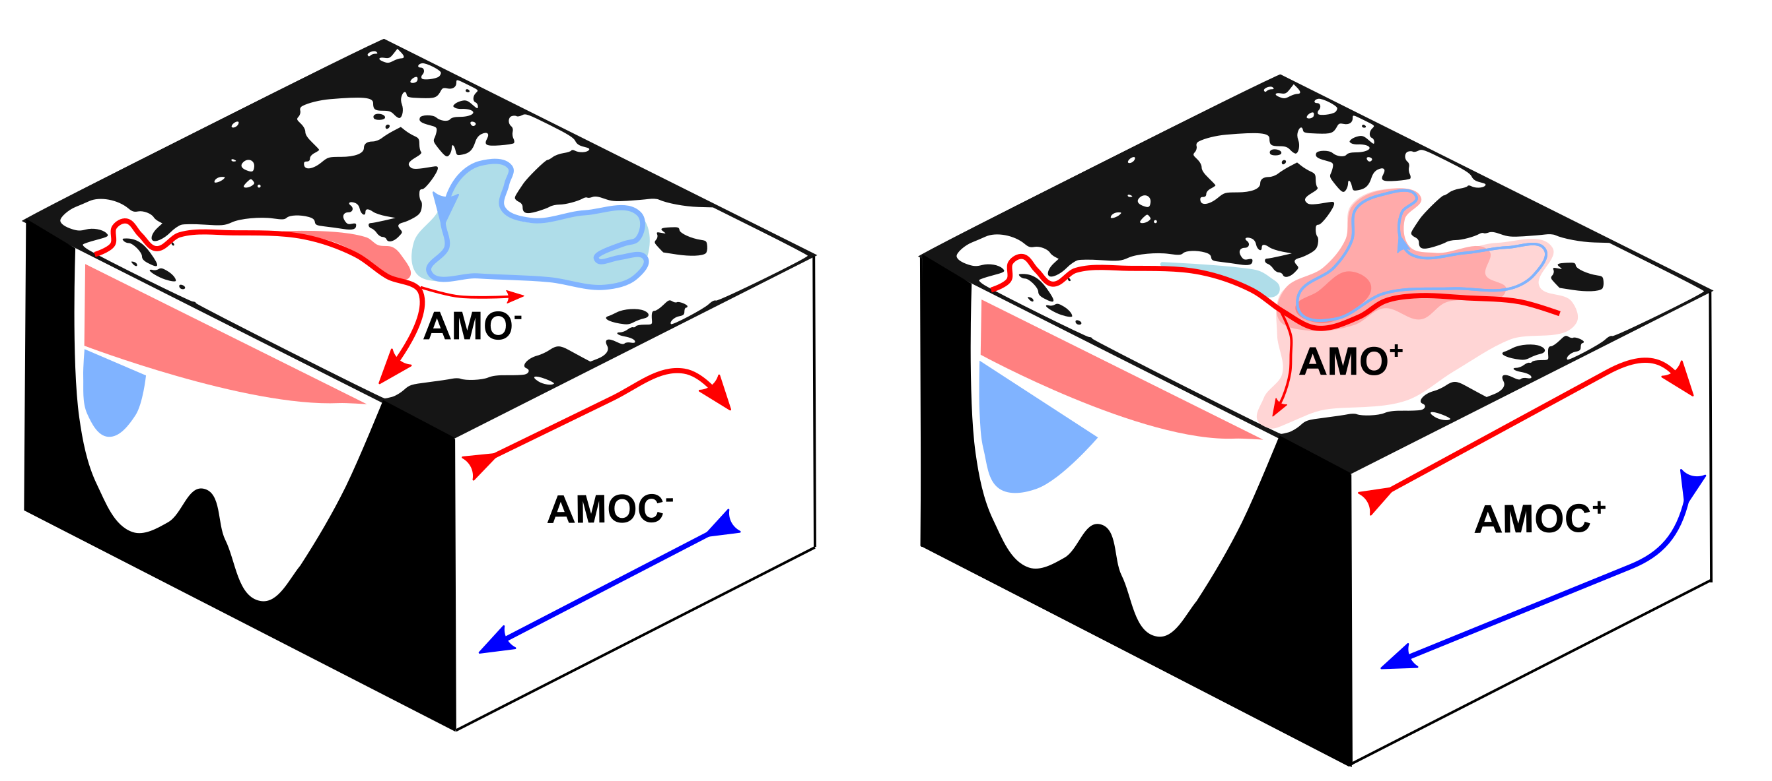
Atlantic Multi-decadal Oscillation (AMO) shows relatively warm and cool decades are a feature of Atlantic sea surface temperatures
Atlantic circulation is believed to drive the phases of the AMO

Slide 8
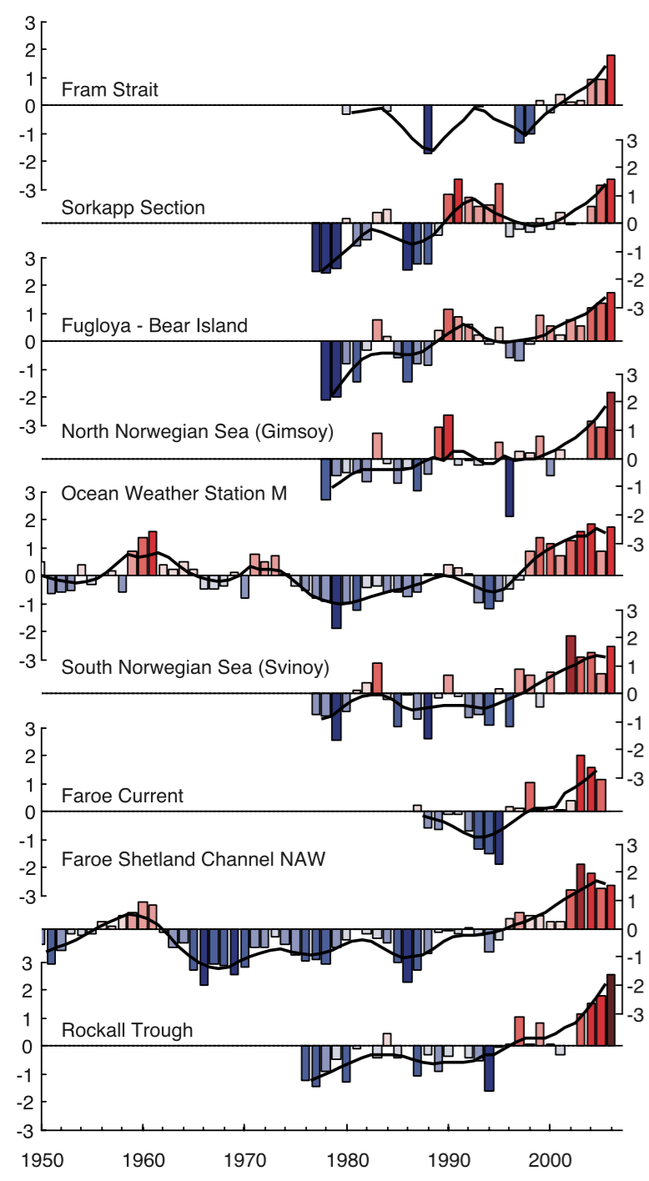
Multidecadal variability is evident through the subpolar gyre to Fram Strait
Sea ice variability reflects the phases of the AMO
Holliday et al., Reversal of the 1960s to 1990s freshening trend in the northeast North Atlantic and Nordic Seas. GRL, 2008

Slide 9
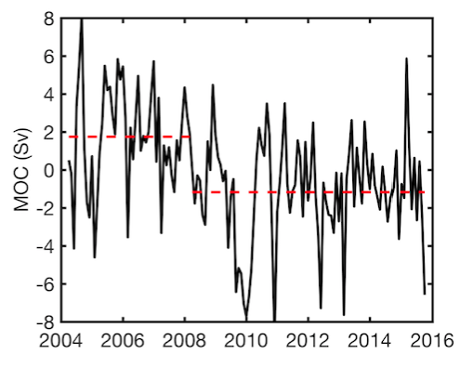
There is growing evidence that the Atlantic is entering a cool phase
Statistical analysis of the RAPID timeseries of the overturning at 26N indicates that a step change in 2008
Smeed, D. A., et al. in prep. The changed state of the Atlantic Meridional Overturning Circulation
Large sub-annual variability:
The first year’s measurements from RAPID² showed that sub-annual variability of the AMOC encompassed more than the full range of the historical measurements.
A large seasonal cycle:
A seasonal cycle of 6 Sv was observed³ (green, dashed).
This is driven by density variations at the eastern boundary.
This update to ref. 3 shows the seasonal cycle peaking in July.
Interannual Variability:
From 2009, the AMOC weakened dramatically. This 30% slowdown persisted for 18 months⁴ and cooled the whole of the subtropical North Atlantic⁵.
Evidence of a slowdown?
A decline of 0.6 Sv/year was observed over the first ten years⁷. This is ten times larger than long term decline predicted by the IPCC.
Latest 18 months of data:
The AMOC has remained low at an average of 15.5 Sv.This is the same average as from 2009 to 2014 but much lower than the 18.5 Sv observed from 2004 to 2009
1957
1981
1992
1997
2004
Figure 2. 10 years of AMOC measurements from the RAPID array. 10-day (grey) and 60-day (black) low-pass filtered values are shown.
The seasonal cycle is shown in green, dashed; a linear trend in orange. Red squares indicate historical AMOC measurements.

Slide 10
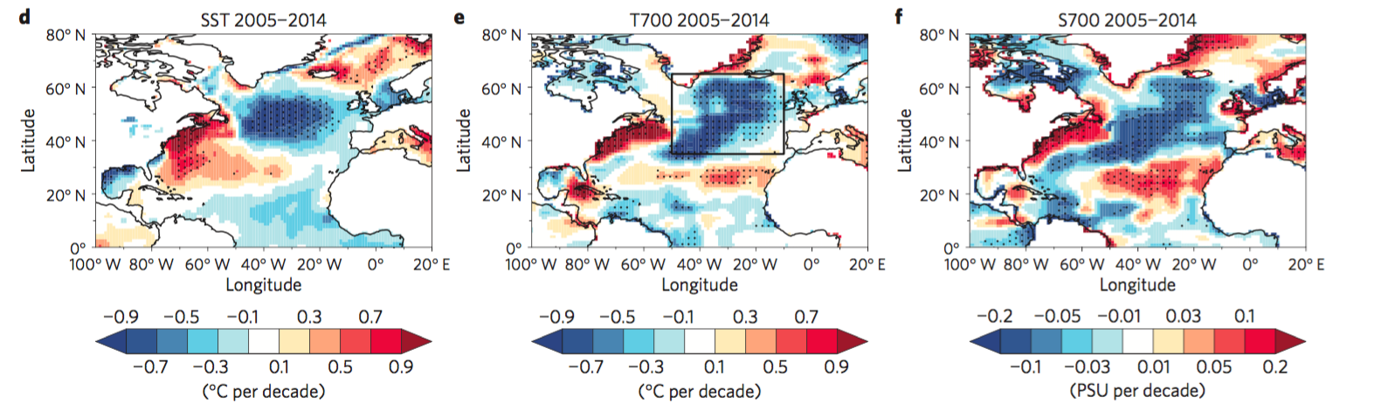
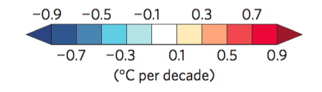
There is growing evidence that the Atlantic is entering a cool phase
Statistical analysis of the RAPID timeseries of the overturning at 26N indicates that a step change in 2008
Smeed, D. A., et al. in prep. The changed state of the Atlantic Meridional Overturning Circulation
Other authors have suggested the AMOC changed in 2005 and that we are entering a cool Atlantic phase with weaker overturning
Robson, J., Ortega, P., & Sutton, R. (2016). A reversal of climatic trends in the North Atlantic since 2005. Nature Geoscience.
Large sub-annual variability:
The first year’s measurements from RAPID² showed that sub-annual variability of the AMOC encompassed more than the full range of the historical measurements.
A large seasonal cycle:
A seasonal cycle of 6 Sv was observed³ (green, dashed).
This is driven by density variations at the eastern boundary.
This update to ref. 3 shows the seasonal cycle peaking in July.
Interannual Variability:
From 2009, the AMOC weakened dramatically. This 30% slowdown persisted for 18 months⁴ and cooled the whole of the subtropical North Atlantic⁵.
Evidence of a slowdown?
A decline of 0.6 Sv/year was observed over the first ten years⁷. This is ten times larger than long term decline predicted by the IPCC.
Latest 18 months of data:
The AMOC has remained low at an average of 15.5 Sv.This is the same average as from 2009 to 2014 but much lower than the 18.5 Sv observed from 2004 to 2009
1957
1981
1992
1997
2004
Figure 2. 10 years of AMOC measurements from the RAPID array. 10-day (grey) and 60-day (black) low-pass filtered values are shown.
The seasonal cycle is shown in green, dashed; a linear trend in orange. Red squares indicate historical AMOC measurements.

Slide 11
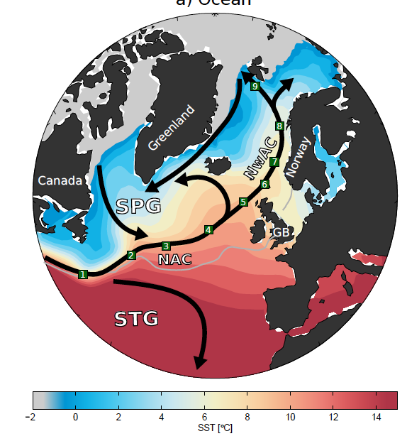
How does this heat reach the Arctic?
Is it changing?
Is it predictable?
Årthun et al., in rev.

Slide 12
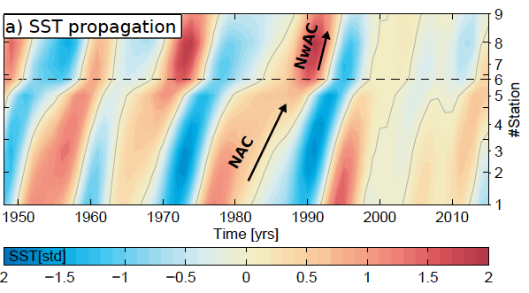
Circulation of ocean heat anomalies
Complex EOF on 5-year low-pass filtered data
HadISST
55% of variance explained
Propagation speed: 3 cm/s
Period: 14 years
Similar propagation characteristics for salinity and radioactive tracers -> ocean circulation
Arthun and Eldevik, On Anomalous Ocean Heat Transport toward the Arctic and Associated Climate Predictability. J. Clim., 2016
Årthun et al., in rev.

Slide 13
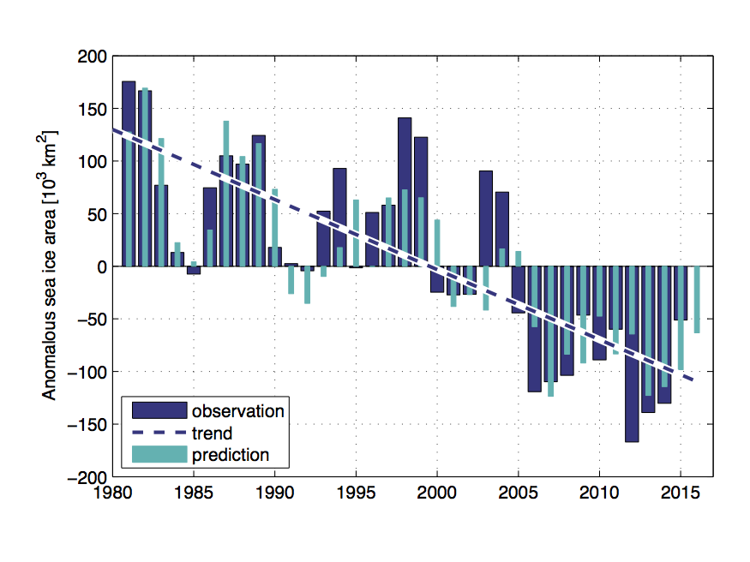
Predictions from Poleward Ocean Heat transport
Skillfull prediction of Barents Sea ice cover
r² = 71%
Onarheim et al., Skillful prediction of Barents Sea ice cover. GRL, 2015

Slide 14
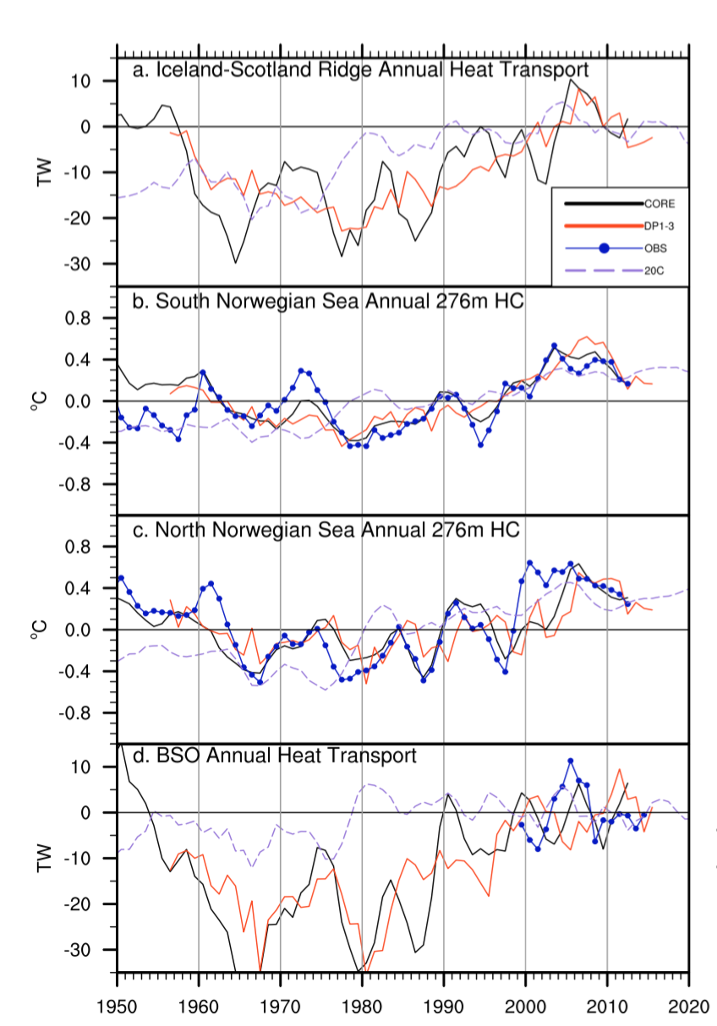
Yeager et al., Predicted slowdown of Atlantic sea ice loss. GRL, 2015
Models able to simulate and consequently predict
However a number of difficult regions exist such as the Greenland-Scotland ridge and Barents Sea

Slide 15
Shetland Branch AW Inflow
K. Walicka
Volume transport above 5° isotherm
Northward transport weighted temperature anomaly
*
Volume transports across the Greenland-Scotland Ridge are very steady
More variability in the temperature transport (~heat transport)

Slide 16
Decadal variability in 2 meter temperature
The Barents Sea stands out on 30 year timescale
Access model, varies among models
Van der Linden et al., Low‐frequency variability of surface air temperature over the Barents Sea: causes and mechanisms. Clim. Dyn., 2016
van der Linden et al Climate Dynamics 2016

Slide 17
Ocean drives the variability – Atmosphere compensates
Ocean heat transport into Barents Sea leads 2m temperature by ~15 yrs
Van der Linden et al., Low‐frequency variability of surface air temperature over the Barents Sea: causes and mechanisms. Clim. Dyn., 2016
van der Linden et al Climate Dynamics 2016

Slide 18
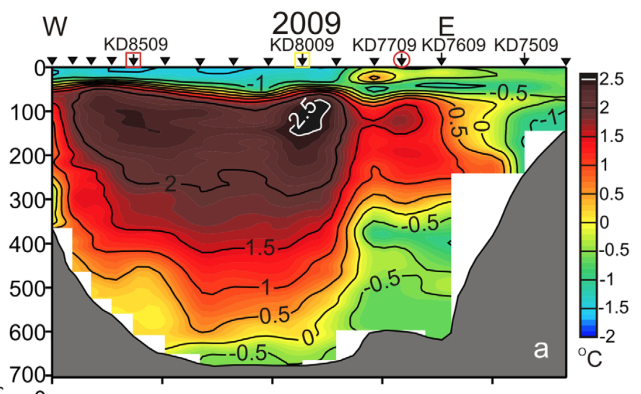
CTD section through Santa-Anna trough
There is a lot of warm water in the Arctic that is currently isolated from the surface
Changes in mixing either via wind in newly ice free zones or tidally could bring this heat to the surface and lead to ice melt

Slide 19
Decline in sea ice extent is one of the most visible manifestations of ongoing climate change
On long timescales, ocean heat transport is a key factor in Atlantic sector sea ice loss
Ocean heat transport is a key source of predictability
Is there going to be a hiatus in sea ice loss?

Slide 20
Blue Action Kick-Off Meeting
Berlin, January 2017
END

Slide 21
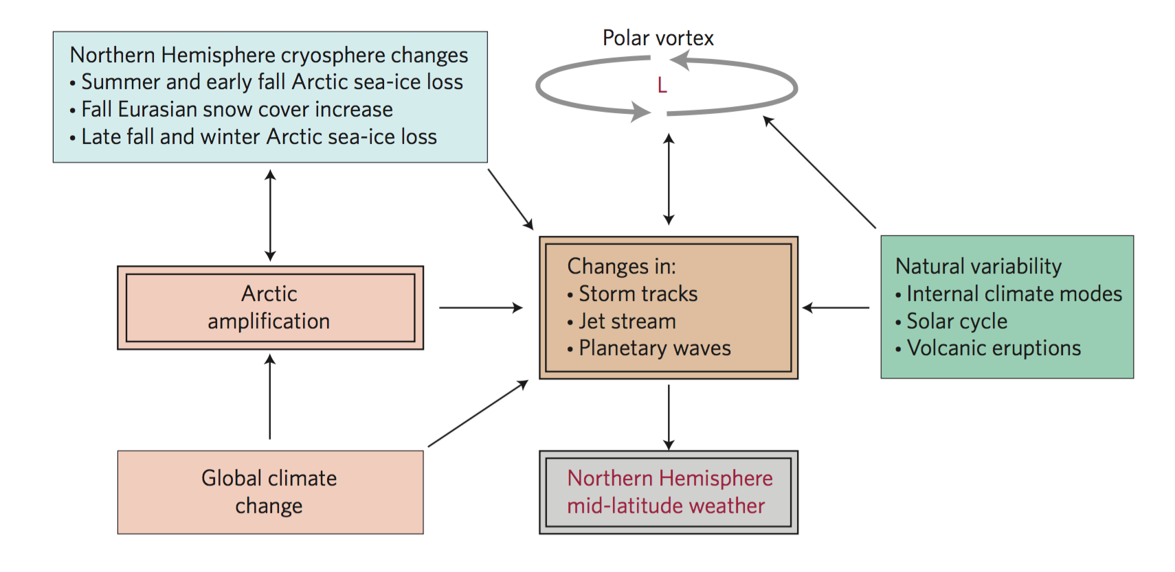
Motivation for BG-10 is Arctic influence on mid-latitude climate
Three mechanisms for feedbacks:
Storm tracks
Jet stream
Rossby waves
Cohen et al., Recent Arctic amplification and extreme
mid-latitude weather. Nature Geoscience, 2014

