Slide 1
Blue Action WP8
Transferring knowledge to a wide range of interested key stakeholder
Peter Vangsbo| Blue-Action Kick-off meeting in Berlin | 20 January 2017

Slide 2
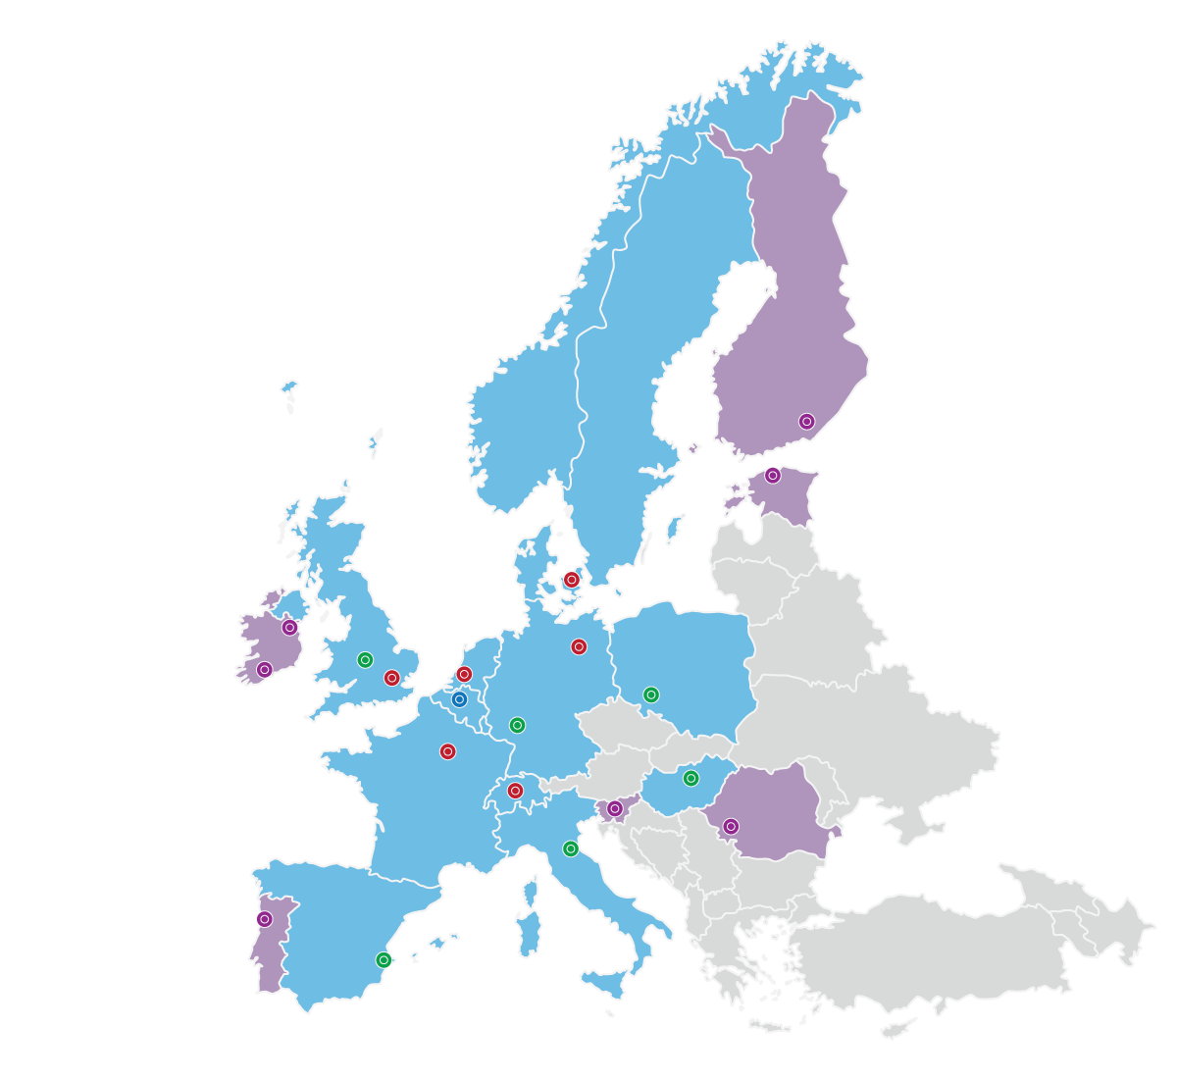
World’s largest Climate PPP delivered €1.8b climate action…
Climate-KIC is one of four Knowledge and Innovation Communities (KICs) created in 2010 by the European Institute of Innovation and Technology (EIT).
We integrate education, entrepreneurship and innovation resulting in connected, creative transformation of knowledge and ideas into economically viable products or services that help to mitigate climate change

Slide 3
Climate-KIC Nordic
Status
3 Core partners and 14 Affiliates
Strong city next – new expansion in autumn 2017
Stavanger, Oslo (Norway)
Aarhus (Denmark)
Stockholm (Sweden)
Reykjavík and Island as new geo

Slide 4
Sustainable Business Development in the Arctic
“Working directly with local communities, businesses operating in the Arctic and industrial organisations, Blue-Action will demonstrate new opportunities for growth through tailored climate services.
These will give users the information they need to live and work safely and successfully in the rapidly changing regions in and surrounding the Arctic”
Dr Steffen M Olsen from the Danish Meteorological Institute

Slide 5
Engaging with emerging and established business and industry
The Blue-Action project will seek to reach out to the private sector decision makers and actively engage with them to enhance response capacity to climate change challenges and foster transfer and use of project results via Climate-KIC, which will in turn boost economic growth. Our focus area are:
Tourism; destination management, cruise tourism, wildlife tourism
Nordic cities; Construction, liveability and life quality, growth
Blue bioeconomy; fisheries, aquaculture, seaweed and marine biotech
Large Scale industries; shipping and logistic, mineral mines, oil and gas
Financial and insurance communities; risk management, investment

Slide 6
Open Innovation
Open Innovation Day is a concept that aims at:
Inviting entrepreneurs, SMEs and corporates to propose new innovative ideas to be tested and implemented addressing specific climate challenges identified
It may bring light to challenges, which a business and a city would otherwise be blind to.
Investigating how new innovative concepts, idea’s and products can be designed to meet end-users climate targets.
It showcases climate initiatives and projects that create green growth
It ensure engagement with business sector end-users, authorities and policy makers and the public, with the specialist Blue Action research community as well as the wider scientific community in the Nordic and beyond.

Slide 7
Business Acceleration
Technology start-ups seldom fail on technology, they fail on commercialisation.
Climate-KIC Accelerator is the only EU acceleration programme focused on climate impact by cleantech commercialisation.
In three stages, our 18-month program brings the knowledge, resources, tools and the coaching a cleantech start-up needs for success.
Every year, Climate-KIC Accelerator supports over 150 start-ups in Europe, and this number is still growing

Slide 8
Peter Vangsbo| Innovation and Nordic Business Developer peter.vangsbo@climate-kic.org

