Slide 1
Blue Action WP5 Developing and Valuing Climate Services
Mark R Payne
National Institute for Aquatic Resources, Denmark
Kathrin Keil
Institute For Advanced Sustainability Studies, Germany

Slide 2
Report from Breakout Session, 19 Jan
Discussion among WP5 case studies & with WP8 and GERICS
Three topics
1. Climate services/stakeholder engagement
2. Data needs & translation
3. WP organisation & way forward

Slide 3
1. Climate services/stakeholder engagement
How to start the process
E.g. user requirement surveys, dictionaries of common terms
Exact forecast number vs. Sensible range of possible developments
Shifting mindsets
E.g. translate change into impacts

Slide 4
2. Data needs & translation
Clustering of case studies
Timescales
Use similar ones to be able to compare
Integration of data work and impact studies
Man/Womanpower needed!
Social & natural scientists involved
Interdiscplinary exercise

Slide 5
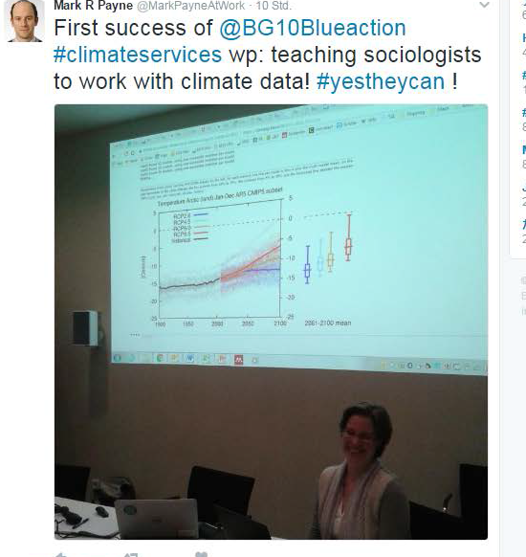

Slide 6
3. WP organisation & way forward
Communication
Within WP
Across WPs
In-depth planning meeting planned for June
GERICS, Hamburg
end-user engagement and climate services
Interact with WP8
Synergies with other projects, e.g. EUPORIAS

Slide 7
Blue Action WP5 Developing and Valuing Climate Services

