Slide 1
Optimizing and Enhancing the Integrated Atlantic Ocean Observing System
#AtlantOS
Prof. Dr. Martin Visbeck
Dr. Johannes Karstensen
Dr. Anja Reitz
GEOMAR Helmholtz Centre for Ocean Research Kiel, Germany

Slide 2
Optimizing and Enhancing the Integrated Atlantic Ocean Observing System
Budget: 21 Mio. Euros in 4 years
Coordinator: GEOMAR; Partner: 62
Horizon 2020 call BG-8-2014: Developing in-situ Atlantic Ocean Observations for a better management and sustainable exploitation of the maritime resources.
The project: AtlantOS is a research and innovation project that proposes the integration of ocean observing activities across all disciplines for the Atlantic, considering European as well as non-European partners.
Goal: Integration of the so far loosely-coordinated set of existing ocean observing activities to a more sustainable, more efficient, and fit-for-purpose Integrated Atlantic Ocean Observing System.
www.atlantos-h2020.eu

Slide 3
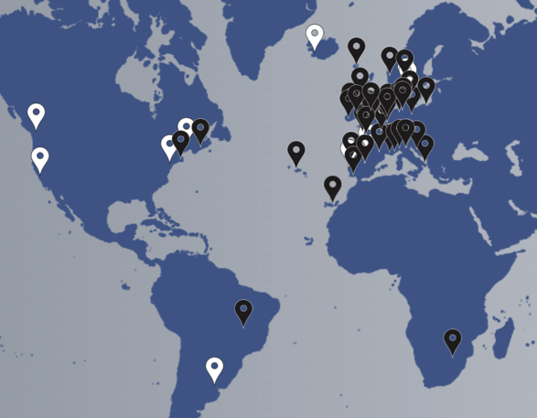
AtlantOS members (white) and 62 H2020 consortium partners (black)
www.atlantos-h2020.eu

Slide 4
Why do we need more ocean observations?
Who are our partners in Atlantic Observing?
What frameworks can we build on?
www.atlantos-h2020.eu

Slide 5
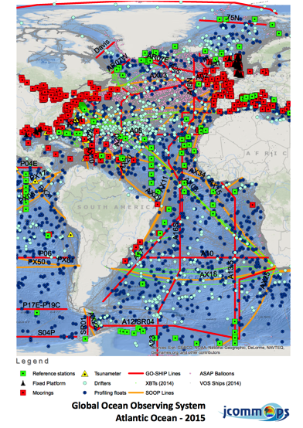
WHY observe the Ocean?
From Deep Sea Discovery to Sustainable Ocean Development:
Ocean and Climate
Life in the Ocean
Blue/Green Economy
Information delivered by Marine Services and Ocean Assessment
Need fit-for-purpose information

Slide 6
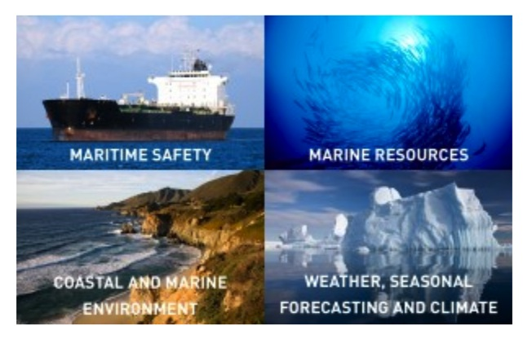
Marine Services

Slide 7
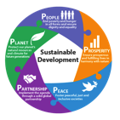
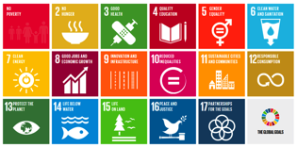
Sustainable Development
Proposed goal 14: Conserve and sustainably use the oceans, seas and marine resources for sustainable development
Targets are discussed and agreed to by the nations.
How to measure progress against targets?
The need to derive indicators building on a smart index framework, based on reliable open access ocean information.

Slide 8
Why do we need more ocean observations?
Who are our partners in Atlantic Observing?
What frameworks can we build on?
www.atlantos-h2020.eu

Slide 9
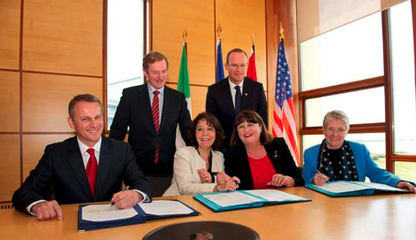
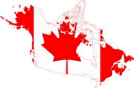
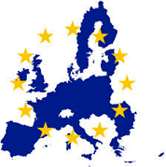
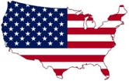
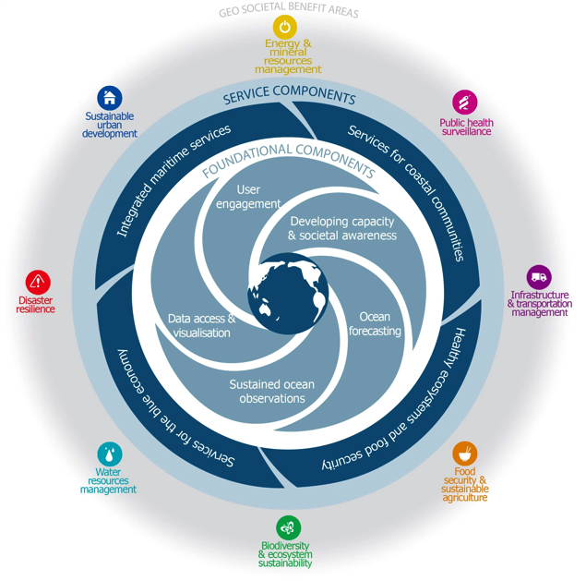
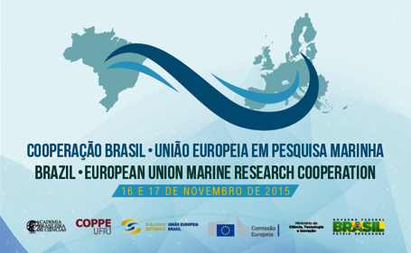
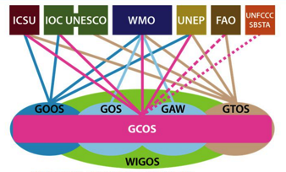
Partners in Atlantic Ocean Reserach
Atlantic Ocean Research Alliance
G7 Science Ministers
South Atlantic Ocean Cooperation
Notes:
AORA: The European Union, the United States and Canada agreed to join forces on Atlantic Ocean research. The agreement focuses on aligning the ocean observation efforts of the three partners. The goals are to better understand the Atlantic Ocean and to promote the sustainable management of its resources. The work will also study the interplay of the Atlantic Ocean with the Arctic Ocean, particularly with regards to climate change.
South Atlantic Ocean Cooperation: This cooperation is intended to increase our joint knowledge of the Atlantic Ocean and its dynamic systems, conducting joint research efforts and reciprocal access to infrastructures …
In details, it is intended to organize a workshop with the participation of marine scientists, representatives of the Government and other stakeholders from Brazil, South Africa, Europe and other countries to be invited (Argentina, Uruguay, Namibia, Angola, Cape Verde, among others).
G7 Science & Technology Ministers calling for Enhanced Global Ocean Observing - The Future of the Seas and Oceans: Toward Science‐Based Management, Conservation and Sustainable Use of the Oceans, Seas and Marine Resources
Support the development of an initiative for enhanced global sea and ocean observation …
Support an enhanced system of ocean assessment …
Promote open science and the improvement of the global data sharing infrastructure …
iv. Strengthen collaborative approaches to encourage the development of regional observing capabilities …
Promote increased G7 political‐cooperation by identifying additional actions needed to enhance future routine ocean observations.
GOOS: GOOS is a permanent global system for observations, modelling and analysis of marine and ocean variables to support operational ocean services worldwide.
GOOS provides accurate descriptions of the present state of the oceans, including living resources; continuous forecasts of the future conditions of the sea for as far ahead as possible, and the basis for forecasts of climate change.
GOOS is a system of programmes, each of which is working on different and complementary aspects of establishing an operational ocean observation capability for all of the world's nations.

Slide 10
Why do we need more ocean observations?
Who are our partners in Atlantic Observing?
What frameworks can we build on?
www.atlantos-h2020.eu

Slide 11
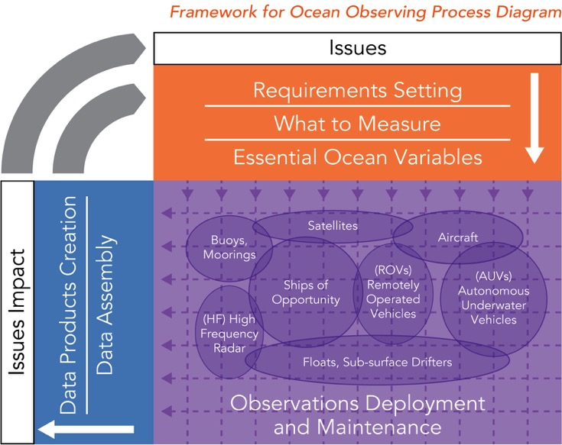
Framework for Ocean Observing

Slide 12
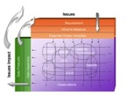
Driven by requirements, negotiated with feasibility in mind Essential Ocean Variables
We cannot measure everything, nor do we need to
basis for including new elements of the system, for expressing requirements at a high level
Driven by requirements, negotiated with feasibility
Allows for innovation in the observing system over time
http://www.oceanobs09.net/foo/
Notes:
A key idea in the Framework is the definition of Essential Ocean Variables, which some overlap with other types of essential variables that have been defined, such as Essential Climate Variables defined by GOOS and GCOS, Essential Variables defined by WMO for weather forecasting, and Essential Biodiversity Variables that are being defined by GEOBON (although largely focused on terrestrial variables).
The idea is that for the key societal and scientific drivers of sustained ocean observations, we cannot measure everything, nor do we need to. Essential Ocean Variables should respond to these high-level drivers, related to climate, to understanding and managing ecosystem services, to conserving biodiversity, to managing living marine resources, to safety and protection of life and property at sea and on the coasts.
Aligning the coordination processes of the observing system on variables, rather than by platforms or observing techniques, stays truer to the natural system which we are trying to observe, while allowing for innovation of observing techniques over time as technology and capability develop.
The definition of an EOV must be driven by these requirements, but be rooted in reality, its measurement must be feasible. We may not be ready to measure all EOVs, but this assessing and encouraging the development of readiness is also a part of the Framework.

Slide 13
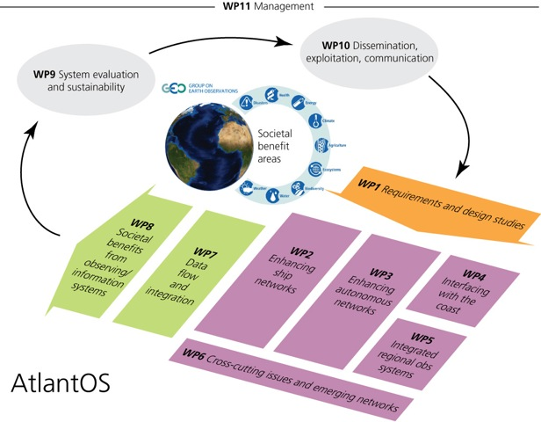
Project Structure
Notes:
WP5: Integrated regional observing systems: This component has the potential to facilitate improved observational logistics (e.g. ship and platform sharing) to make sampling more complete and efficient. Furthermore, there is significant innovation potential by exploiting collocated physical, chemical and ecological data to support an improved assessment of fish stocks and their reaction to climate change. The merging of different types of data across platforms and combining them with process models has the potential to create new information as well as products with improved quality/accuracy, when compared to the current system. New process models promise significant innovation potential when they can be integrated at a later stage into more complete ocean modelling systems

Slide 14
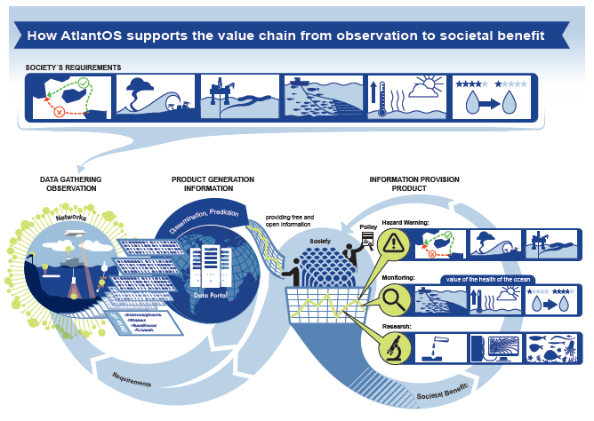

Slide 15
Highest level objective for all WPs
to carry out the research and innovation needed to deliver the framework and tools for a fit-for-purpose, efficient, integrated and sustainable Integrated Atlantic Ocean Observing System – leaving a legacy for GEO/GEOSS and GOOS
Achieve a significant change in planning, observations, data systems, and leave a legacy for the countries around the basin
Steering a voluntary collaboration of investment two orders of magnitude greater than that in the project itself

Slide 16
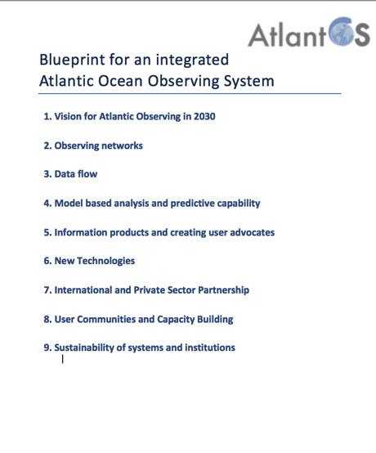
#AtlantOS
Outcome of AtlantOS and related initiatives:
Blueprint for OceanObs19
An international, multi-disciplinary and multi-sectoral team is currently established
www.atlantos-h2020.eu

Slide 17
This project has received funding from the European Union's Horizon 2020 research and innovation programme under grant agreement No 633211.

Slide 18
WP1 Observing System requirements and design studies
Objectives:
Requirements – identification of major societal challenges requiring sustained observations, and scientifically rigorous requirements for Essential Ocean Variables
Evaluation - gap analysis, assessing capacity and feasibility (technical readiness, cost and sustainability by funding agencies)
Design studies – using models in OSSEs to guide scientific design -> feeding into compromise systems design
Strong links to WP 9 (for evaluation), 10 (for stakeholder engagement / sustainability)

Slide 19
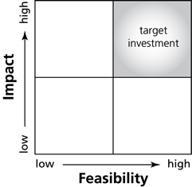
WP1 Observing System requirements and design studies
Essential Ocean Variables
We can not measure everything nor do we need to
Including new variables is driven by requirements, negotiated with feasability
Allows for information in the observing system over time

Slide 20
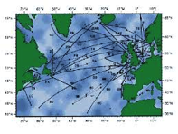
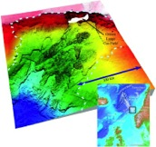
WP2 Enhancement of ship-based observing networks
Objectives:
Enhance, coordinate and support vessel-based observations – including programs like Go-Ship and others
Enhance delivery of biochemical and ecological variables using new technology
Improve the fish survey data availability
Integrate the national European deep seafloor mapping results and enhance the accessibility of sea floor data

Slide 21
WP3 Autonomous observing networks
Objectives:
Network enhancement: quantitative and qualitative improvement of measurements
Data flux: format requirements and accessibility
Network sustainability beyond AtlantOS

Slide 22
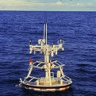
WP3 Autonomous observing networks
Autonomous observing networks:
Argo (ERIC Euro-Argo)
OceanSites - Network of fixed point biogeochemical observatories - Pirata mooring Array - Transport Mooring Array
Glider network
Surface Drifters
European Animal Telemetry Network

Slide 23
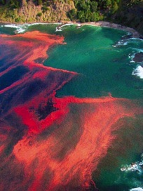
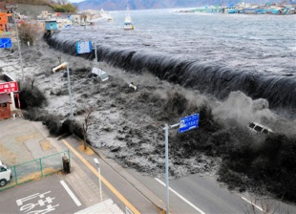
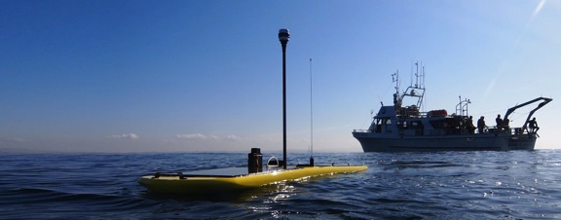
WP4 Interfaces with costal ocean observing systems
Objectives:
Conduct gap analysis for the connection between costal and deep ocean networks
Optimize shelf sampling over seasonal timescales
Strengthen access to sea level data networks
Share best practice

Slide 24
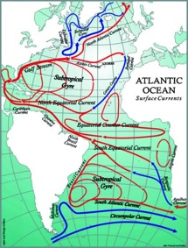
WP5 Integrated regional observing systems
Objectives:
Optimize the regional observing systems
Application of regional ocean observing: climate and ecosystem
Regional Observing system simulation experiments and process modelling
Showcase the power of integrated trans-Atlantic observing to provide information necessary to cope with global challenges such as climate change, increased pressures on natural resources, and global-scale hazards
OSNAP
11°S monitoring
SAMOC

Slide 25
WP6 Cross cutting issues and emerging networks
Objectives:
Coordination and integration of existing instrumentation and sensor development
Common metrology and best practice
Coordinating testing, deployment, maintenance and operation of the Integr. Atlantic Ocean Observing System infrastructure
Maximizing international collaboration and dissemination of observing system best practices
Development of new and emerging observational activities

Slide 26
WP7 Data flow and data integration
Objectives:
Data harmonization with data providers
Integration and dissemination with users

Slide 27
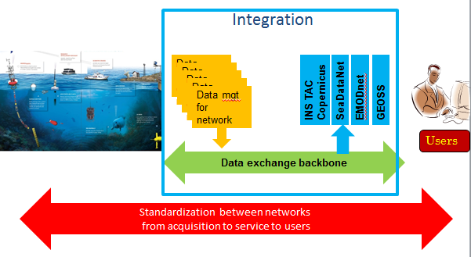
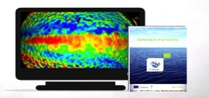
WP7 Data flow and data integration
Towards and integrated data system
Improvement of existing synthesis
Impact on Copernicus Marine Service

Slide 28
WP8 Societal benefits from observing/information systems
Objectives:
Demonstrate the value and societal benefit of existing observing systems
Integrate data from the Copernicus Marine Service and EMODnet – produce decision support tools
Produce data adequacy reports from the different pilot actions

Slide 29
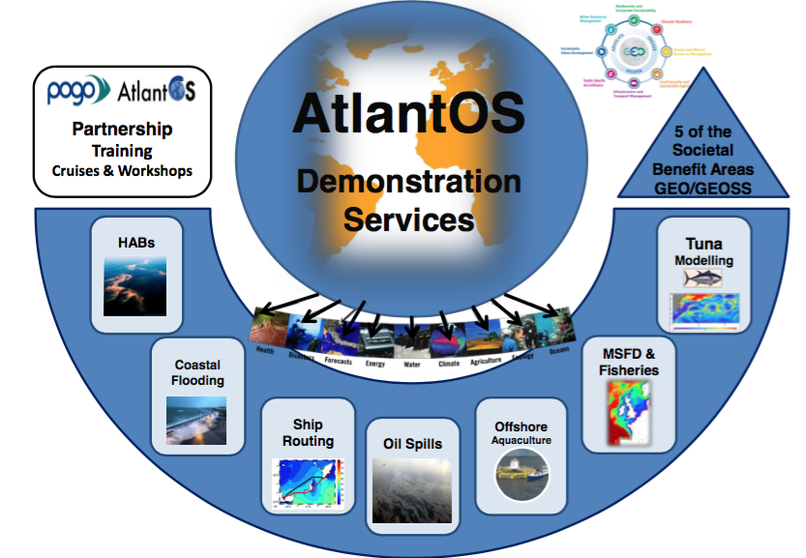

Slide 30
WP9 System evaluation and sustainability
Objectives:
Provide quantitative and near real time information of the state of the in-situ Atlantic Observing System
Analyze and properly document for each EOV the adequacy of the current observing and information system
Develop a long-term sustainability plan for Integrated Atlantic Ocean Observing Systems

Slide 31
WP10 Engagement, Communication and Dissemination
Main Objectives:
Develop a results-oriented dialogue with key stakeholders communities to enable a meaningful exchange between the products and services that Integrated Atlantic Ocean Observation Systems can deliver and the demands and needs of the stakeholder communities
Services:
AtlantOS Engagement and Communication Strategy
Data dissemination and exploitation
Science – Policy engagement
Communicating project results

