Slide 1
Improving seasonal long range forecast skill of risks for hazardous weather and climate events (WP 1)
Johanna Baehr and Jens Hesselbjerg Christensen
Universitaet Hamburg, Danish Meterorological Institute
Daniela Domeisen (Geomar), Valerio Lucarini (U Reading),
Erik Kolstad (Uni Research), Alessio Belucci (CMCC),
Claude Frankignoul (CNRS), Shang-Ping Xie (SIO), Soon-Il An (CTL)

Slide 2
When cold air from over the sea-ice is transported over open ocean, the chances of severe weather such as polar lows increase
Cold
air
Warmer
ocean
We cannot forecast polar lows on the S2S time scale, but we can perhaps forecast the environment in which it forms: cold air outbreaks

Slide 3
We cannot forecast polar lows on the S2S time scale, but perhaps the environment in which they form: cold air outbreaks
Example: large increases in the frequency of cold air outbreaks (top) coincide geographically with the regions of mean temperature change (bottom).
Top: The composite number of cold days divided by the date-wise climatological mean number of cold days for each grid point relative to weak vortex days during the specified time intervals.
Bottom: Composites of 850 hPa geopotential height anomalies (in m with solid contours, positive in black, negative in grey, contour interval 10 m, zero contour omitted) and 850 hPa temperature anomalies (in K with filled contours, with white contours along the values specified on the colour bar) relative to weak vortex days, averaged over the specified time intervals.
Kolstad et al., 2010

Slide 4
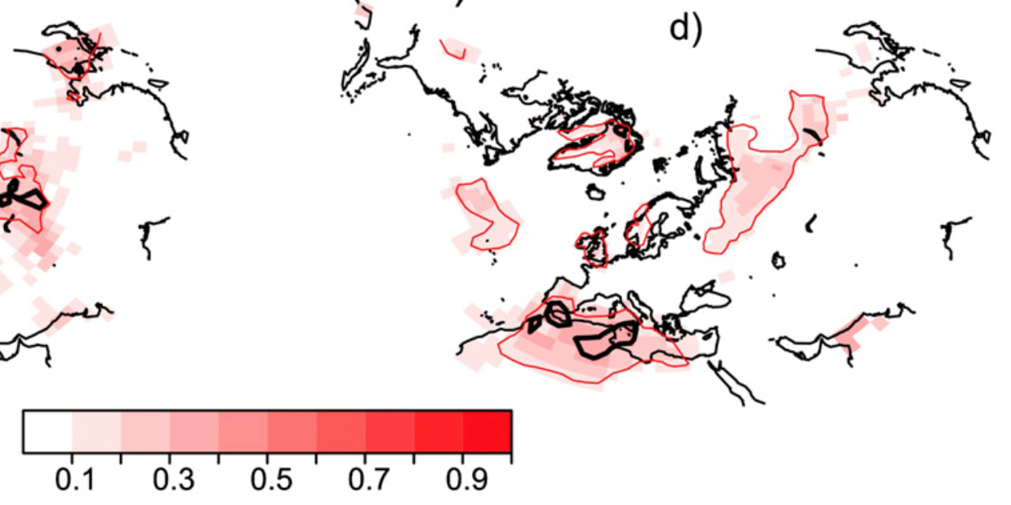
Arctic variability is also connected to European climate variability with considerable lags…
Example: Barents-Kara sea-ice is related to temperature in Europe via the NAO.
A decrease of SIC is connected with
- cold winters over Northern Europe
- warm winters over Southern Europe / Mediterranean Sea
Cross-validated correlation between Barents-Kara sea ice November index and Surface Air Temperature in DJF of ERA-Interim.
95% confidence interval for standard correlation SIC/SAT
90% confidence interval for cross validated correlation
Summary :
Garcia-Serrano et al., 2015

Slide 5
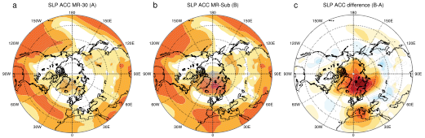
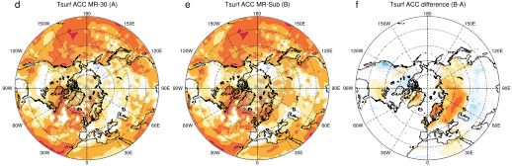
Arctic variability is also connected to European climate variability with considerable lags, which may be utilized to improve hindcasts
Example: selecting from a hindcast ensemble only those members, where the DJF NAO evolves as ’guessed’ from initial conditions, improves seasonal hindcast skill.
Full ensemble
Subsampled ensemble
Difference
Top: Anomaly correlation of DJF Sea-Level-Pressure hindcast ensemble mean against ERAinterim.
Bottom: Anomaly correlation of DJF surface temperature hindcast ensemble mean against ERAinterim.
Based on hindcasts with MPI-ESM initialized every November between 1982 – 2014 (with 30 members for each start year)
SLP ACorrelation
Tsurf ACorrelation
Dobrynin et al., in prep.

Slide 6
WP1 – our plan (i)
Use a process-oriented diagnostic and analysis of weather systems with a focus on the conditions associated with hazardous events
Notes:
Our one slide summary…

Slide 7
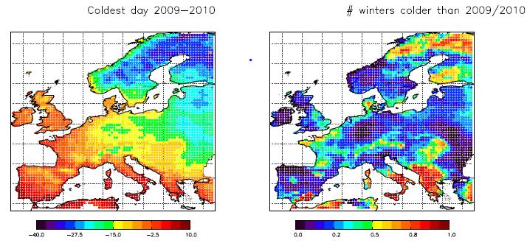
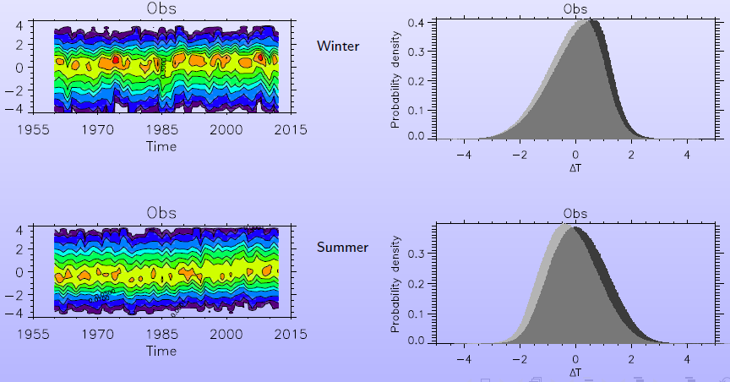
Yet, statistics might change under global warming
Change of European Temperature distribution
European winter/summer T normalized with local standard deviations and pooled for all grid points
The extreme cold winter in 2009/2010
T at the coldest day in 2009/10
Fraction of winters in 1963-2013 with days colder then 2009/10
Distribution as function of time
Distribution over all days before and after 1985
Christiansen et al, 2016
Notes:
Plots show examples of such studies using observational dataset E-OBS. Left demonstrates the cold winter in 2009/10 is a rare event; Right shows the European temperature (normalized with local standard deviation and pooled for all grid points) distribution as function of time and the distribution changes before and after 1985 for winter (top) and summer(bottom). While the summer distribution clearly shifts toward warmer climate as a whole (i.e, both the mean and the shape), the shift to the warm climate for the winter temperature is skewed, with a near unchanged distribution in the cold tail.

Slide 8
Yet, future Arctic warming may drive atmospheric & oceanic teleconnections that precondition the occurrence of such extremes
Example: While Europe will warm overall in the future, episodes of cold months will continue to occur and there remains substantial probability for the occurrence of cold winters in Europe linked with sea ice reduction in the Barents and Kara Sea sector.
Left: Multi-model ensemble mean of composites of SAT anomalies for European (a) cold Januaries in the historical period of 1956– 2005. The monthly mean anomaly of a given model is the difference of the monthly SAT with that of the respective model climatology as defined. The crossed areas indicate where more than 75% of the models (i.e., 10 out of 13 models) agree in sign.
Right: Same as left but for European cold Januaries in the future period of 2006– 2050 as projected in scenario RCP4.5. The crossed areas indicate where more than 75% of the models (i.e., 10 out of 13 models) agree in sign.
Yang and Christensen, 2012
Notes:
More from the paper: The European area and the Barents and Kara Sea area are marked with red/black boxes. … A pattern of cold-European warm-Arctic anomaly is typical for the cold events in the future, which is associated with the negative phase of the Arctic Oscillation. These patterns, however, differ from the corresponding patterns in the historical period, and underline the connection between European cold winter events and Arctic sea ice reduction.

Slide 9
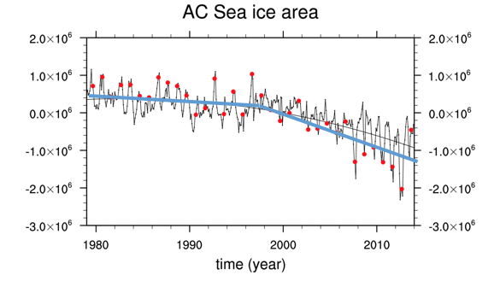
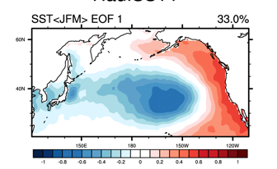
And the Arctic interacts with the North Pacific with potential consequences on extreme weather
Background: Arctic ocean and North Pacific are an interactive system, to some degree. So PDO/NPGO are likely influenced by or influence sea ice variability.
Consequently, the sea ice-modified PDO/NPGO obviously limit PDF of extreme weather.
(CO2 forcing)
Arctic Ocean (Beaufort/Chukchi sea)
heat/moisture transport (Woodgate et al. 2012)
Cold-air outbreak
(Kim et al. 2014)
North Pacific/PDO, NPGO

Slide 10
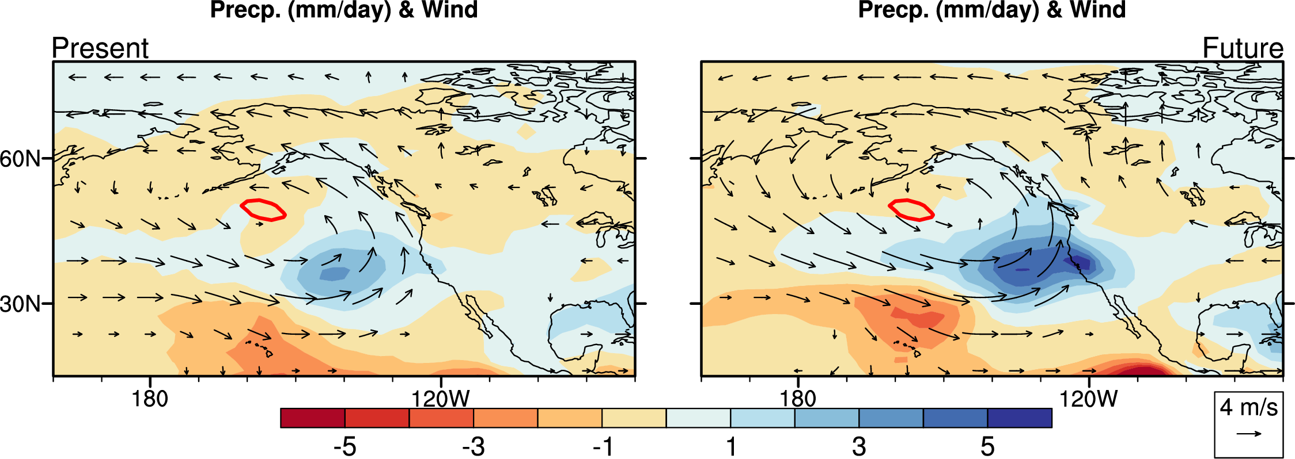
And the Arctic also interacts with the tropics
Examples:
El Nino: Arctic change → tropical response (Deser et al. 2015) → ENSO (Zheng et al. 2016)
Teleconnections (e.g., PNA): ocean warming pattern effect (Zhou et al. 2014)
Regional air-sea coupling, e.g., over Indo-western Pacific? … with impact on Asian-Pacific societies (Xie et al. 2016)
Increased rainfall & storminess in El Nino winter in west U.S. in warmer climate (Zhou et al. 2014).
Precip (mm/day) & 850-mb wind in El Nino winter
Notes:
Deser, C., R. A. Tomas, and L. Sun, 2015: The role of ocean-atmosphere coupling in the zonal-mean atmospheric response to Arctic sea ice loss. J. Climate, 28, 2168-2186, doi: 10.1175/JCLI-D-14-00325.1.
Xie, S.-P., Y. Kosaka, Y. Du, K. Hu, J. Chowdary, and G. Huang, 2016: Indo-western Pacific ocean capacitor and coherent climate anomalies in post-ENSO summer: A review. Adv. Atmos. Sci., 33, 411-432, doi:10.1007/s00376-015-5192-6.
Zheng, X.T., S.-P. Xie, L.H. Lv, and Z.Q. Zhou, 2016: Inter-model uncertainty in ENSO amplitude change tied to Pacific ocean warming pattern. J. Climate, 29, 7265-7279, doi: 10.1175/JCLI-D-16-0039.1.
Zhou, Z.-Q., S.-P. Xie, X.-T. Zheng, Q. Liu, and H. Wang, 2014: Global warming-induced changes in El Nino teleconnections over the North Pacific and North America. J. Climate, 27, 9050-9064, doi: 10.1175/JCLI-D-14-00254.1.

Slide 11
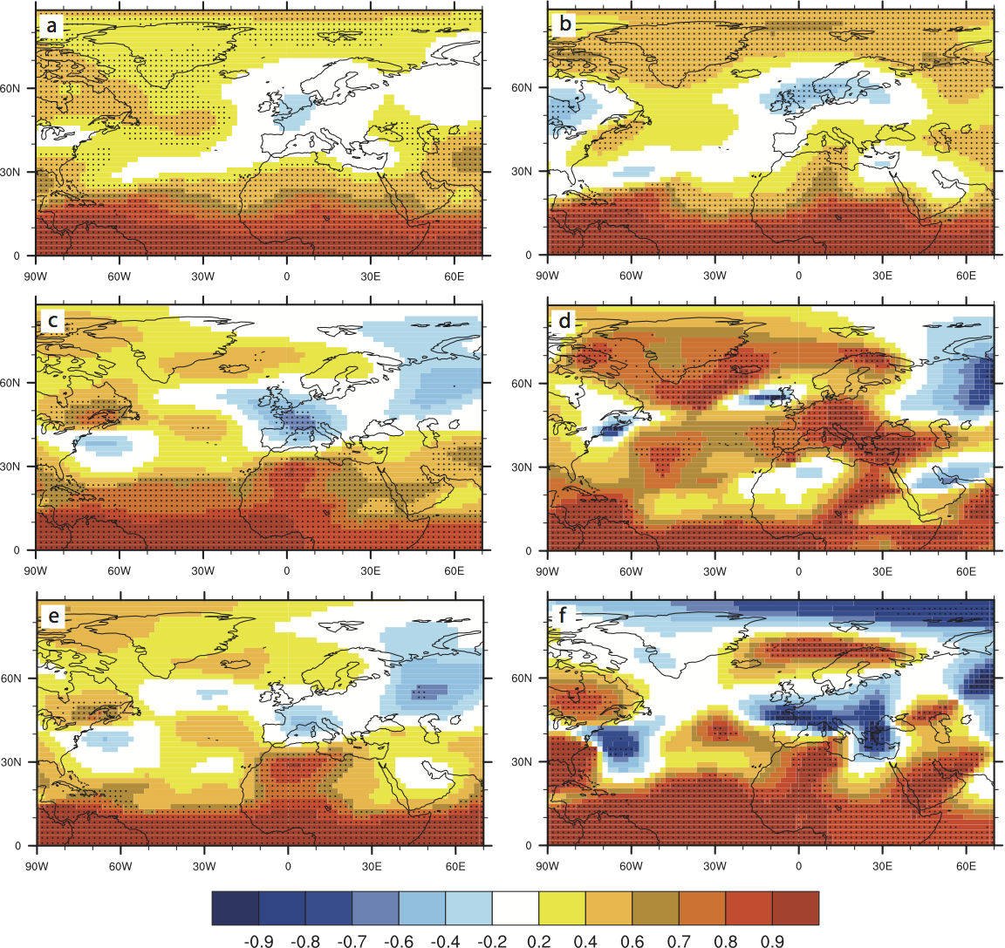
State of tropics may also influence predictability over Europe:
Example: While the ensemble mean (top left) shows no mean hindcast skill over North Atlantic/Europe, hindcast skill after El Nino and SSW events increases (lower right)
0.9
0.8
0.7
0.6
0.4
0.2
-0.2
-0.4
-0.6
-0.7
-0.8
-0.9
All years
Sudden Stratospheric Warming years
El Nino years
El Nino & SSW years
500hPa geopotential height: Anomaly correlation for DJFM (2-5 months lead time) for an ensemble of 1982 – 2012 annual start dates in November (10 members each)
Domeisen et al., 2015

Slide 12
WP1 – our full plan & tasks
use a process-oriented diagnostic analysis of weather systems
focus will be on the conditions associated with hazardous weather events under present and future climate conditions (including large scale modes of variability and teleconnections)
characterize extremes at different spatial and temporal scales by using a rigorous mathematical framework (extreme value theory)
conduct a process-oriented diagnosis of weather systems associated with the occurrence of weather extremes
detection and attribution of weather systems and extremes
analyze weather systems and extremes in seasonal prediction systems
transfer the results to operational use, including stakeholder contacts (with WP5)
Notes:
Our one slide summary…

Slide 14
WP business (i): Tasks
Task 1.1 Extremes at different spatial and temporal scales
[Lead: UREAD, Participants: UHAM, DMI, Month 1-36, Deliverables associated: D1.1]
Task 1.2 Process-oriented diagnosis of weather systems
[Lead: UHAM, Participants: UREAD, GEOMAR, DMI, CNRS, CMCC, Month 1-48, Deliverables associated: D1.1]
Task 1.3 Detection and attribution of weather systems and extremes
[Lead: DMI, Participants: UHAM, CTL, Month 1-48, Deliverables associated: D1.2]
Task 1.4 Weather systems and extremes in seasonal prediction systems
[Lead: GEOMAR/UHAM, Participants: UREAD, DMI, CMCC, Month 1-48, Deliverables associated: D1.3]
Task 1.5 Subseasonal-to-seasonal forecasting of severe weather
[Lead: UNIRES, Participants: DMI, CTL Month 1-48, Deliverables associated: D1.4]

Slide 15
WP business (ii): Deliverables
D1.1 Technical report: How to identify weather patterns associated with occurrences of extreme events in models, UHAM, M24
D1.2 Technical report or paper: Attribution of extremes to climate phenomena, DMI, M48
D1.3 Technical report or paper: Quantified skill in weather patterns associated with extreme events, UHAM (co-lead GEOMAR), M48
D1.4 A report on the predictability of marine cold air outbreaks and polar lows with dynamical s2s forecasts, UNIRES, M48

