Slide 1


NCAR Activities Relevant for Blue Action
Gokhan Danabasoglu, Steve Yeager, Alicia Karspeck,
Who Kim, and Fred Castruccio
National Center for Atmospheric Research
Boulder, CO, USA
Overarching objective: Advance our understanding and technical capabilities in areas related to (decadal) climate variability, predictability, and prediction with a particular focus on the North Atlantic.
Goal: Produce an improved and reliable decadal prediction (DP) system within the Community Earth System Model (CESM) framework, including predictive capabilities for marine ecosystems and biogeochemical constituents.

Slide 2
Coordinated Ocean-ice Reference Experiments (CORE-II)
An experimental protocol for ocean – sea-ice coupled simulations forced with inter-annually varying atmospheric data sets for the 1948-2007 period (Large and Yeager 2009). This effort is coordinated by the CLIVAR Ocean Model Development Panel (OMDP).
These hindcast simulations provide a framework for
evaluation, understanding, and improvement of ocean models,
investigation of mechanisms for seasonal, inter-annual, and decadal variability,
evaluation of robustness of mechanisms across models,
complementing data assimilation in bridging observations and modeling and in providing ocean initial conditions for climate (decadal) prediction simulations.
The CORE-II framework and protocol form the foundation of the Ocean Model Inter-comparison Project (OMIP) included in CMIP6.

Slide 3
AMOC EOF1
No detrending
Danabasoglu et al. (2016, Ocean Modelling)

Slide 4

New Data Sets for Ocean – Sea-ice Hindcast Simulations (JRA55-do)
Hiroyuki Tsujino (JMA-MRI, CLIVAR-OMDP)
The current forcing data set was produced more than ten years ago, having been updated only to 2009;
Horizontal resolution (T62 ~ 200 km) of the current dataset may not be suitable for simulations that employ high horizontal resolution;
Using a modern atmospheric reanalysis (JRA-55) and updated satellite products as reference fields, a new data set has been developed;
Available to the broader community in early spring 2017.
Comparison of Forcing Datasets
 | Current (LY09) | New (JRA55-do)
Time Period | 1948-2009 | 1958-present (to 2023 at longest)
Horz. resolution | T62 (~ 200 km) | TL319 (~ 55 km)
Base data | NCEP/NCAR-R1, Satellite products | JRA-55 (→ self-contained)
Interval | Dependent on field (6-hourly, daily, monthly) | 3-hourly

Slide 5
Idealized Atlantic Multi-decadal Variability (AMV) Experiments
In collaboration with Yohan Ruprich-Robert, Rym Msadek, and Tom Delworth (GFDL)
Our primary goals are to
Document climate impacts of sea surface temperature (SST) anomalies related to the AMV via atmospheric teleconnections;
Investigate the associated physical mechanisms;
Assess robustness of our results across models.
We follow a common experimental protocol and perform suites of idealized AMV SST perturbation experiments using CESM1 and GFDL CM2.1 and FLOR fully coupled models.
Related publications:
Ruprich-Robert et al. (2017, J. Climate, in press; global impacts)
Ruprich-Robert et al. (2017, in preparation; extremes over North America)
Castruccio et al. (2017, in preparation; impacts on the Arctic sea-ice)

Slide 6
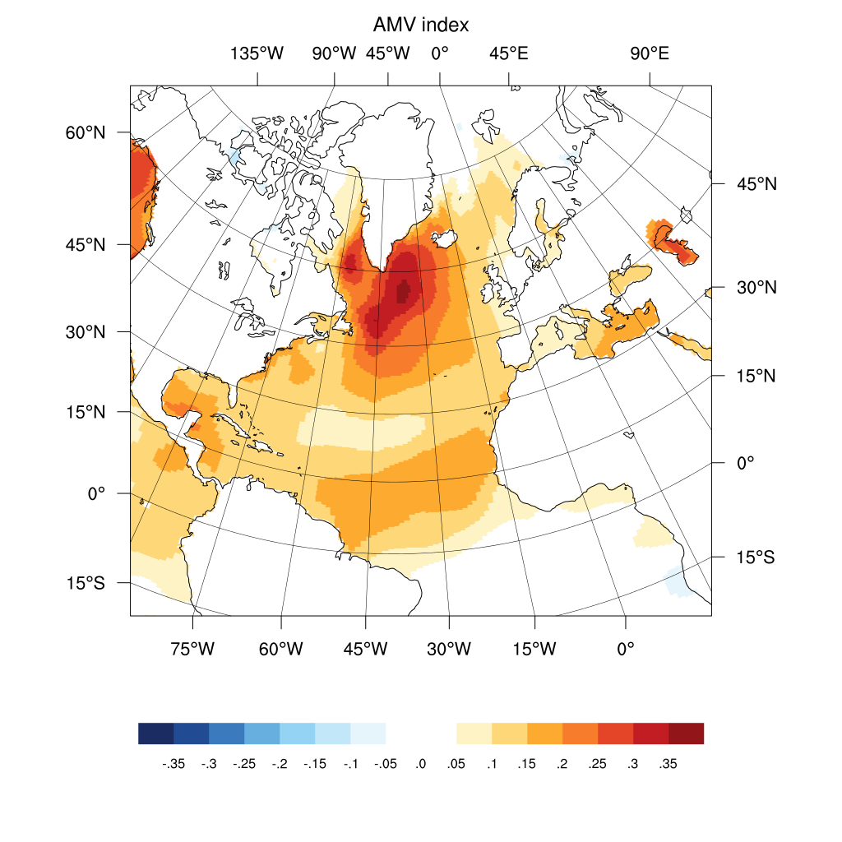
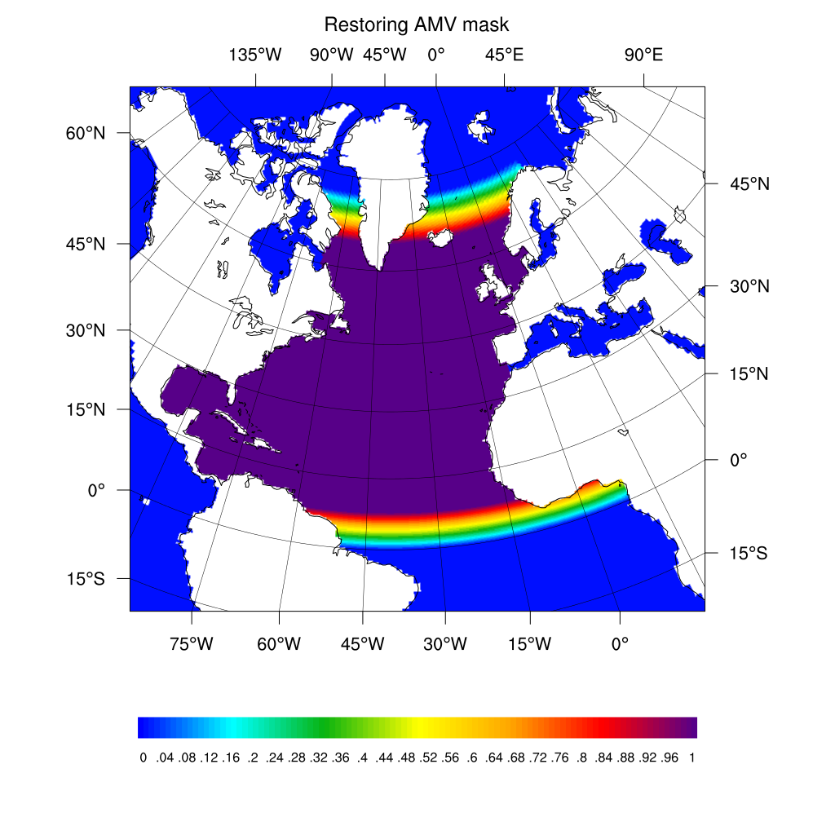
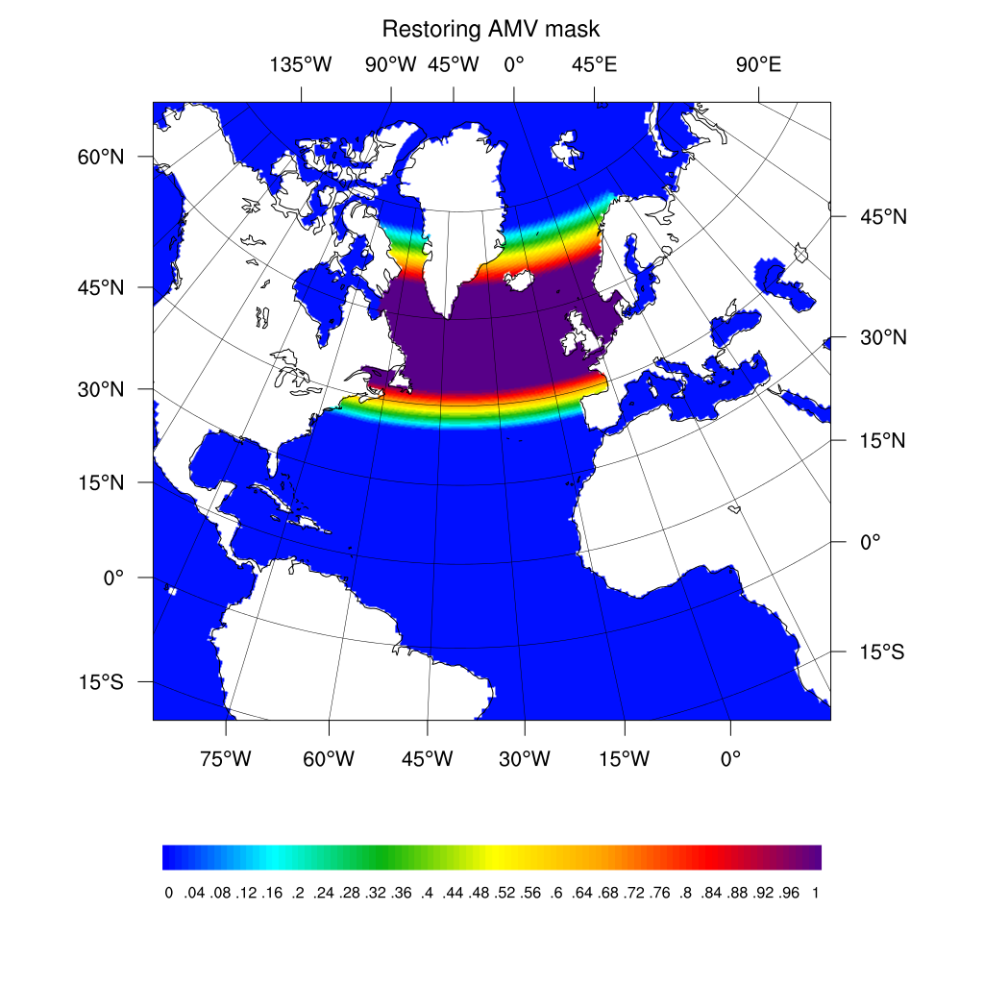
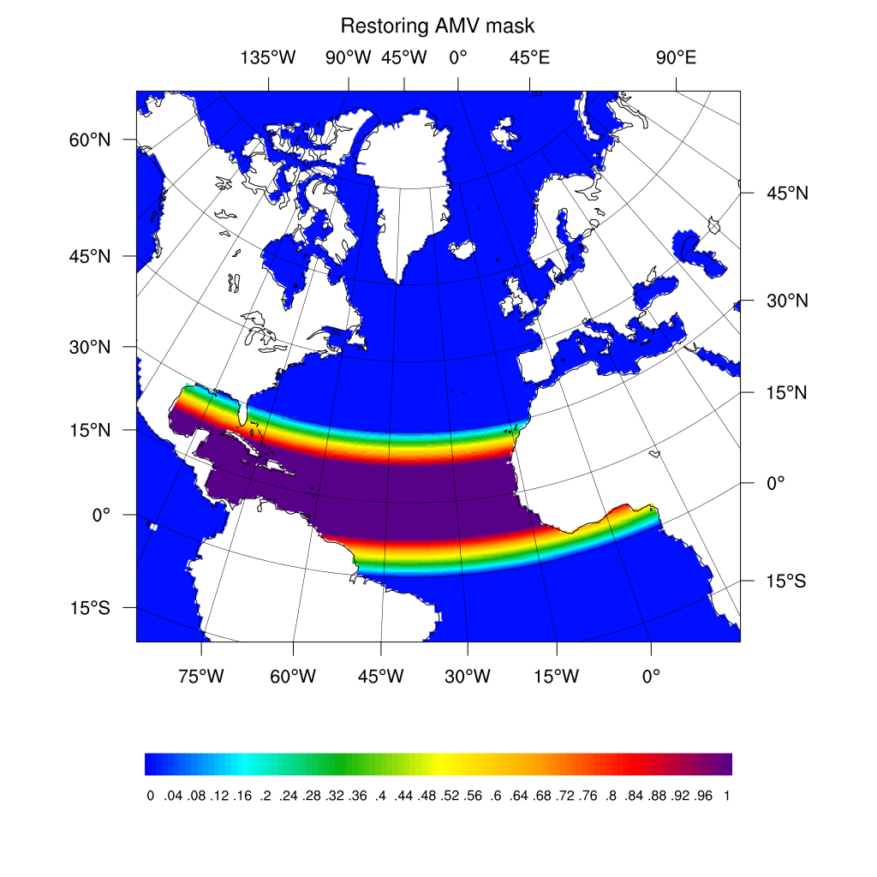
Experimental Setup
AMV pattern (based on Ting et al. 2009)
ºC/sd
Full NA restoring
SPNA restoring
TA restoring

Slide 7
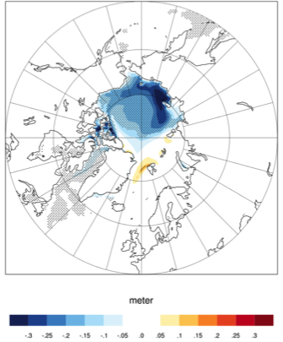
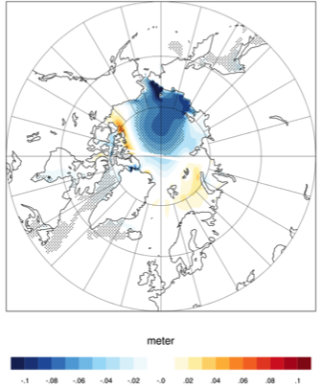
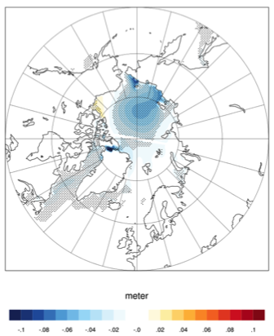
Impacts on Sea Ice Thickness
10-year Mean Differences Between AMV+ and AMV- Ensemble Simulations
CESM1 FLOR CM2.1
m

Slide 8
Skillful Prediction of 10-year Trends in Arctic Winter Sea Ice
HD
Skillful retrospective prediction of observed decadal trends in subpolar SST & winter sea ice extent.
Prediction of recent (and suggestion of future) slowdown in Atlantic winter sea ice loss.
DP
OBS DP DP
Yeager et al. (2015, GRL)

Slide 9
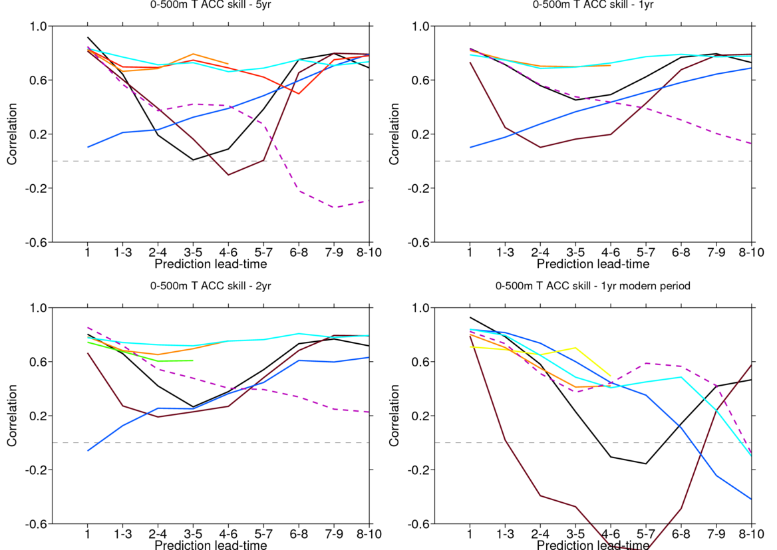
Subpolar Gyre 0-500 m Temperature Prediction Skill
CESM HadCM3 MPI IPSL HiGEM
EC-E-FF-LR EC-E-AA-LR EC-E-HR Persistence
From Jon Robson (SPECS)

Slide 10
Pre-Industrial Control Ensemble
Coupled model simulations show rich AMOC variability, with time scales of variability and mechanisms differing substantially among them. MULTI-MODEL FRAMEWORK
GFDL CM2.1 (Msadek et al. 2010)
CESM (Danabasoglu et al. 2012)
ECHAM5/MPI-OM (Jungclaus et al. 2005)
AMOC

Slide 11
Pre-Industrial Control Ensemble
A systematic assessment of the AMOC variability and mechanisms in a SINGLE-MODEL FRAMEWORK, considering effects of ocean model parameter choices and atmospheric initial conditions as well as statistical stationarity.
Primary goal is to identify both robust and non-robust elements of variability and mechanisms, initially focusing on AMOC.

Slide 12
Ensemble Experiments
Vertical mixing parameterization (VBD):
Reduce internal background mixing from 0.17x10⁻⁴ to 0.10x10⁻⁴ m² s⁻¹
Submesoscale mixing parameterization (SUBM):
The circulation is inversely proportional to width of mixed layer fronts, L, but no guidance on L except that 0.2 < L < 5 km. Reduce L from 5 to 3.33 km.
Mesoscale mixing parameterization:
Increase deep ocean values of isopycnal and thickness diffusivities from 300 to 600 m² s⁻¹ (MDO)
Reduce the boundary layer / upper ocean isopycnal and thickness diffusivities from 3000 to 2000 m² s⁻¹ (MBL)
Horizontal viscosity parameterization (HV):
Reduce the interior viscosities from 600 to 300 m² s⁻¹
Atmospheric initial condition perturbation (IC)
600-year simulations

Slide 13
AMOC Index Power Spectra
50
60
85
50
85
40
40
50
45
45
35
50
70
100+
dots: 95%
squares: 90%

Slide 14
Examples of Additional Capabilities and Simulations
CESM – DART Coupled Reanalysis: Weakly; cross-component; ensemble optimal interpolation (static background ensemble perturbations)
Existing, two sets of decadal prediction (DP) simulations following CMIP: w/ BGC and w/o volcanoes
DP with larger ensemble size (40 members)
CESM1 Large Ensemble simulations for the 1920-2100 period (40+ members)
CESM2 CMIP6 DECK experiments + numerous MIP experiments, including new DP experiments
Semi-prognostics method
AMOC stability

Slide 15
Sea Ice Concentration for September 2007
Ilicak et al. (2016)
Wang et al. (2016a; 2016b)

