Slide 1
INTAROS – Integrated Arctic Observation System
A project funded by EC - H2020-BG-09-2016
Coordinator: Stein Sandven
Nansen Environmental and Remote Sensing Center, Norway
Total budget: 15.5 mEuro
49 partners from 20 countries
Start date: 01 December 2016
Duration: 5 years

Slide 2
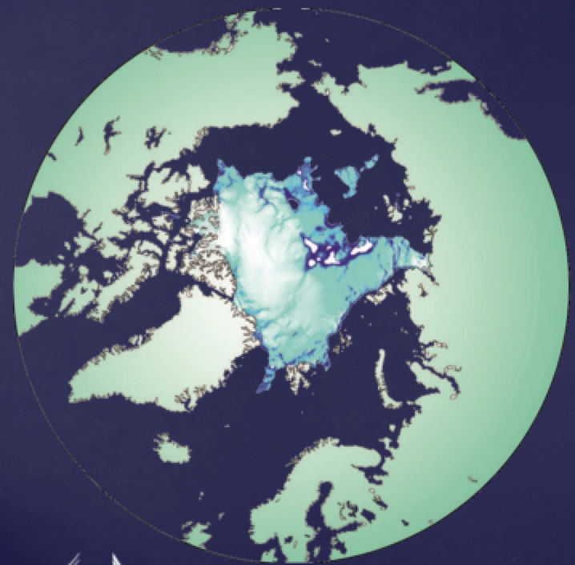
INTAROS overall objective:
to develop an efficient integrated Arctic Observation System by
extending,
improving and
unifying
existing and evolving systems in the different regions of the Arctic

Slide 3
An integrated Arctic Observing System needs to cover
Atmosphere
Ocean
Terrestrial themes
at appropriate temporal and spatial scales and resolution. The largest gaps are in the in-situ observation network, which should provide
data that cannot be obtained from remote sensing and, numerical models
data needed for validation of from remote sensing and numerical models

Slide 4
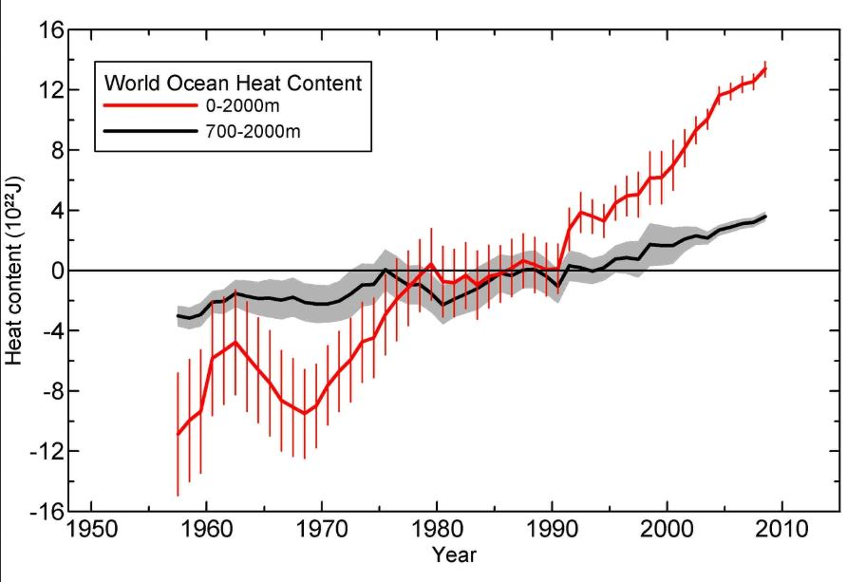
INTAROS Specific objectives (1)
Establish a Pan-Arctic forum for collaboration across EU and non-EU countries and transnational organisations (WP1)
Develop a Roadmap for building a sustainable Arctic observing system (WP1)
Exploit existing observing systems and databases (WP2)

Slide 5
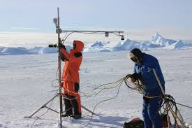
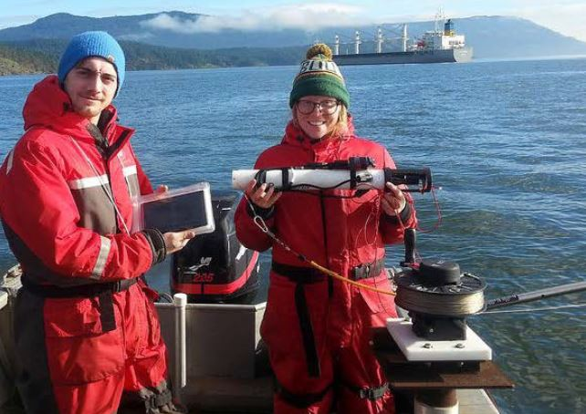
INTAROS Specific objectives (2)
Fill gaps of the present in situ observing systems (WP3)
Enhance community-based observing programmes (WP4)
Develop and implement the iAOS platform for integration of multidisciplinary data from distributed repositories (WP5)

Slide 6
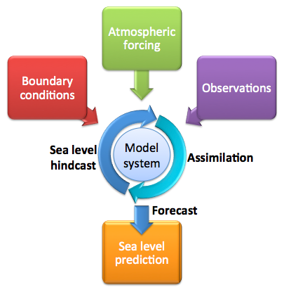
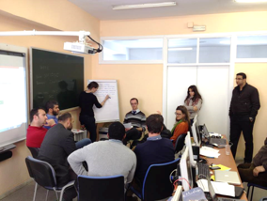
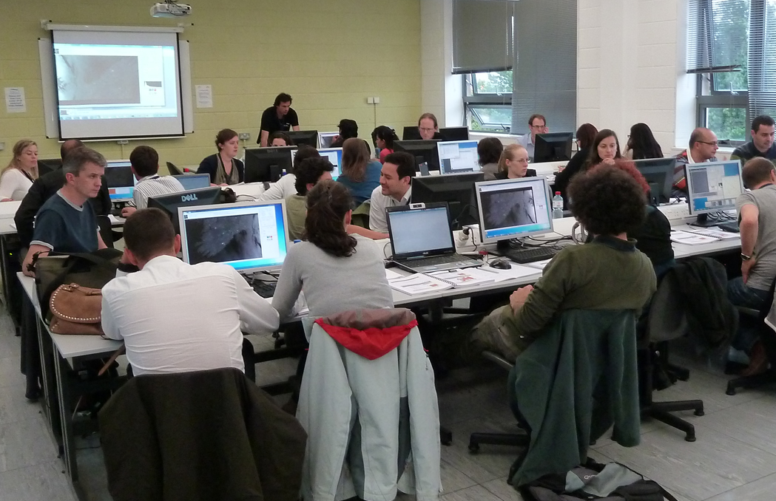
INTAROS Specific objectives (3)
Develop professional skills in using the iAOS platform (WP5)
Use of data in numerical models, collaboration with APPLICATE and BLUE ACTION (WP6)
Demonstrate benefit of data from INTAROS for stakeholder groups (WP6)

Slide 7
Workpackage structure
WP1: Requirements and strategy for a Pan-Arctic system
WP2: Exploitation of existing observing systems
WP3: Enhancement of in situ systems
WP4: Community-based observing systems
Scientific data
Scientific data
WP5: Data integration & management - IAOS
Community data
Integrated data, prepared for applications
Feedback to requirements, strategy and roadmap
WP6: Applications towards stakeholders
Feedback to requirements, strategy and roadmap
Climate modelling
Ice – ocean statistics
WP7: Dissemination and outreach

Slide 8
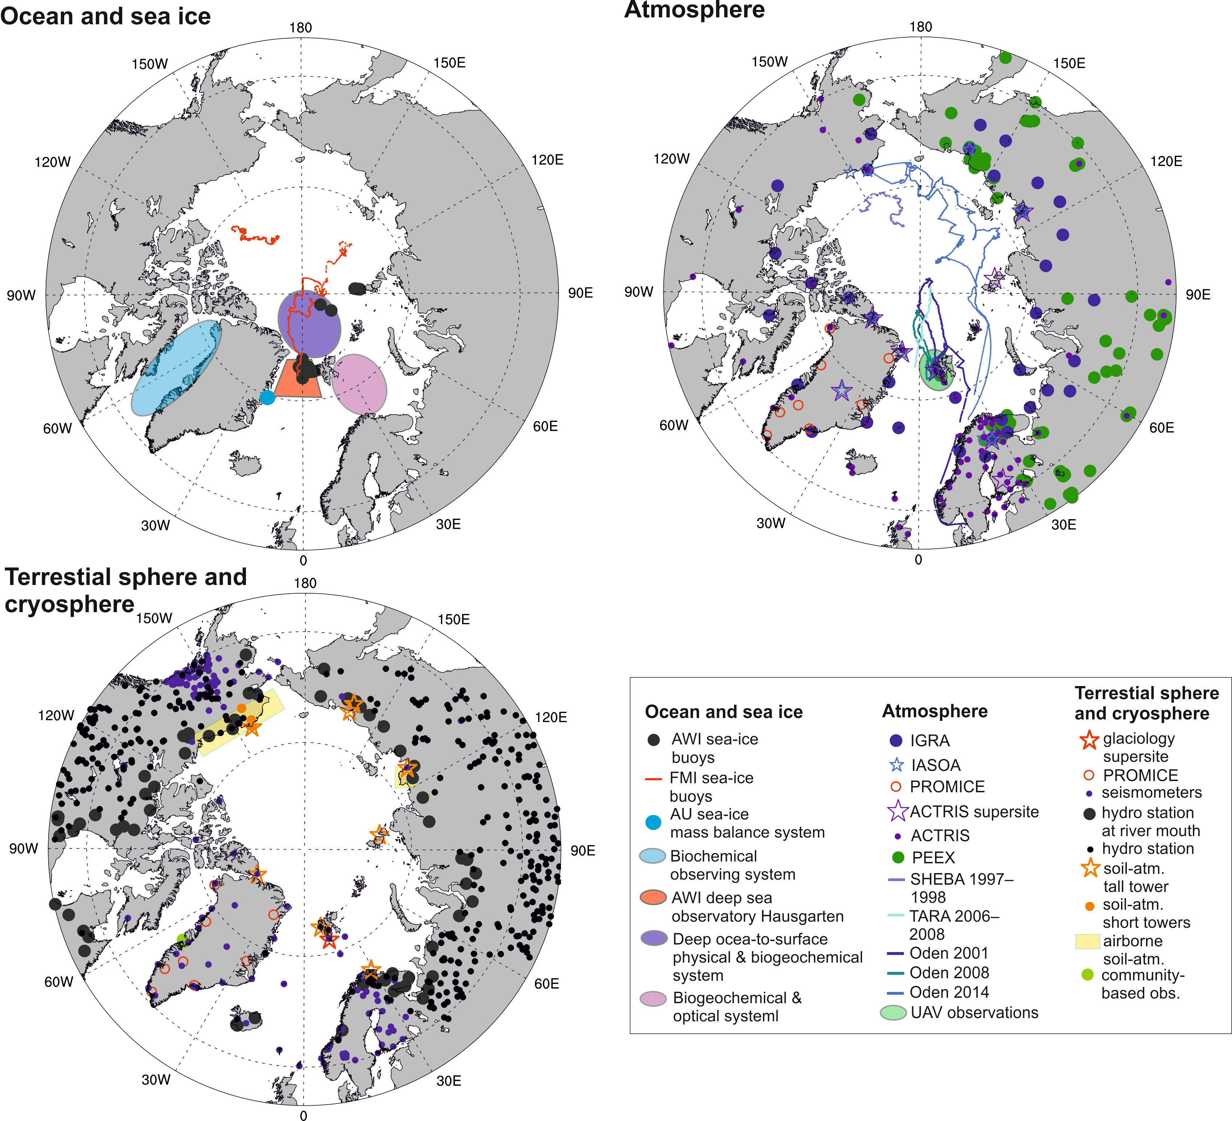
(1) Assess, exploit, and standardize the existing Arctic observing systems (2) Provide data for the integrated observing system in WP5
WP2 -
Exploitation of existing observing systems

Slide 9
WP3 In situ observing systems
Agnieszka Beszczynska-Möller, IOPAN (lead)
Peter Voss, GEUS (co-lead)
Overall objectives:
➽ To improve critical gaps in the Arctic observation system
➽ To build additional capacity of pan-Arctic monitoring networks

Slide 10
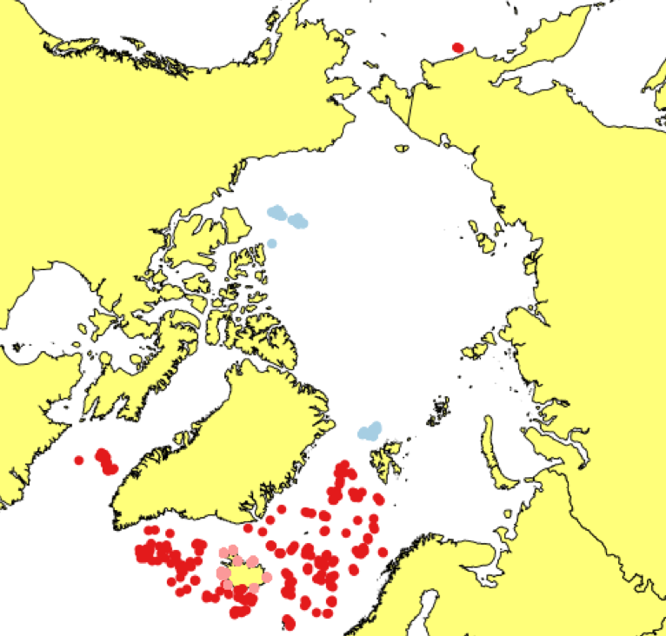
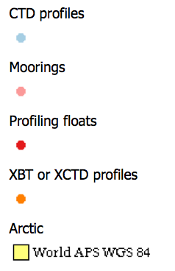
Oceanographical data from the Arctic
Profile data available in near-real time, north of 60 N, last 30 days from 08 Jan 2017. Ref. http://arctic-roos.org

Slide 11
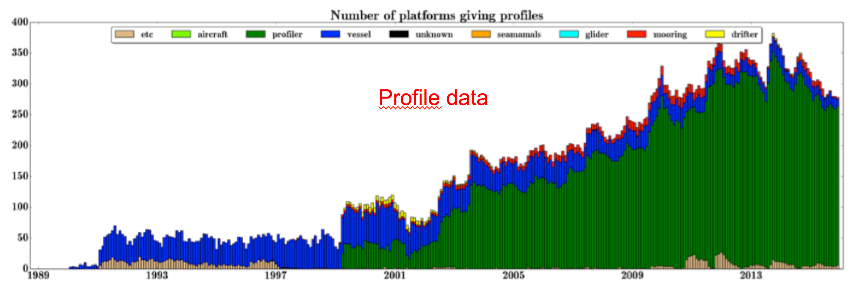
Number of ocean observing platforms north of 60N from 1989 to 2015
From: Copernicus marine and environmental services (CMEMS) quality document

Slide 12
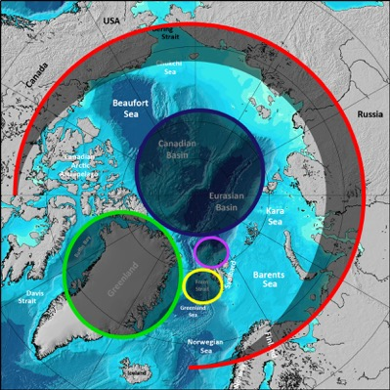
WP3 Deployment areas
Coastal Greenland
North of Svalbard towards the deep Nansen Basin
Fram Strait - Kongsfjorden
Central Arctic Ocean
Selected sites across Arctic
land areas

Slide 13
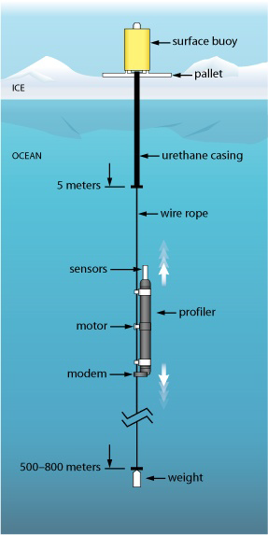
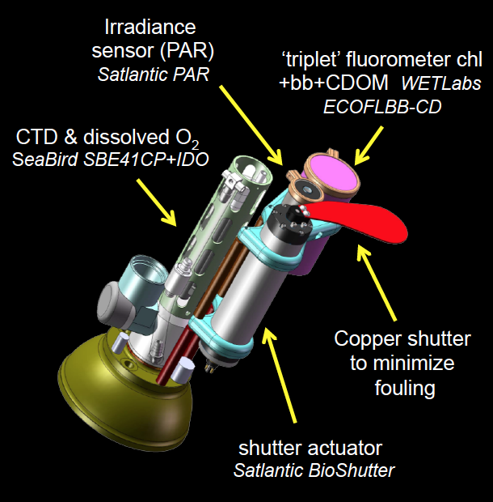
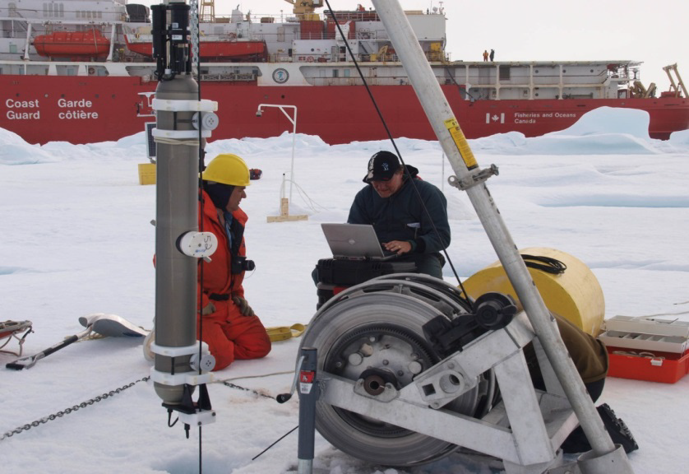
Central Arctic Ocean (1)
ice-tethered platforms (WHOI) for measurements of ocean physical variables combined with biogeochemical sensors
Laney et al., 2014, 2015
Customized ‘triplet’ fluorometer to measure chlorophyll fluorescence, dissolved organic matter fluorescence, and optical scatter
Radiometer (light levels)
Copper shutter: for biofouling
Toole et al., 2011

Slide 14
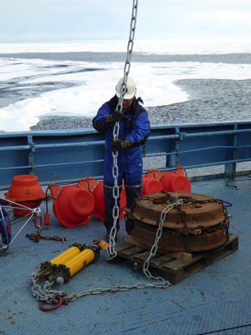
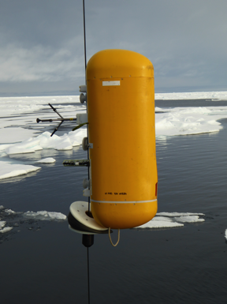
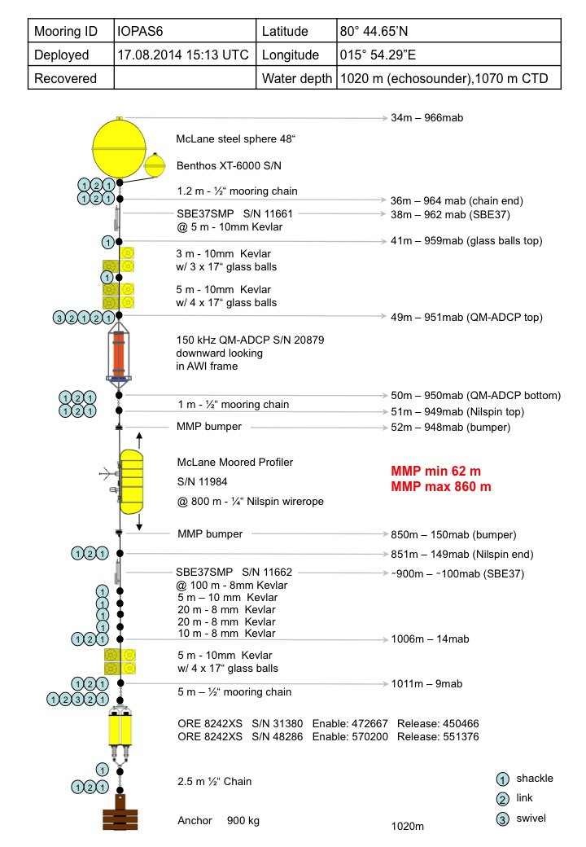
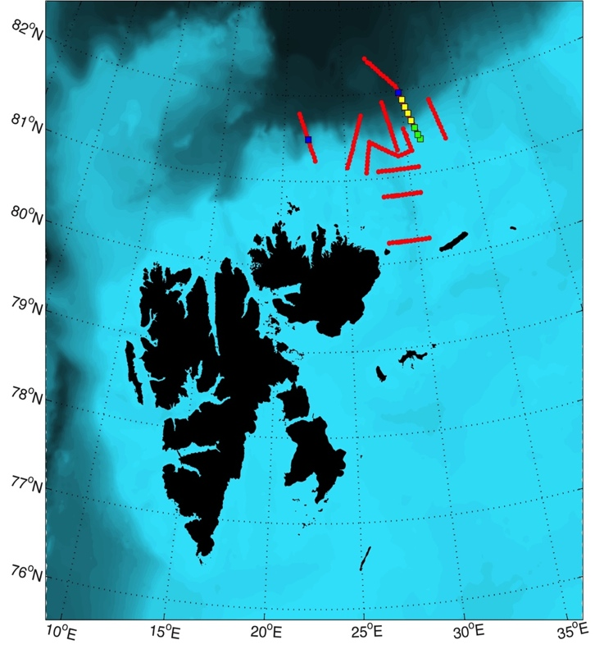
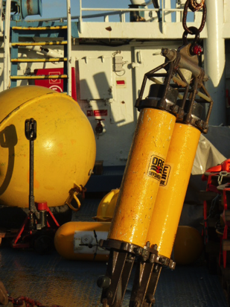
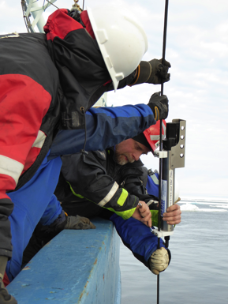
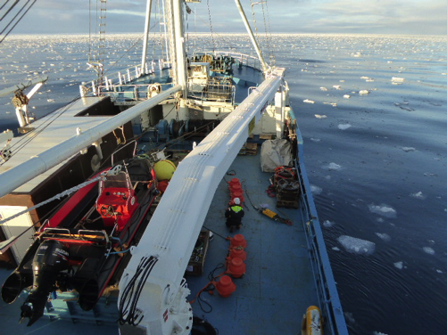
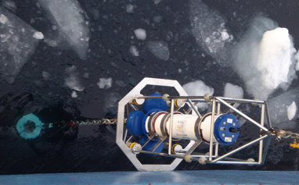
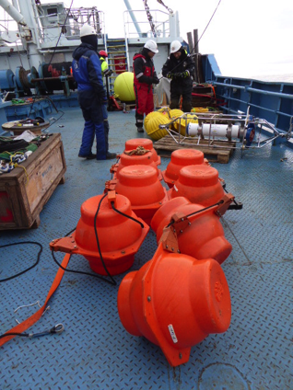
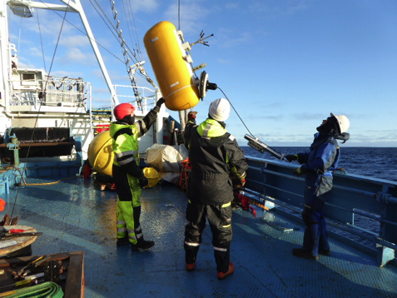
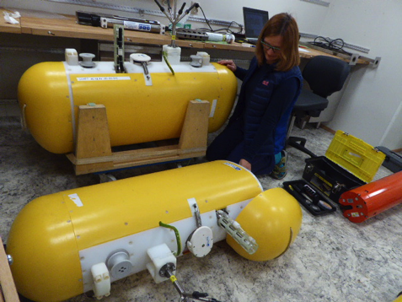
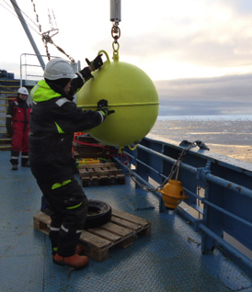
North of Svalbard towards the deep Nansen Basin

Slide 15
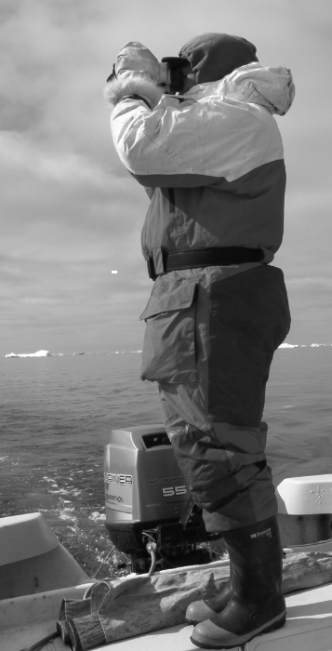
Building on Report of SAON Task 9, identify: 1. Capabilities 2. ’Best’ practices, and 3. Challenges in current Community-Based Monitoring Programs in the Arctic Conduct case studies in Greenland and Svalbard
WP4: Community-based observing programs

Slide 16
WP5: Data integration and management
To integrate multidisciplinary and distributed data repositories into a scalable and resilient Pan-Arctic observing system, iAOS
To offer seamless access to observations and derived parameters provide a set of tools for data analysis, transformation and visualization of spatiotemporal datasets
Data management steps
Collect
Ingest
Store
Search
Analyse
Visualise

Slide 17
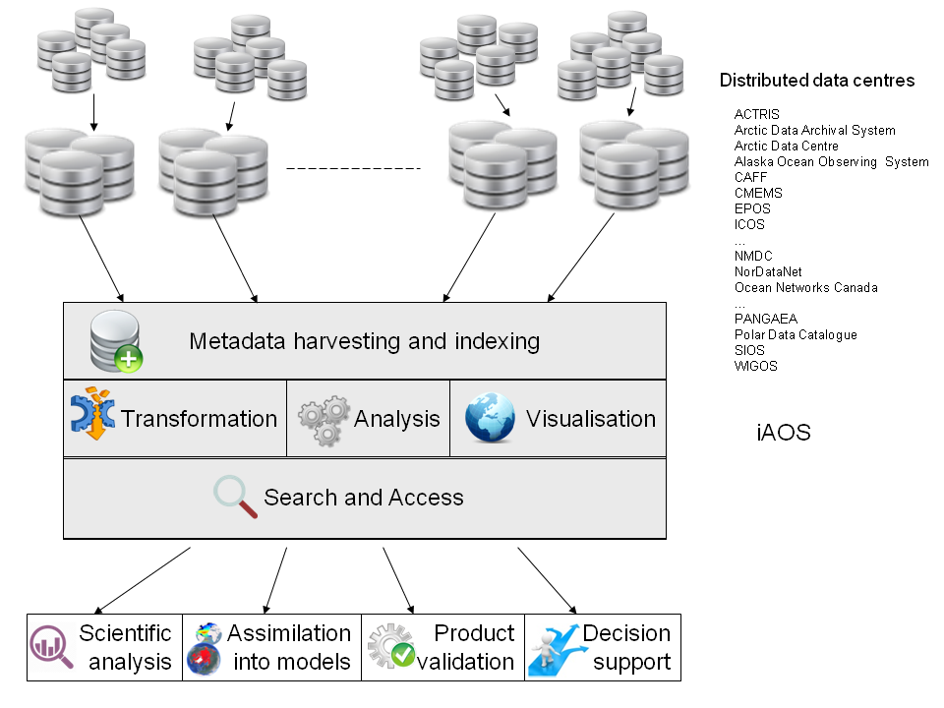
Conceptual architecture of an integrated Arctic observing system

Slide 18
Schedule
2017
2018
2019
2020
2021
WP1: Requirements and strategy
First deployment season
Second deployment season
WP2: Exploitation of existing observing systems
Assessment of present systems
Improve data delivery chains
and data products
WP3: Enhamcement of in situ observing systems
Deployment and data dissemination
Planning and testing
WP4: Community-based observing programmes
Planning phase
Implementation phase and data dissemination
WP5: Data manage-ment & integration
Planning and design
Incremental implementation
WP6: Applications towards stakeholders
WP7: Dissemination and outreach
YOPP field experiments

Slide 19
Partners
Norway: NERSC, UIB, IMR, UNIS, NIVA, NORUT, DNV-GL
Denmark: GEUS, DTU, NORDECO, Aarhus University
Sweden: SMHI, Stockholm University
Finland; FMI, University of Helsinki
Germany: AWI, U. Hamburg, U. Bremen, MPG, GFZ
UK: University of Sheffield, University of Exeter
Ireland: Maynooth University
Poland: IOPAN, IGPAN, University Slaski
France: CNRS, Ifremer, ARMINES
Spain: Polyt. Univ Madrid, Barcelona Supercomputing Centre
Portugal : Eurocean
Belgium: EuroGOOS AISBL
Italy: Terradue, JRC
Greenland: GINR
Russia: RIHMI-WDC, NIERSC
USA: UAF,UCSD/ SIO, WHOI, JPL
Canada: Université Laval, ONC
China: RADI, NMEFC, PRIC
Japan: NIPR
South Korea: KOPRI
Consortium members
Norway: NERSC, UIB, IMR, UNIS, NIVA, DNV-GL
Denmark: GEUS, DTU, NORDECO, Aarhus University
Sweden: SMHI, Stockholm University
Finland; FMI, University of Helsinki
Germany: AWI, U. Hamburg, U. Bremen, MPG, GFZ
UK: University of Sheffield, Open University
Ireland: Maynooth University
Consortium members
Norway: NERSC, UIB, IMR, UNIS, NIVA, DNV-GL
Denmark: GEUS, DTU, NORDECO, Aarhus University
Sweden: SMHI, Stockholm University
Finland; FMI, University of Helsinki
Germany: AWI, U. Hamburg, U. Bremen, MPG, GFZ
UK: University of Sheffield, Open University
Ireland: Maynooth University

Slide 20
EU’s Arctic project cluster 2016-2017
EU PolarNET
Coordination action
INTAROS
observing systems
(NERSC)
APPLICATE
Modelling – forecasting
(AWI: T. Jung)
Arctic permafrost
(open call)
BLUE ACTION
Modelling – forecasting
(DMI: S. Olson)
Infrastruture projects: ENVRI, INTERACT, ACTRIS, ICOS, SIOS, ++

