Slide 1
Blue-Action – WP2 Lower latitude drivers of Arctic changes
Lead: Karin Margretha H. Larsen, HAV
Co-lead: Gerard McCarthy, NERC/NOC

Slide 2
WP2 – Who are we?
20 partners (DMI, CNRS, GEOMAR, HAV, MEOPAR, MPI, MRI, MSS, UCAR, NERSC, NIOZ, NLeSC, NERC, SRSL, UHAM, UIB, UNIRES, UoS, UoW, WHOI)
~40 scientists
Observers and modellers

Slide 3
What will we do?
Key conclusions:
The importance of the AMOC for the climate is paramount
There is a pressing need for sustained observations of the AMOC and associated heat transport;
The potential predictability of the AMOC and therefore of its climate impacts needs further study.
Lower latitude drivers of
Arctic changes

Slide 4
“Interannual- to decadal-scale ocean heat anomalies associated with the northern limb of the AMOC propagate persistently toward the Arctic”
“Ocean heat anomalies in the northern seas are reflected in regional sea ice extent and found to influence the atmosphere...”

Slide 5
“Three key predictors for internal low-frequency variability of summer Arctic sea ice extent are identified ... including both the Atlantic and Pacific ocean heat transport into the Arctic, as well as the atmosphere circulation.”

Slide 6
WP2 – Task 2.1
Assessment of key lower latitude influences on the Arctic and their simulation (NERC)
D2.1 Model-observation and reanalyses comparison at key locations for heat transport to the Arctic (NERC)
D2.2 Seasonal to decadal variability of the subpolar gyre (SAMS)
D2.3 Processes and flow over the Iceland-Faroe Ridge (DMI)
D2.4 Synthesis and dissemination of ocean and atmosphere heat transport to the Arctic (NLeSC)

Slide 7
WP2 – Tasks 2.2
Pathways and interactions sustaining Arctic predictability (UiB)
D2.5 Assessment of Oceanic anomalies of predictive potential (UiB)
D2.6 Oceanic heat anomalies and Arctic sea-ice variability (CNRS)
MS8 Assessment of heat transport and distribution in the high Arctic in eddy resolving model (CNRS)
MS9 Coupled reanalysis of the Arctic climate (CNRS)

Slide 8
WP2 – Tasks 2.3
Optimization and coordination of existing TMA systems, improved data delivery for predictions and identification of gaps (HAV)
D2.7 Cost-benefit analysis of the RAPID and OSNAP arrays (GEOMAR)
D2.8 Optimization of the GSR inflow arrays (HAV)

Slide 9
WP2 - Objectives
Enhancing the predictive capacity beyond seasons
Assessment of Oceanic anomalies of predictive potential
Reanalyses to serve as input to WP4 (Enhancing the capacity of s2d prediction)
Optimizing observational systems
Near real time data access from TMAs (NACLIM, AtlantOS, NERC)
Integrate New Earth Obs. to inflow arrays

Slide 10
WP2 – Objectives (cont.)
Reducing and evaluating the uncertainty in prediction systems
Improve simulations of poleward flow
Observations and newest reanalyses products to be compared with climate models
Collaborate with the Copernicus Climate Change Service (C3S)

Slide 11
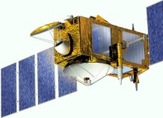
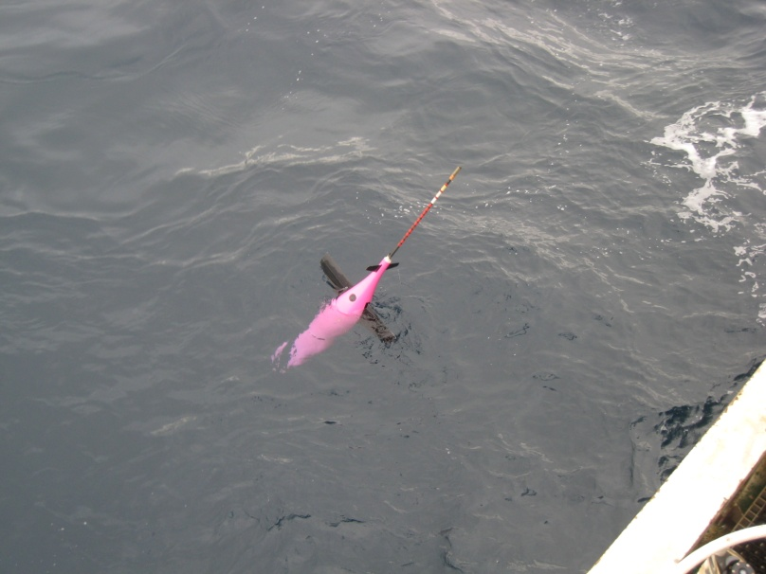
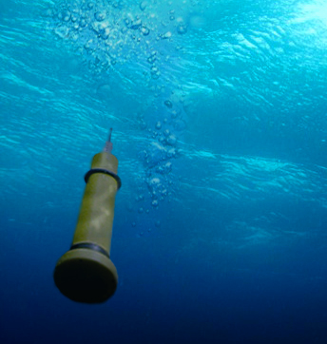
WP2 Observations/Data
New Earth Obs.
Univ. W.
(+ Ber.Str.)
GSR-TMAs
Gliders
(SAMS)
OWS-M
EEL
OSNAP
Argo Floats
OVIDE
RAPID

Slide 12
Models and Reanalyses
Models:
Coupled climate: HadGEM-Charisma, IPSL, CESM
High res ocean-only: NEMO (1/24°), a.o.
Reanalyses:
MERRA, ERA5, ERA20CM, ORAS5
NorCPM, IPSL (produced within Blue-Action)

Slide 13
Presentations tomorrow
Heat transport to the Arctic and its impacts – Gerard McCarthy
Towards a new reanalysis with the IPSL climate model – Juliette Mignot

Slide 14
WP2 | Deliverables | Lead
D2.1 | Model-observation and reanalyses comparison at key locations for heat transport to the Arctic | NERC
D2.2 | Seasonal to decadal variability of the subpolar gyre | SAMS
D2.3 | Processes and flow over the Iceland-Faroe Ridge | DMI
D2.4 | Synthesis and dissemination of ocean and atmosphere heat transport to the Arctic | NLeSC
D2.5 | Assessment of Oceanic anomalies of predictive potential | UiB
D2.6 | Oceanic heat anomalies and Arctic sea-ice variability | CNRS
D2.7 | Cost-benefit analysis of the RAPID and OSNAP arrays | GEOMAR
D2.8 | Optimization of the GSR inflow arrays | HAV

Slide 15
 | Milestone title | WPs | Lead | Means of verification
MS8 | Assessment of heat transport and distribution in the high Arctic in eddy resolving model | WP2, WP3 | CNRS | Identification of robust metrics
MS9 | Coupled reanalysis of the Arctic climate | WP2, WP3, WP4 | CNRS | Two novel climate reanalyses made available to the project for evaluation (WP2), process analysis (WP3) and predictability studies (WP4)

