Slide 1
WP4: Enhancing the capacity of seasonal-to-decadal predictions in the Arctic and over the Northern Hemisphere
Daniela Matei (MPI) and Noel Keenlyside (UiB)
Motivation:
Observations and ocean, atmosphere, and coupled modelling studies indicate a two-way link between the North Atlantic and Nordic Seas/Arctic that implies:
a potential for skillful prediction in Nordic Seas and the Arctic
a potential for enhanced prediction skill in the North Atlantic, and
a potential for enhanced prediction skill of climate over adjacent continental regions and the Northern Hemisphere on seasonal-to-decadal timescales by better capturing variations in the oceans in both regions and in sea ice.
This apparent prediction potential of Arctic-lower latitude linkages has yet to be explored in a coordinated manner within the state-of-art multi-model ensemble predictions.

Slide 2
Potential predictability of monthly mean pan-Arctic
Sea Ice Area and Volume
Guemas et al. 2016, QJRMS

Slide 3
Ocean heat transport contributes to sea ice variations
Observed and predicted anomalous sea ice cover
Prediction using previous year heat transport across Barents Sea Opening and sea ice
Onarheim et al. 2015
Notes:
Abstract A main concern of present climate change is the Arctic sea ice cover. In wintertime, its observed variability is largely carried by the Barents Sea. Here we propose and evaluate a simple quantitative and prognostic framework based on first principles and rooted in observations to predict the annual mean Barents Sea ice cover, which variance is carried by the winter ice (96%). By using observed ocean heat transport and sea ice area, the proposed framework appears skillful and explains 50% of the observed sea ice variance up to 2 years in advance. The qualitative prediction of increase versus decrease in ice cover is correct 88% of the time. Model imperfections can largely be diagnosed from simultaneous meridional winds. The framework and skill are supported by a 60 year simulation from a regional ice-ocean model. We particularly predict that the winter sea ice cover for 2016 will be slightly less than 2015.

Slide 4
Observed and forecasted decadal trends in Arctic Sea Ice
Yeager et al. 2015, GRL

Slide 5
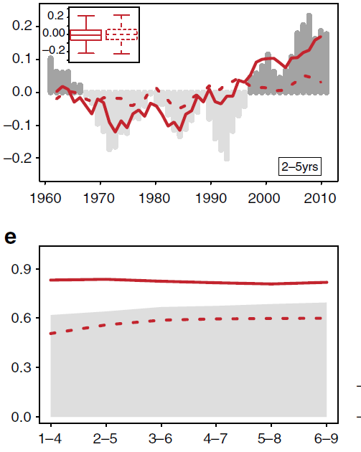
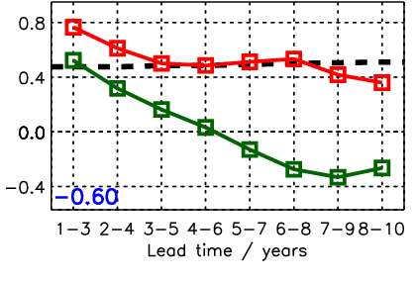
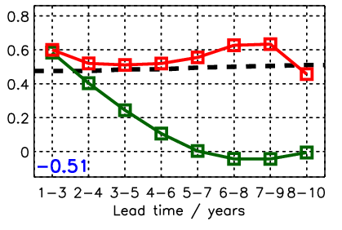
Robust North Atlantic multi-year predictive skill in both individual models and CMIP5 MME
CMIP5 MME AMV predictive skill
CMIP5 MME Upper Ocean Salt Content predictability
Eastern SPG
Nordic Seas
°C
COR
Lohmann, Matei, Bersch, Jungclaus (in prep.)
COR
Doblas-Reyes et al. 2012 (Nat. Com.)
North Atlantic Subpolar Gyre region stands out as the region with the highest predictive skill in surface temperature and upper ocean heat and salt content.

Slide 6
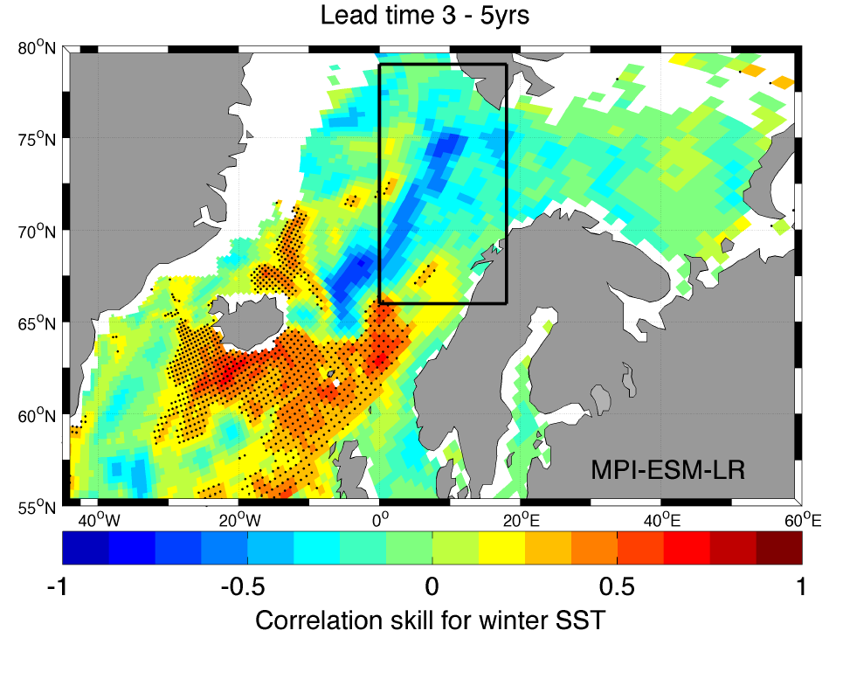
Any predictive skill for of winter SST in the Nordic Seas and Barents Sea?
Langehaug, Matei, Eldevik, Lohmann, Gao (2016)
Yes! – but the predictive skill and representation of mechanisms differ widely among models!

Slide 7
WP4: Enhancing the capacity of seasonal-to-decadal predictions in the Arctic and over the Northern Hemisphere
Goal
To identify the current limitations in predicting Arctic climate (and its link to NH climate) and
to develop improved models and methodologies to enhance the skill of initialized climate predictions in the Arctic and over the NH.
An updated forecast ensemble will be performed with the improved systems and delivered to selected impact case studies.

Slide 8
Task 4.1: Mechanistic and statistical skill assessment of baseline subseasonal-to-decadal multi-model predictions
Lead: MPI, Participants: NLeSC, NERSC, DMI, CMCC, NCAR, CNRS, UoS, MERCATOR
Perform coordinated process-based evaluation of key processes in the benchmark retrospective seasonal-to-decadal prediction systems.
Assess in a seamless approach whether the linkages identified in WP3 are found in initialised predictions (focus on extremes - link to WP1)
Skill assessment:
  both deterministic and probabilistic
  test innovative calibration approaches.

Slide 9
Task 4.2: Coordinated experiments to quantify the contribution of the Artic and high latitude North Atlantic in predictability of Northern Hemisphere extreme weather and climate
Lead: DMI; Participants: MPI, UiB, DMI, CMCC, UoS, NCAR
The impact of mechanisms identified in WP2/WP3 further assessed through two types sensitivity prediction experiments:
  Type 1: Retrospective seasonal-to-multiyear hindcasts for selected case studies (pacemaker or data with-holding predictions)

Slide 10
An impact of freshwater release in the North Atlantic?
Rahmstorf et al. 2015
Rahmstorf et al. (2015): Greenland ice sheet (GrIS) melting as a key player for 20th AMOC weakening (if any…)
Boning et al. (2016): impact of GrIS melting only clear since 2010s in the Labrador Sea convective activity
Böning et al. 2016

Slide 11
Type 2: Including effects of GrIS melting in hindcasts and forecasts
WP4 analysis in link with the impact of freshwater content in the Nordic Seas-subpolar gyre:
  Include in some of the CMIP6 DCPP hindcasts and forecasts the recent and future GrIS melting and evaluate its potential impact on the North Atlantic climate hopefully in a mutli-model framework (only recent start dates)
  Need to decide which projection for the melting (linear acceleration of the melting since the 1990s according to Rignot et al. 2011, do we stick on this?)
  + Conditionnal predictability depending on amount of freshwater released from the Arctic through Fram Strait (Great Salinity Anomalies): window of opportunity for better predictability?

Slide 12
Task 4.3: Explore alternative ways of enhancing predictive skill
through improved model configurations and innovative initialization techniques
Lead: UiB; Participants: MPI, NERSC, NLeSC, DMI, CMCC, UoS, NCAR
Role of enhanced atmospheric and oceanic resolution
Role of Sea ice and Atmospheric initialisation on the accuracy of NH climate predictions
Innovative bias reduction and initialisation strategies
Task 4.4: Developing a protocol for improved seasonal-to-decadal prediction systems in the Arctic and over the Northern Hemisphere. Lead: NLeSC; Participants: MPI, UiB, NERSC, DMI, CMCC, UoS, NCAR, MERCATOR

Slide 13
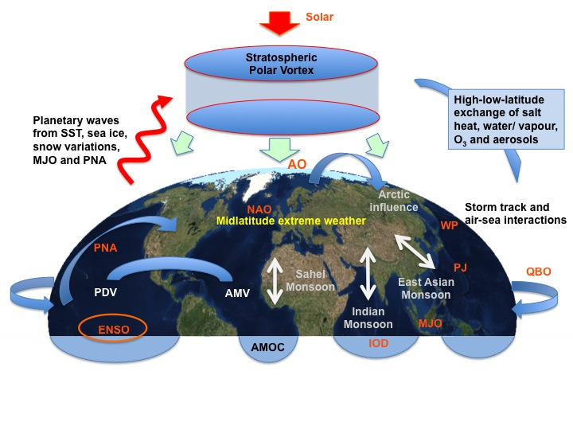
JPI Climate Belmont InterDec
The potential of seasonal-to-decadal-scale inter-regional linkages to advance climate predictions
2016-2020
Main objectives:
To investigate mechanisms that govern the fast atmospheric linkages through both tropospheric and stratospheric processes between polar and lower latitudes and explore the potential for predictions on S2S time scales.
To advance our understanding of how the frequency and amplitude of extreme weather events can be modulated by decadal changes in the background climate conditions.
To explore the role of the ocean for low frequency signal communication between high and low latitudes and the implications for decadal predictability.
To explore the added value of increased climate model resolution for a more realistic representation of the processes linking high and low latitudes and for enhancing the predictability of high-impact climate and extreme weather events on regional scales.
MPI-M
U Tokyo
U Niigata
NERSC
U Bergen
U Reading
ECMWF
IAP-CAS
SMHI
GEOMAR
Notes:
13

