Slide 1
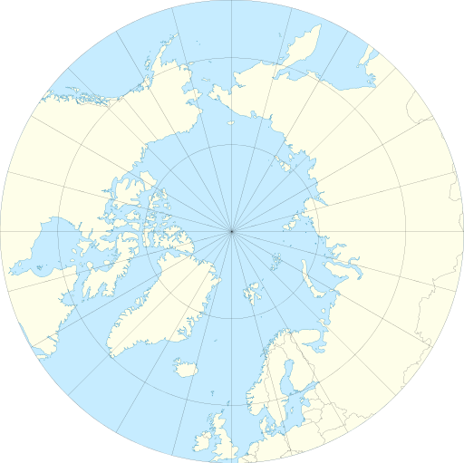
Communication, Dissemination, Engagement, & Exploitation (WP8)
Raeanne Miller (SRSL / SAMS)
Peter Vangsbo (Climate-KIC)
By Tentotwo [CC BY-SA 3.0 (http://creativecommons.org/licenses/by-sa/3.0)]

Slide 2
WP Objectives
Communication
Dissemination
Engagement
Exploitation
(what do they mean)
Specific Activities
Developing an effective approach

Slide 3
WP 8: Objectives
Foster the capacity of key stakeholders to adapt and respond to climate change
Boost economic growth
Transfer knowledge to a wide range of key stakeholders

Slide 4
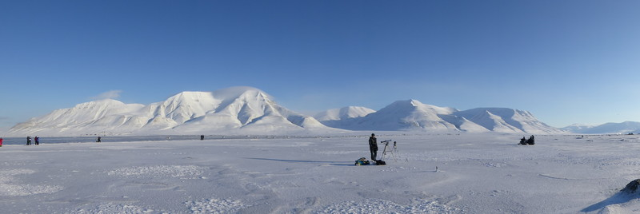
Why Blue Action?
Purpose
Vision
Potential Outcomes
Communication
Dissemination

Slide 5
How and where does it apply?
Who uses this science?
What science can be applied?
What are our networks?
Engagement

Slide 6
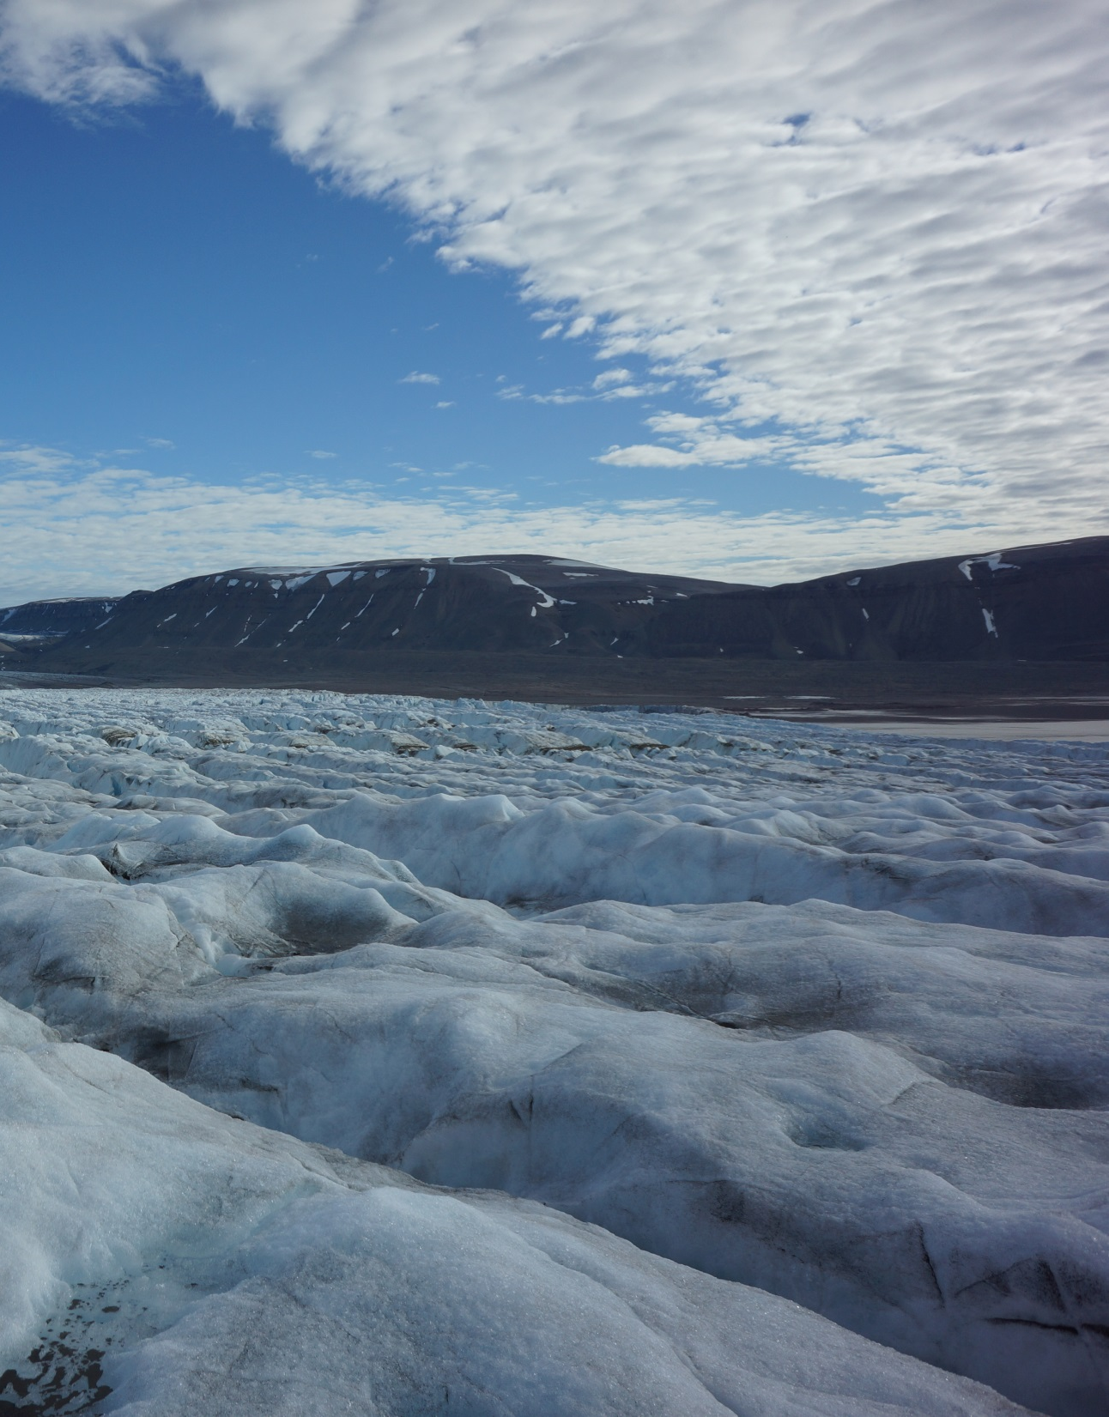
What new ideas or innovations?
Benefit others:
Other research projects
Business & economy
Risk
Policy
Environment
Human wellbeing
Exploitation
Notes:
Lifetime of the project!!!

Slide 7
Specific Aims & Activities
Facilitate communication among the partnership
Dissemination of results beyond the partnership
Communication & Dissemination Plan

Slide 8
Professional Development
Build skills and competences for those working in this area
Business
Understand & adapt to climate change
Policy
Science-based decision making
Project partners
Recognizing potential innovation & IP
Students
Dissemination & links with higher education
Science comms

Slide 9
External Engagement
Emerging start-ups
Established businesses
Policy & decision-makers
Indigenous communities
WP5
Wider stakeholders
Climate KIC, WOC, KDM

Slide 10
Developing an effective approach – lets discuss!
Science understanding
Shape communication pathways
Begin to explore new ideas & innovation
next 5 years and beyond

Slide 11
Communication, Dissemination, Engagement, & Exploitation (WP8)
Raeanne Miller (SRSL / SAMS)
Raeanne.Miller@sams.ac.uk
Peter Vangsbo (Climate KIC)
peter.vangsbo@climate-KIC.org
By Tentotwo [CC BY-SA 3.0 (http://creativecommons.org/licenses/by-sa/3.0)]

