Slide 1

Blue Action WP5
Developing and Valuing
Climate Services
Mark R Payne
National Institute for Aquatic
Resources, Denmark
Kathrin Keil
Institute For Advanced Sustainability
Studies, Germany

Slide 2
What is a climate service?
We attribute to the term a broad meaning, which covers the transformation of climate-related data — together with other relevant information — into customised products such as projections, forecasts, information, trends, economic analysis, assessments (including technology assessment), counselling on best practices, development and evaluation of solutions and any other service in relation to climate that may be of use for the society at large. As such, these services include data, information and knowledge that support adaptation, mitigation and disaster risk management (DRM)
- European Roadmap for Climate Services

Slide 3






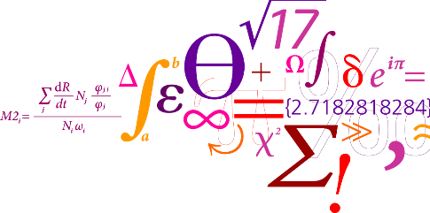


”Climate data is not climate information”
- Francisco Doblas-Reyes, IC3, Barcelona
?
€
?
€
Climate Services
are
Translation Services
?

Slide 4
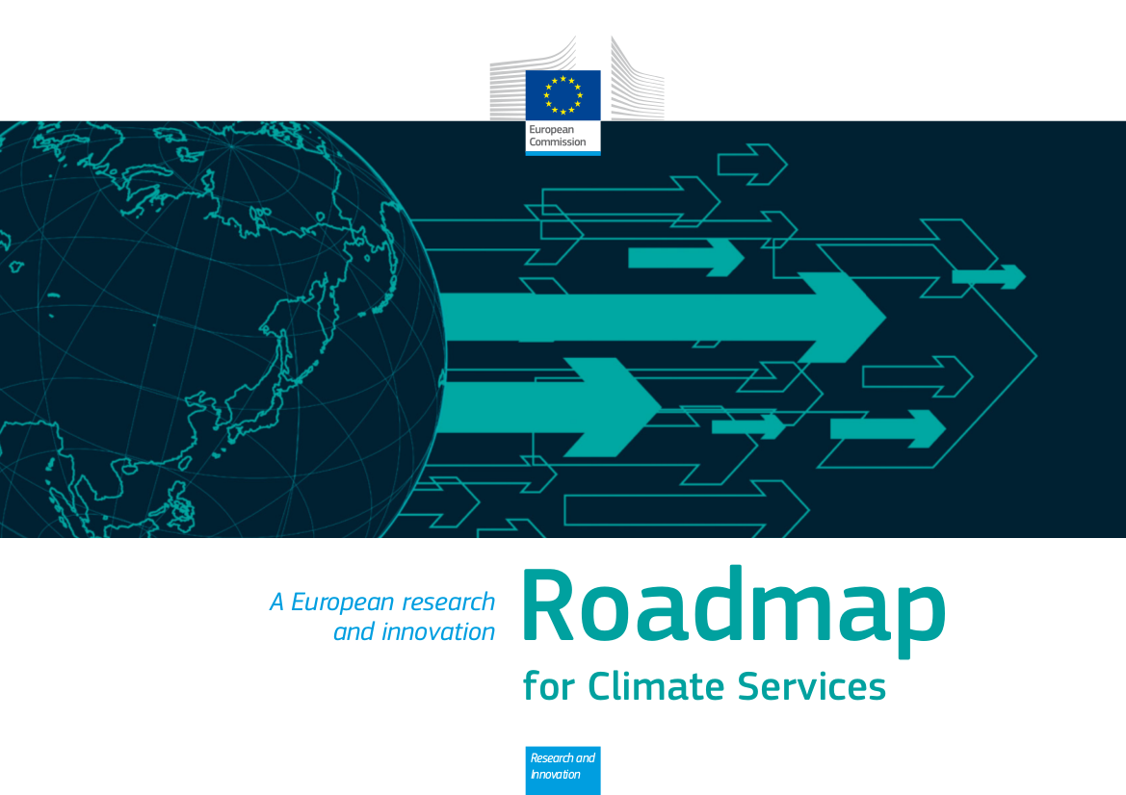
European Roadmap for Climate Services

Slide 5
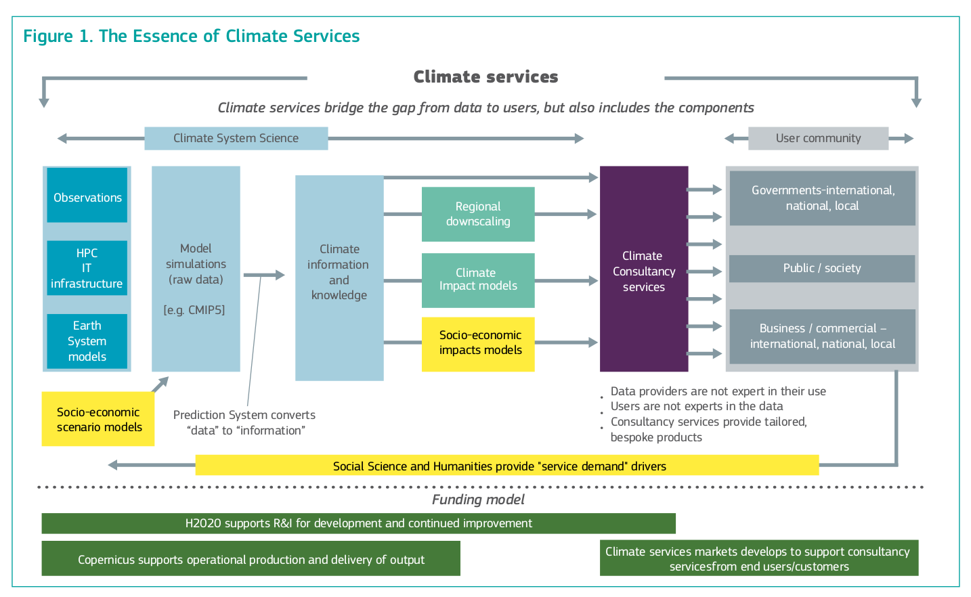

Slide 6

Blue Action is a Blue Growth Call

Slide 7
WP5 Objectives
Translate the skill of forecast models into
products that are relevant to stakeholders
Demonstrate the value of these products to stakeholders and estimate their economic value

Slide 8






Standing on the Shoulders of Giants

Slide 9
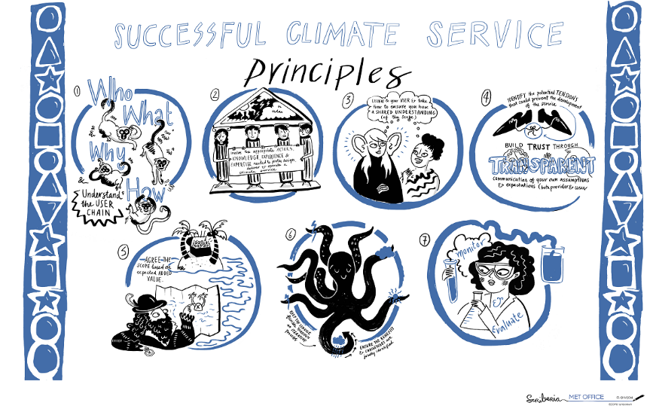
E.g. Principles of Climate Service Development

Slide 10
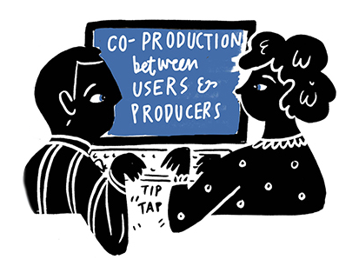









End-Users are Key

Slide 11
Five Case Studies Applying a Common(ish) Approach
Identification
of end-user-relevant climate services
Development
of products in collaboration with end-users
Evaluation/Valuation
of products preferably in economic terms
Dissemination
to the wider sector

Slide 12

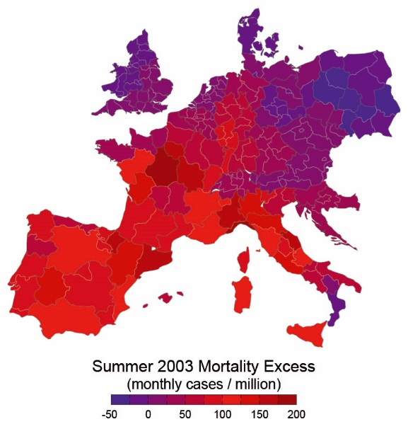
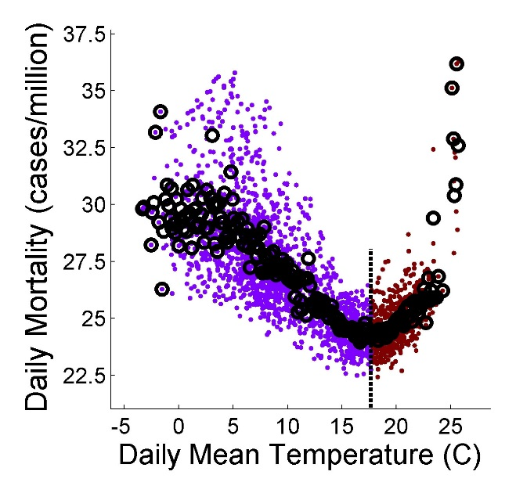
Temperature Related Mortality (TRM)
(Joan Ballester, IC3)
Develop forecast scheme for thermal stress and TRM for 160 administrative units across Europe
e.g. Excess Mortality due to
2003 Summer Heatwave
Both summer and winter
temperatures are important

Slide 13

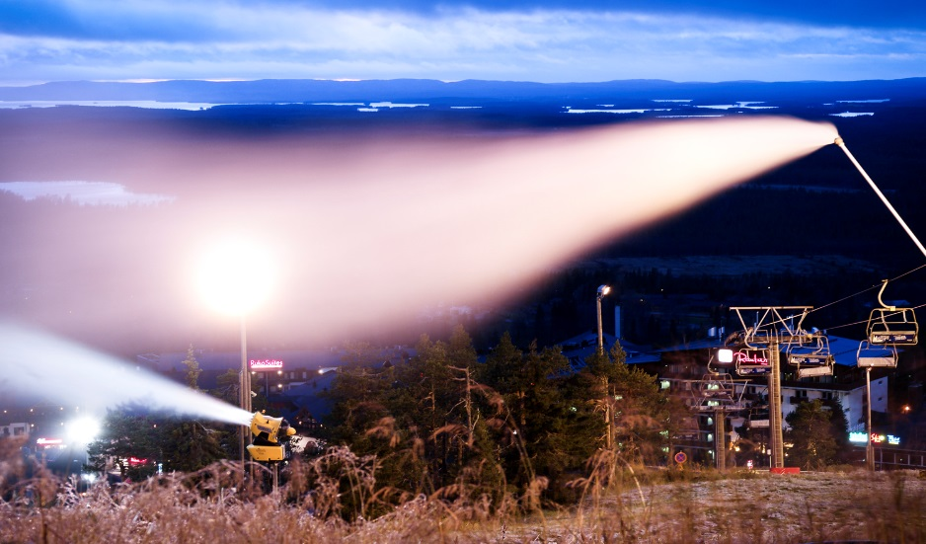
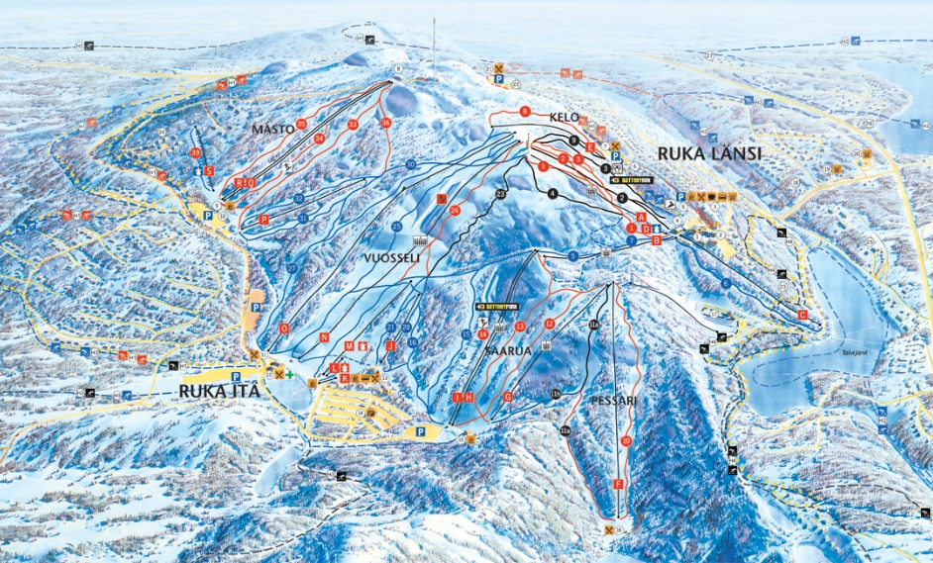
Winter Tourism Industry in Lapland
(Pamela Lesser, U. Lapland)
Seasonal forecasts of winter conditions to 1) allow for planning of activities & 2) compare with Alps to establish competitiveness of Lapland
Planning of snow-making
and storage requirements
Planning of alternative activities

Slide 14

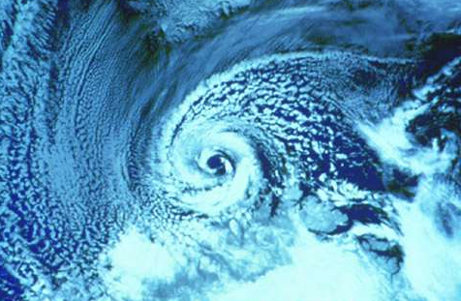
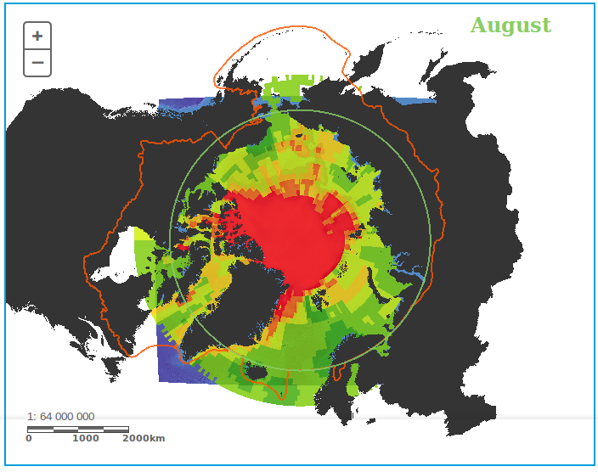
Polar Low Forecasts
(Erik Kolstad, Uni Research)
Prediction of cold air outbreaks and polar low environments to incorporate into shipping risk assessment tools
Polar Low in Barents Sea
Safety risk map for August

Slide 15



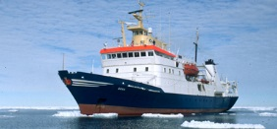
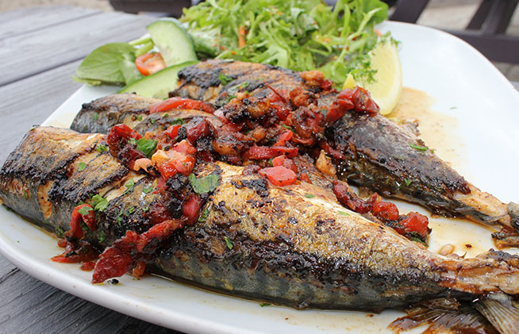
Climate Services for Fisheries
(Mark Payne, DTU Aqua)
Develop forecasts for the distribution, productivity and timing of commercially important fish stocks
Applications in scientific
monitoring of fish stocks
Planning and performance
of commerical fisheries

Slide 16
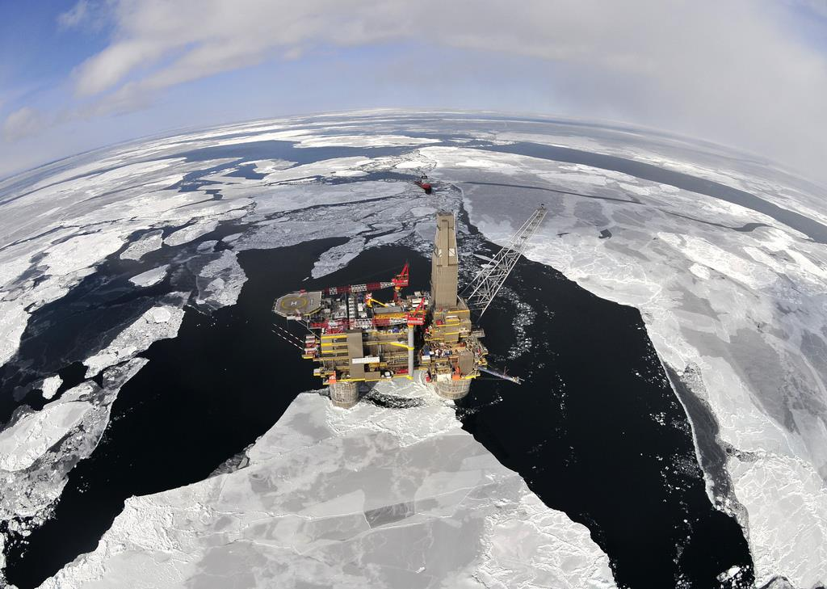
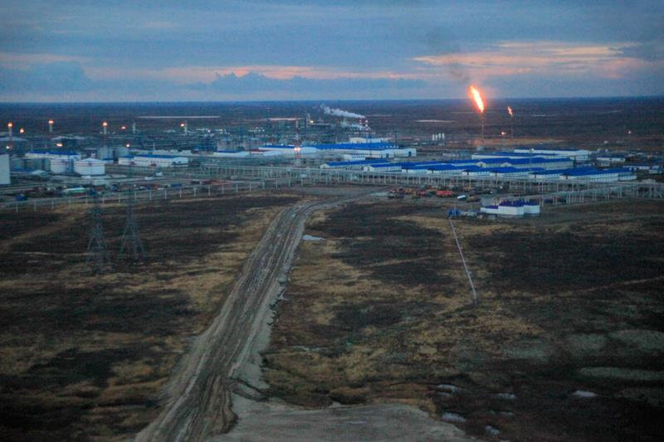
Impacts of resource extraction on Russian Arctic
(Kathrin Keil, IASS Potsdam)
Collaboratively develop scenarios outlining possible impacts of climate change on stakeholders in the region

Slide 17
Case Study Overview
Hemispheric
Polar
Lows
Continental
Temp.
Mortality
Spatial Scale
Fishing
Regional
Lapland
Tourism
Arctic
Impacts
Local
Weather
Seasonal
Inter-
Annual
Sub-Decadal
Decadal
Climate
Temporal Scale

Slide 18
Blue Action WP5
Developing and Valuing
Climate Services

