Slide 1
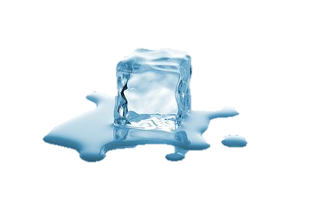
Sea ice retreat,
ocean surface warming,
Michael Steele
Polar Science Center, Applied Physics Lab, Univ. of WA
Seattle, WA USA

Slide 2
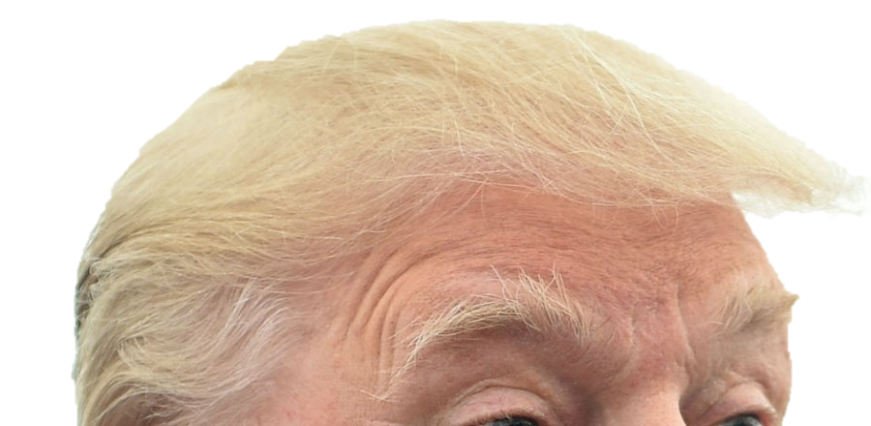
Sea ice retreat,
ocean surface warming,
&
What’s new in the US of A?
Michael Steele
Polar Science Center, Applied Physics Lab, Univ. of WA
Seattle, WA USA
besides this…

Slide 3
Or…
Michael Steele
Polar Science Center, Applied Physics Lab, Univ. of WA
Seattle, WA USA

Slide 4
Mike talks about:
His research
A view of Washington, D.C.
from 2,300 miles away in Seattle
Michael Steele
Polar Science Center, Applied Physics Lab, Univ. of WA
Seattle, WA USA

Slide 5
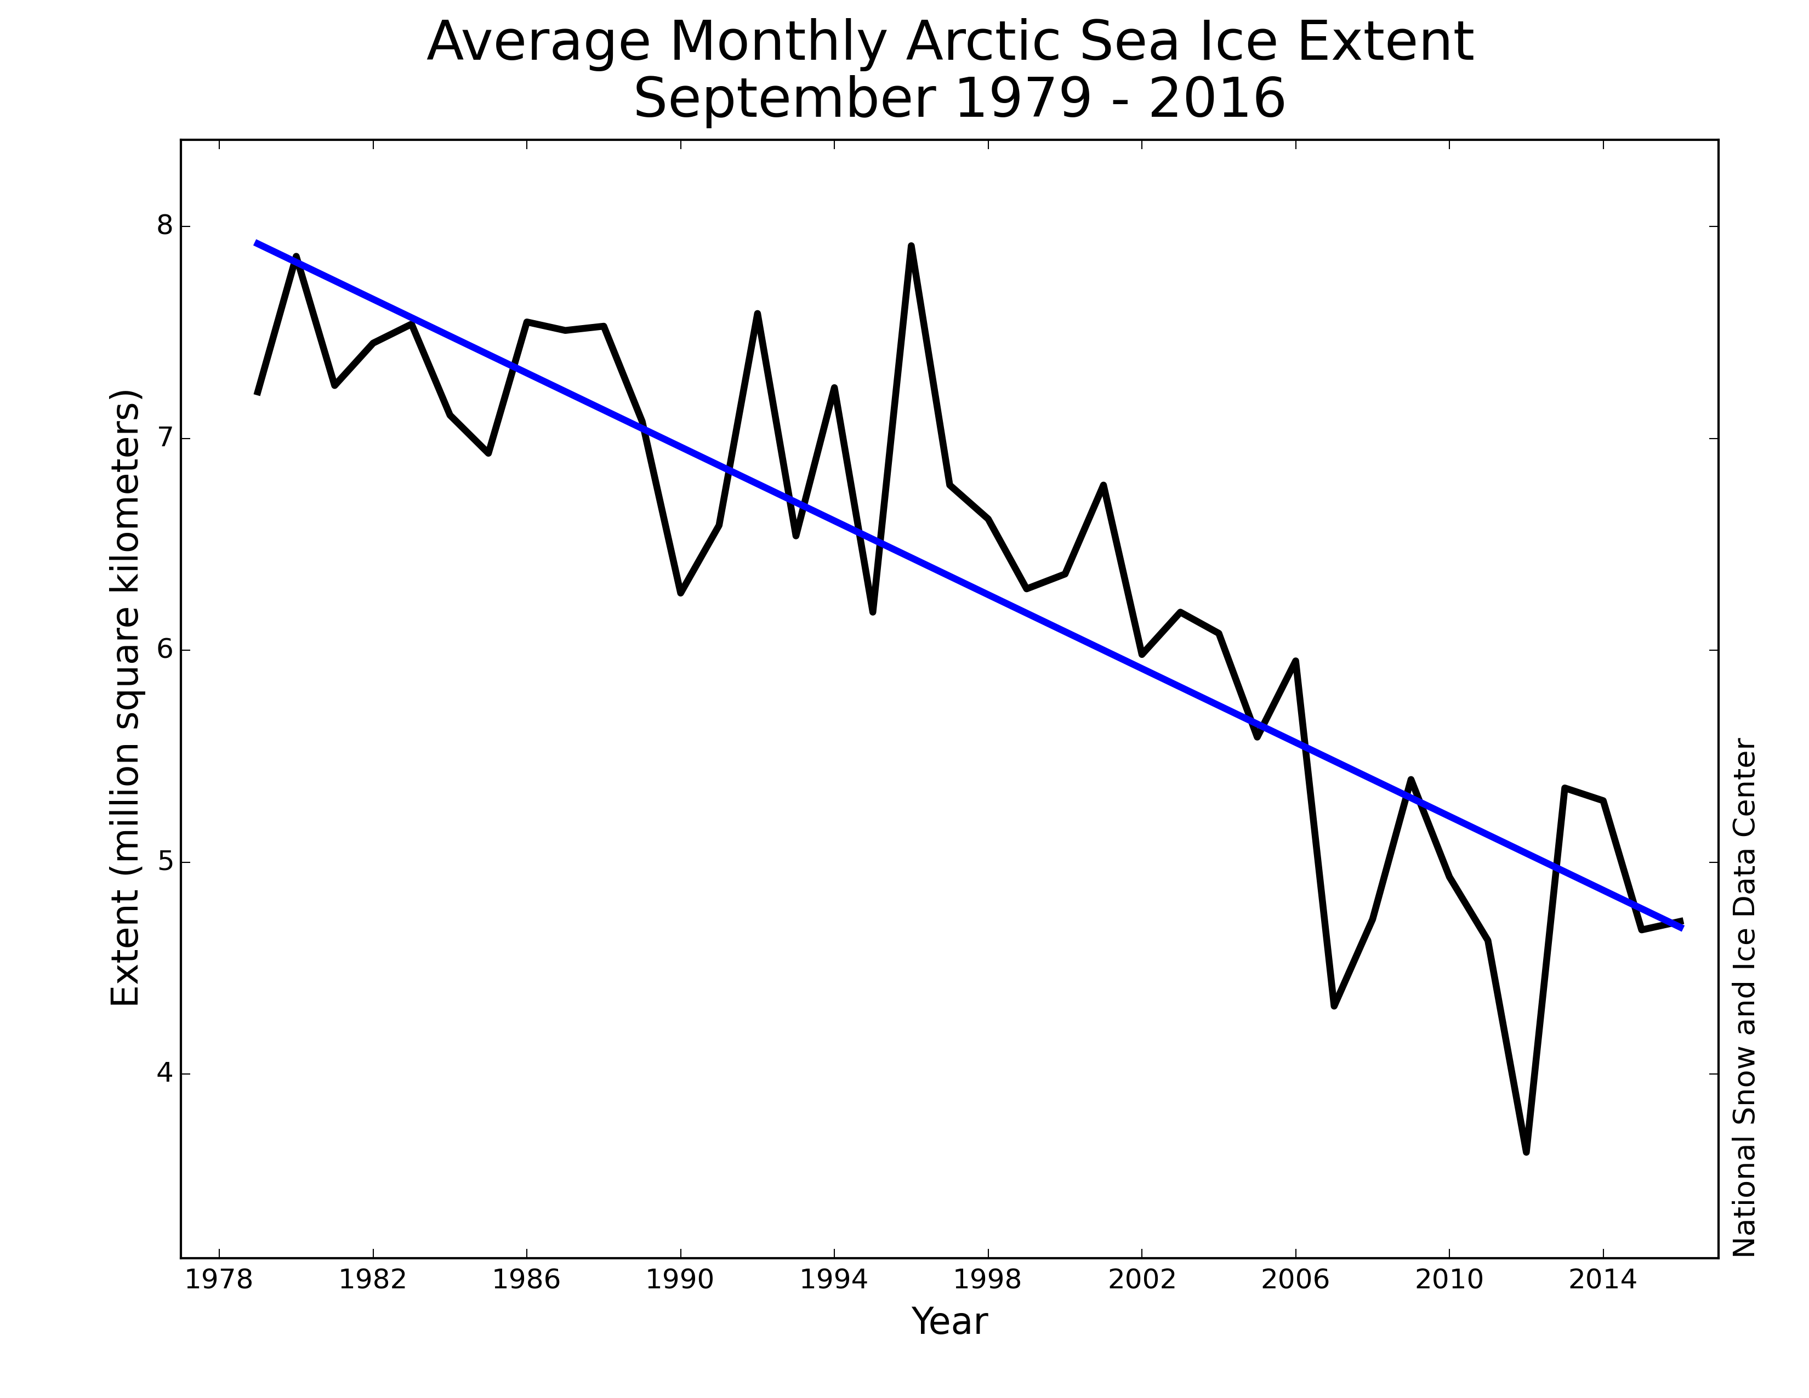
Sea Ice
Decline
September Arctic Sea Ice Extent
1979 - 2016
8
7
6
5
4
0.087 Mkm²/yr
Extent (Mkm²)
2007
2012
1980 1990 2000 2010 ²⁰¹⁶
Year

Slide 6
Ice Retreat ➔ Ocean Warming
2000
Russia
2001
2002
Steele et al. (GRL, 2008)
Alaska
2.5
Sept
sea
ice
1.5
0.5
Anomaly of Summer ≡ JAS
Sea Surface Temperature (°C)
Greenland
-0.5
(relative to 1982-2007 mean)
2003
2004
2005
-1.5
-2.5
2006
2007
SST: dOISST (AVHRR only)
Ice edge: 15% concentration (NASA Team1)
Notes:
1980s – 1990s: Warm, cool anomalies, nothing obviously spectacular (“ehh…”)
Early 2000s: some warm years, what I would have said were VERY warm until 2007!
2007: Crazy ass warming, obviously tied to ice retreat Too fast and too strong for Pacific Water to be major cause: it’s got to be mostly solar heating But we want to work with Perovich’s SASS group to better understand this

Slide 7
Ice Retreat ➔ Ocean Warming
2000
Russia
2001
2002
Steele et al. (GRL, 2008)
Alaska
2.5
Sept
sea
ice
1.5
0.5
Anomaly of Summer ≡ JAS
Sea Surface Temperature (°C)
Greenland
-0.5
(relative to 1982-2007 mean)
2003
2004
2005
-1.5
-2.5
Most of this is local solar input
Steele et al. JGR (2010)
2006
2007
Notes:
1980s – 1990s: Warm, cool anomalies, nothing obviously spectacular (“ehh…”)
Early 2000s: some warm years, what I would have said were VERY warm until 2007!
2007: Crazy ass warming, obviously tied to ice retreat Too fast and too strong for Pacific Water to be major cause: it’s got to be mostly solar heating But we want to work with Perovich’s SASS group to better understand this

Slide 8
Ice Retreat ➔ Ocean Warming
2000
Russia
2001
2002
Steele et al. (GRL, 2008)
Alaska
2.5
Sept
sea
ice
1.5
0.5
Anomaly of Summer ≡ JAS
Sea Surface Temperature (°C)
Greenland
-0.5
(relative to 1982-2007 mean)
2003
2004
2005
-1.5
-2.5
Most of this is local solar input
Steele et al. JGR (2010)
2006
2007
Update…
Notes:
1980s – 1990s: Warm, cool anomalies, nothing obviously spectacular (“ehh…”)
Early 2000s: some warm years, what I would have said were VERY warm until 2007!
2007: Crazy ass warming, obviously tied to ice retreat Too fast and too strong for Pacific Water to be major cause: it’s got to be mostly solar heating But we want to work with Perovich’s SASS group to better understand this

Slide 9
Ice Retreat ➔ Ocean Warming
2000
Russia
2001
2002
Steele et al. (GRL, 2008)
Alaska
2.5
Sept
sea
ice
1.5
0.5
Anomaly of Summer ≡ JAS
Sea Surface Temperature (°C)
Greenland
-0.5
(relative to 1982-2007 mean)
2003
2004
2005
-1.5
-2.5
So what?
ecosystems
air-sea fluxes
sub-surface T_{max} layers (the “NSTM”)
ice-albedo fdbk
2006
2007
Steele et al.
(JGR, 2011)
Notes:
1980s – 1990s: Warm, cool anomalies, nothing obviously spectacular (“ehh…”)
Early 2000s: some warm years, what I would have said were VERY warm until 2007!
2007: Crazy ass warming, obviously tied to ice retreat Too fast and too strong for Pacific Water to be major cause: it’s got to be mostly solar heating But we want to work with Perovich’s SASS group to better understand this

Slide 10
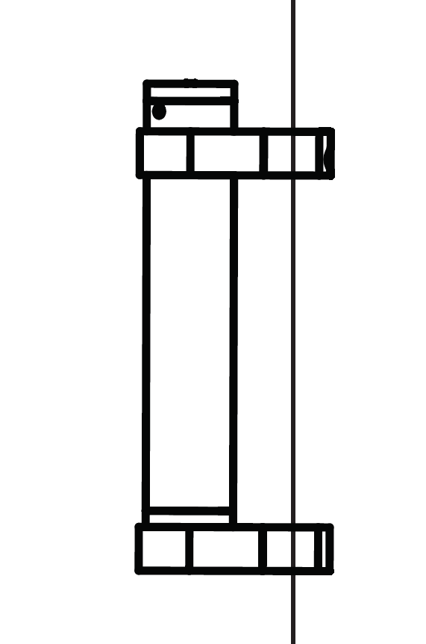
The UpTempO buoy
Upper Temperature of the polar Oceans
Steele et al. (J Tech, 2017)
submergence
Surface: SLP, SST, GPS, Iridium …[anemometer]
Cable: 12-16 x T (± 0.1°C), 3 x P (± 1 dbar) …[S]
60 m (basin) or 25 m (shelves)
, GPS
salt switch
SST
thermistors: ± 0.1°C
2.5, 5, 7.5, 10,
15, 20, 25, 30, 35
40, 50, 60 m depth
60 m
Euphotic Zone
pressure: ± 1 dbar
20, 40 m, 60 m depth

Slide 11
The UpTempO buoy
Upper Temperature of the polar Oceans
Steele et al. (J Tech, 2017)
submergence
Surface: SLP, SST, GPS, Iridium …[anemometer]
Cable: 12-16 x T (± 0.1°C), 3 x P (± 1 dbar) …[S]
60 m (basin) or 25 m (shelves)
Deploy: in ice or water by ship, ice camp, air
25 m long for shelves
, GPS
salt switch
SST
thermistors: ± 0.1°C
2.5, 5, 7.5, 10,
15, 20, 25, 30, 35
40, 50, 60 m depth
60 m
Euphotic Zone
March, 2011
August, 2011
pressure: ± 1 dbar
20, 40 m, 60 m depth
Google “uptempo arctic”

Slide 12
The UpTempO buoy
Upper Temperature of the polar Oceans
Steele et al. (J Tech, 2017)
submergence
Surface: SLP, SST, GPS, Iridium …[anemometer]
Cable: 12-16 x T (± 0.1°C), 3 x P (± 1 dbar) …[S]
60 m (basin) or 25 m (shelves)
Deploy: in ice or water by ship, ice camp, air
25 m long for shelves
, GPS
salt switch
SST
thermistors: ± 0.1°C
2.5, 5, 7.5, 10,
15, 20, 25, 30, 35
40, 50, 60 m depth
60 m
Euphotic Zone
March, 2011
August, 2011
pressure: ± 1 dbar
20, 40 m, 60 m depth
Castro, Wick, & Steele
Validation of satellite SST analyses in the Beaufort Sea using UpTempO buoys
Rem. Sens. of Environ, 2016

Slide 13
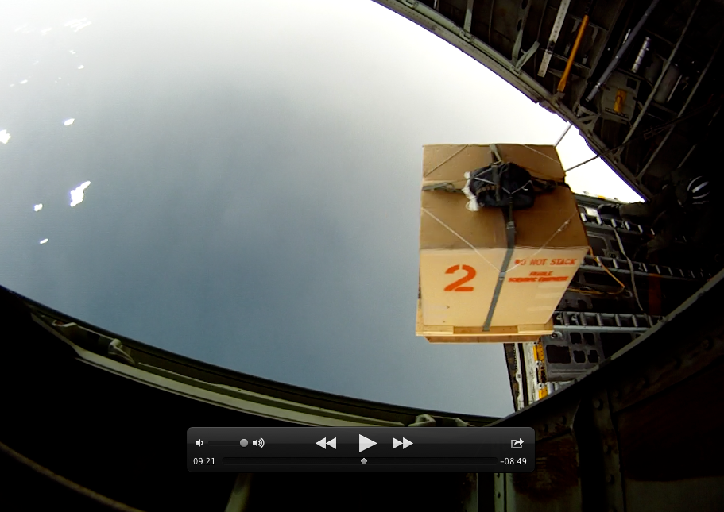
Deployment by C130 aircraft
(a)
parachute
buoy
box
pallet
salt blocks

Slide 14
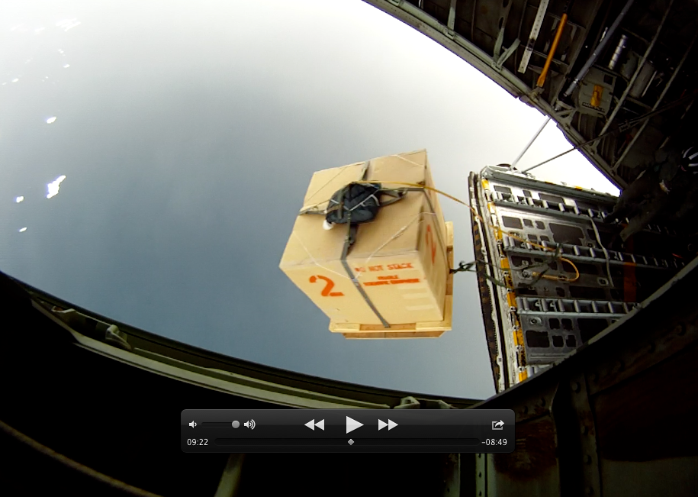
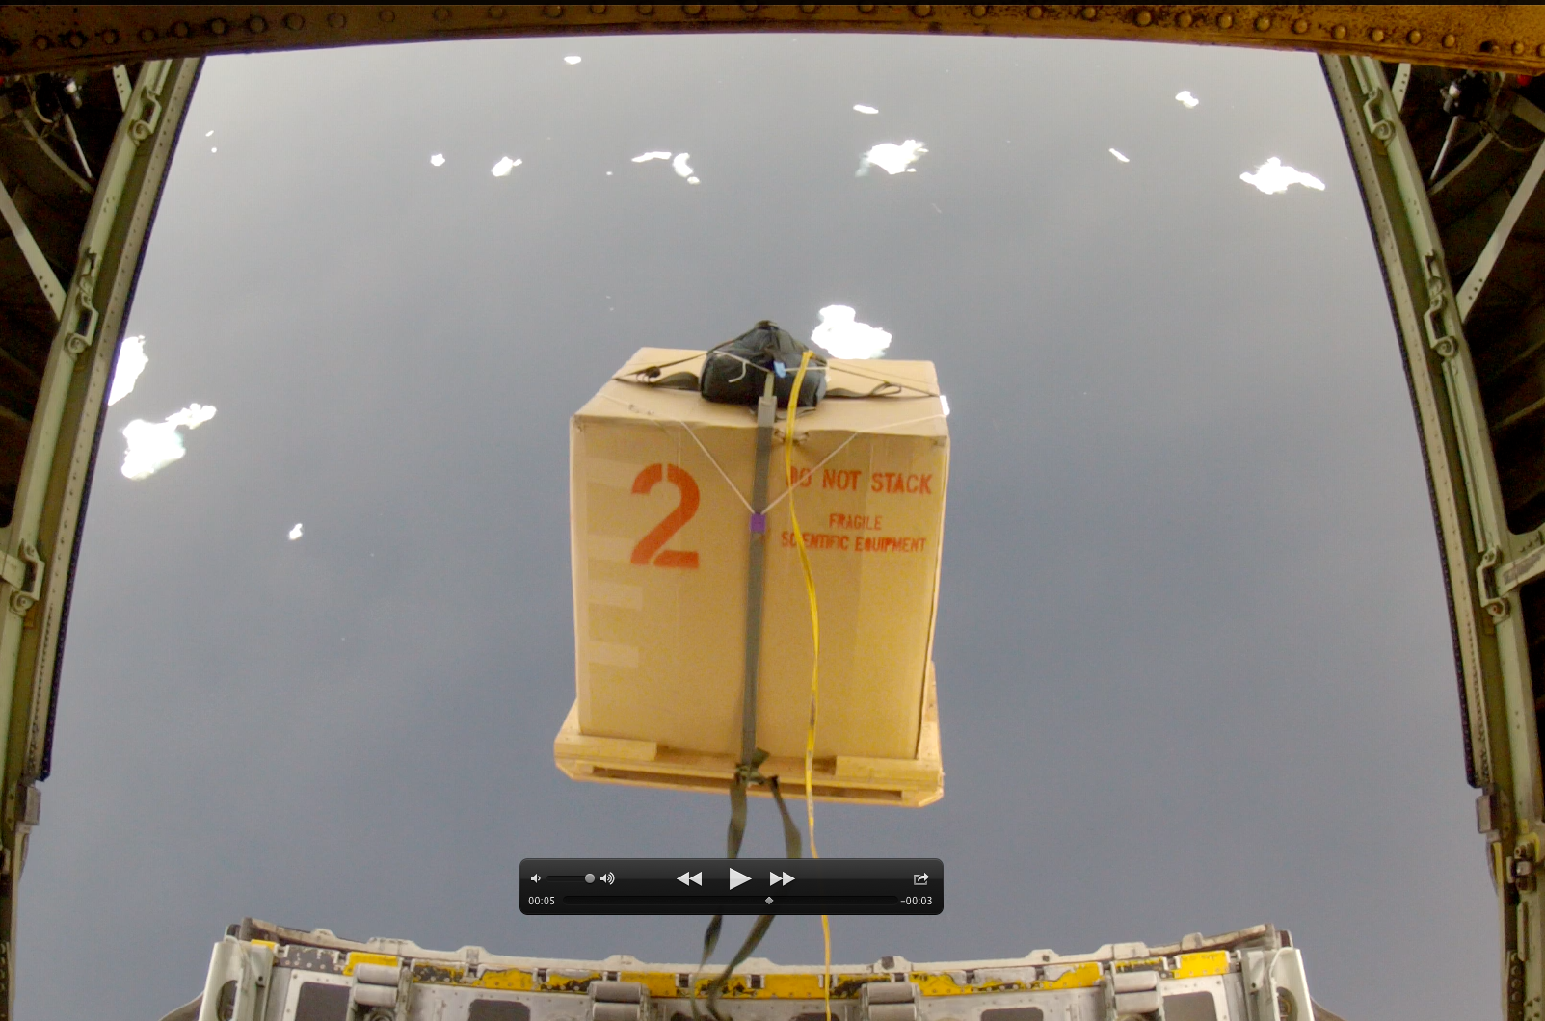
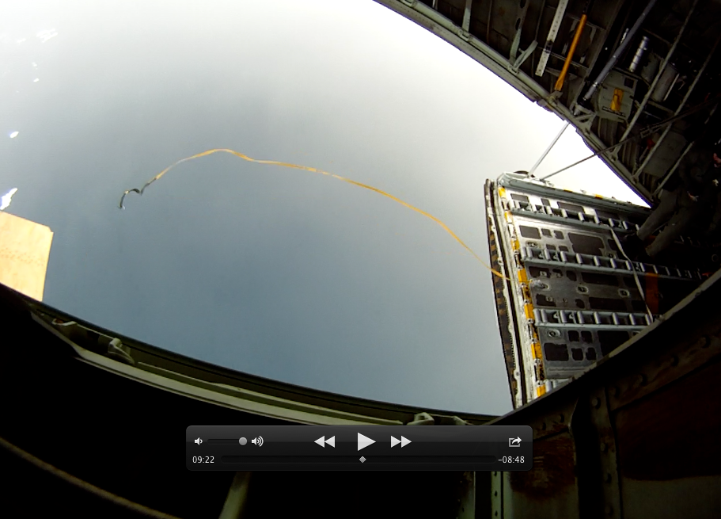
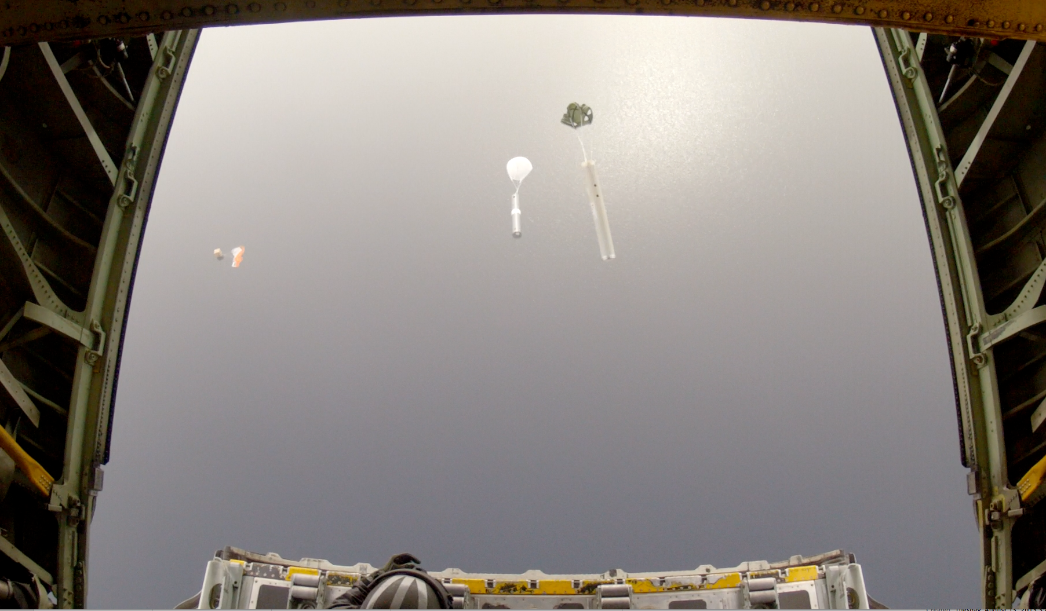
Deployment by C130 aircraft
(a)
(b)
(c)
parachute
parachute
buoy
box
straps
pallet
static line
salt blocks
(d)
(e)
(f)
static line
parachute
buoy
buoy
expendable
profilers

Slide 15
Deployment by C130 aircraft
(a)
(b)
(c)
parachute
parachute
buoy
box
July 27, 2014
straps
pallet
static line
salt blocks
2014
(d)
(e)
(f)
static line
parachute
buoy
buoy
expendable
profilers
A way to deploy “early!”

Slide 16
Ice Retreat ➔ Ocean Warming
2000
Russia
2001
2002
Steele et al. (GRL, 2008)
Alaska
2.5
Sept
sea
ice
1.5
0.5
Anomaly of Summer ≡ JAS
Sea Surface Temperature (°C)
Greenland
-0.5
(relative to 1982-2007 mean)
2003
2004
2005
-1.5
-2.5
Most of this is local solar input
Steele et al. JGR (2010)
2006
2007
Notes:
1980s – 1990s: Warm, cool anomalies, nothing obviously spectacular (“ehh…”)
Early 2000s: some warm years, what I would have said were VERY warm until 2007!
2007: Crazy ass warming, obviously tied to ice retreat Too fast and too strong for Pacific Water to be major cause: it’s got to be mostly solar heating But we want to work with Perovich’s SASS group to better understand this

Slide 17
UpTempO + Optics:
The "WARM" buoy
WArming &
irRadiance Measurements
V. Hill, B. Light, M. Steele
Thermistors
OCR
Licor PAR
LICOR PAR
ECO
0.5 m
1.0 m
5.0 m
Satlantic OCR 412, 443, 555nm
Wetlabs ECO, Chl, FDOM, bb532
Thermistor
7.5 m
10 m
15 m
20 m
upward-looking camera
Ballast, Pressure sensor
…& some to 50 m
Notes:
1980s – 1990s: Warm, cool anomalies, nothing obviously spectacular (“ehh…”)
Early 2000s: some warm years, what I would have said were VERY warm until 2007!
2007: Crazy ass warming, obviously tied to ice retreat Too fast and too strong for Pacific Water to be major cause: it’s got to be mostly solar heating But we want to work with Perovich’s SASS group to better understand this

Slide 18
UpTempO + Optics:
The "WARM" buoy
WArming &
irRadiance Measurements
V. Hill, B. Light, M. Steele
Thermistors
OCR
Licor PAR
LICOR PAR
ECO
0.5 m
1.0 m
5.0 m
Satlantic OCR 412, 443, 555nm
Wetlabs ECO, Chl, FDOM, bb532
Thermistor
7.5 m
10 m
warming ~ solar + advection
15 m
T ~ PAR + residual
20 m
upward-looking camera
Ballast, Pressure sensor
Steele et al. (JGR, 2017)
…& some to 50 m
Notes:
1980s – 1990s: Warm, cool anomalies, nothing obviously spectacular (“ehh…”)
Early 2000s: some warm years, what I would have said were VERY warm until 2007!
2007: Crazy ass warming, obviously tied to ice retreat Too fast and too strong for Pacific Water to be major cause: it’s got to be mostly solar heating But we want to work with Perovich’s SASS group to better understand this

Slide 19
Ice retreat + Ocean warming
Part 1: “Loitering”

Slide 20
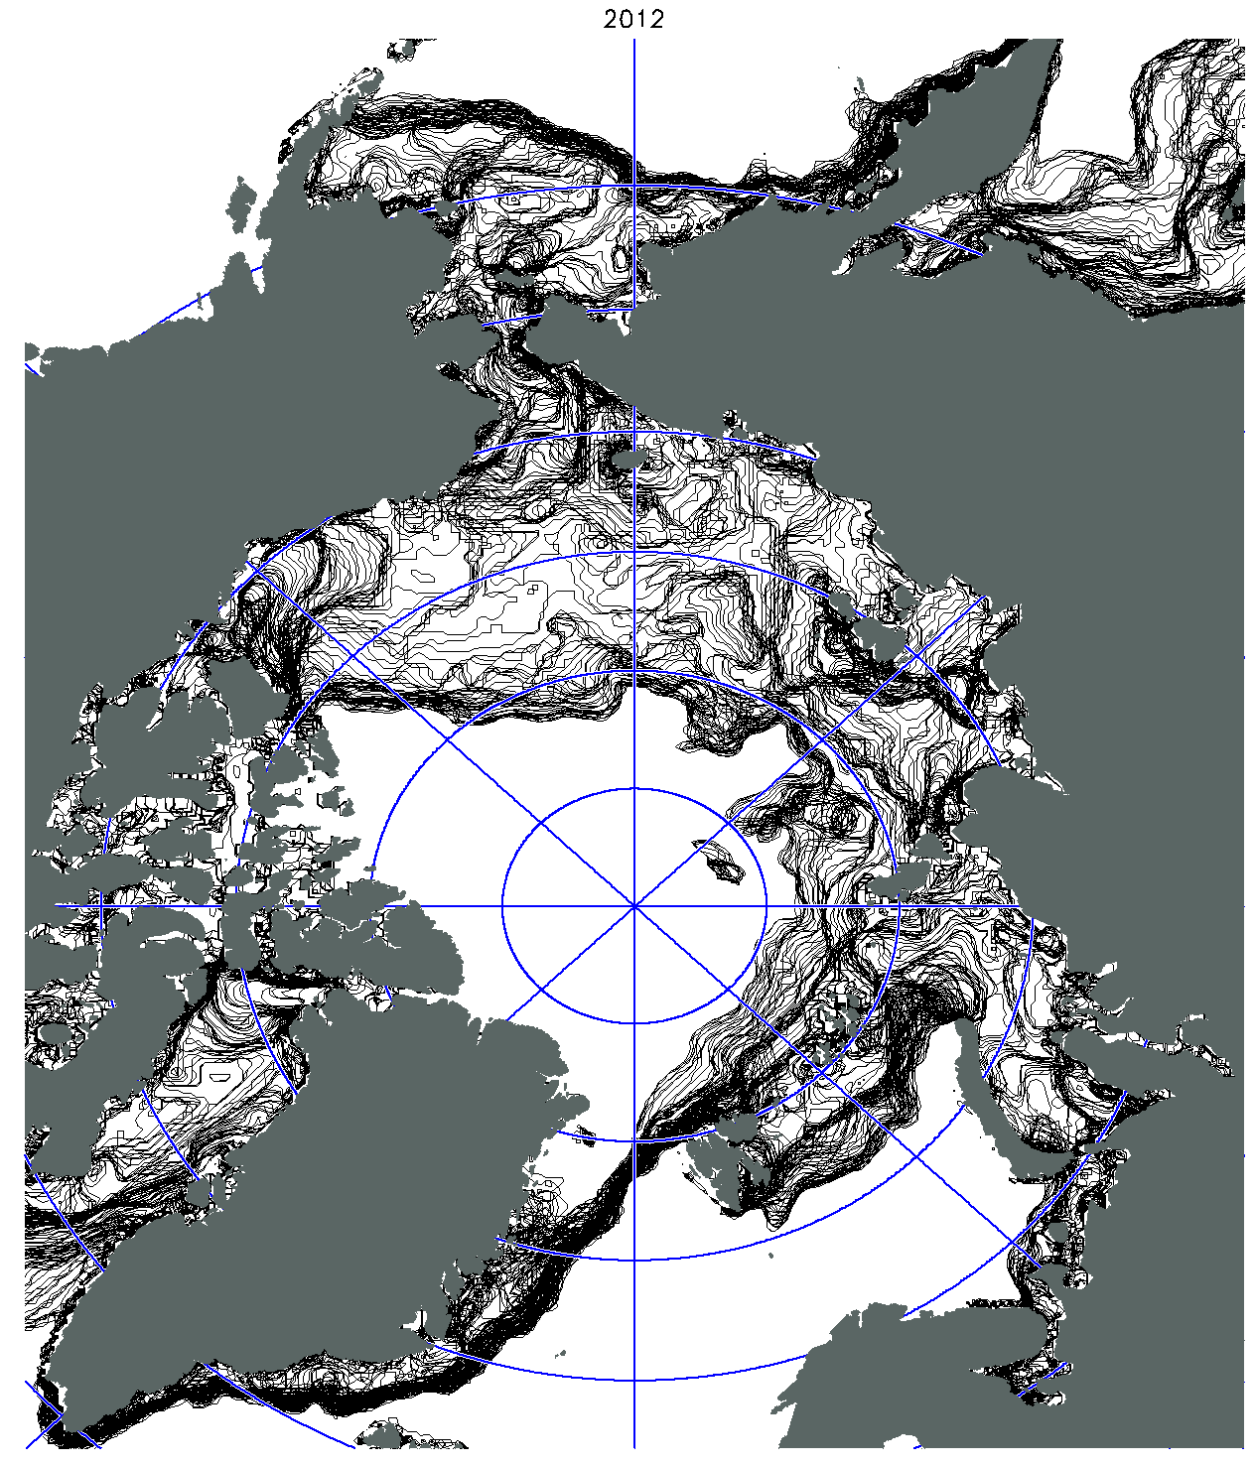
Daily ice retreat
winter
max
Steele & Ermold (JGR, 2015)
Daily 15% ice concentration contour
= "ice edge"
SSM/I-SSMIS (NASA Team algorithm)
Alaska
Russia
summer
min
180°E
Canada
90°W
90°E
85°N
0°E
80°N
Greenland
75°N
70°N
2012
March 13 – September 23
65°N

Slide 21
Daily ice retreat
winter
max
Steele & Ermold (JGR, 2015)
Daily 15% ice concentration contour
= "ice edge"
SSM/I-SSMIS (NASA Team algorithm)
Alaska
Seasonal Ice Zone (SIZ)
The "SIZ"
= Seasonal Ice Zone
= winter max to summer min
Russia
summer
min
180°E
A_{SIZ}
( Mkm² )
Canada
90°W
90°E
12
10
85°N
0°E
80°N
+0.05 Mkm²/year
Greenland
75°N
1990 1995 2000 2005 2010²⁰¹²
Year
70°N
2012
March 13 – September 23
65°N

Slide 22
Daily ice retreat
Steele & Ermold (JGR, 2015)
Daily 15% ice concentration contour
= "ice edge"
SSM/I-SSMIS (NASA Team algorithm)
Alaska
fast
Russia
180°E
Canada
90°W
90°E
85°N
0°E
80°N
Greenland
75°N
70°N
2012
March 13 – September 23
65°N

Slide 23
Daily ice retreat
Steele & Ermold (JGR, 2015)
Daily 15% ice concentration contour
= "ice edge"
SSM/I-SSMIS (NASA Team algorithm)
Alaska
slow
Russia
slow: “Loitering”
180°E
Canada
90°W
90°E
85°N
0°E
80°N
Greenland
75°N
70°N
2012
March 13 – September 23
65°N

Slide 24
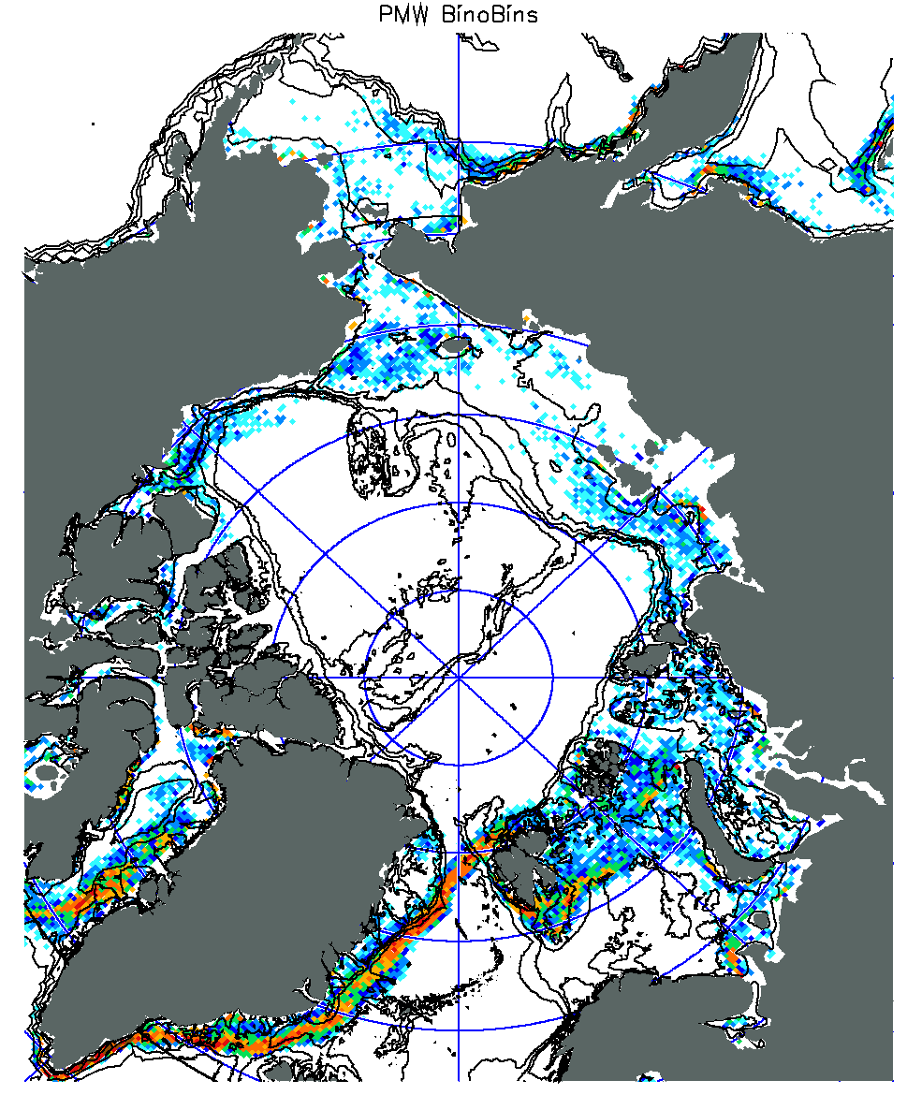
Space & Time Scales
1989-2013
SSMI/SSMIS
SSMI/SSMIS
(1989-2013)
not here
here
Alaska
Russia
180°E
Canada
90°W
90°E
85°N
80°N
0°E
Greenland
75°N
65°N
70°N
Europe
0.3 0.5 0.7 0.9
Loitering
Frequency F₄₊
Loitering covers
20-25% of the SIZ

Slide 25
Space & Time Scales
1989-2013
SSMI/SSMIS
SSMI/SSMIS
(1989-2013)
0.6
0.4
0.2
0
1.0
0.8
0.6
0.4
0.2
0
Alaska
Russia
180°E
N₄₊ / ΣN₄₊
Canada
90°W
90°E
85°N
80°N
0°E
(ΣN₄₊ = 5,802)
Greenland
75°N
5 10 15
65°N
70°N
T₄₊ (days)
Europe
80% of loitering
events last 4-7 days
0.3 0.5 0.7 0.9
Loitering
Frequency F₄₊
Loitering covers
20-25% of the SIZ
...synoptic storms...

Slide 26
Where does it loiter?
Alaska
Russia
Canada
Greenland
2012
Mar 13 – Sep 23
N. Baffin, E. Beaufort,
N. Chukchi, Laptev...

Slide 27
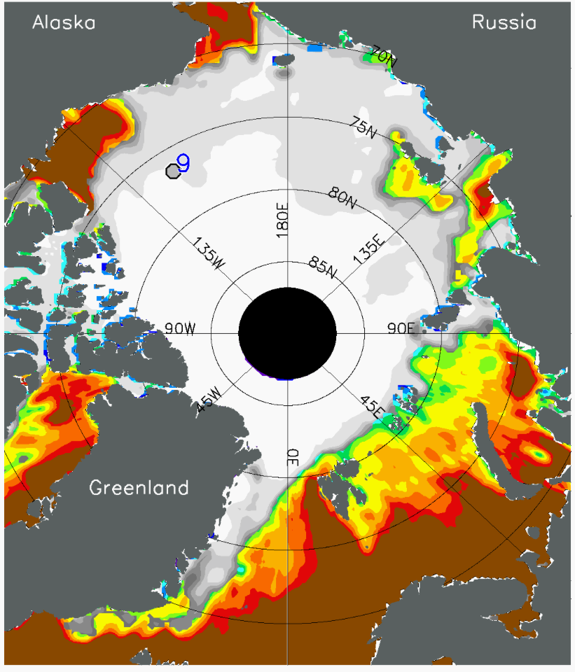
Where does it loiter?
Early ice retreat
⬇
early SST warming
⬇
loitering
Alaska
Russia
Canada
Greenland
2012
July 8
2012
Mar 13 – Sep 23
-2 -1 0 1 2 3 4 5
SST (°C)
(satellite data:
NOAA OI.v2
AVHRR)
N. Baffin, E. Beaufort,
N. Chukchi, Laptev...
0.2 0.3 0.4 0.5 0.75
ice conc.

Slide 28
Where does it loiter?
Why?
Early ice retreat
⬇
early SST warming
⬇
loitering
Steele et al. (JGR, 2015)
…for the Beaufort Sea
Alaska
Russia
Canada
Greenland
2012
July 8
2012
Mar 13 – Sep 23
-2 -1 0 1 2 3 4 5
SST (°C)
(satellite data:
NOAA OI.v2
AVHRR)
N. Baffin, E. Beaufort,
N. Chukchi, Laptev...
0.2 0.3 0.4 0.5 0.75
ice conc.

Slide 29
So why does it loiter?
Loitering:
wind + warm SST
ice
ice
edge
melt
melt
Off-ice
wind
melt
warm
Warm SST = 2.5°C above freezing
can melt ~ 35 cm/day

Slide 30
So why does it loiter?
The retreat season
Retreat
On-ice winds
Loitering
Off-ice winds + warm SST
Advance
Off-ice winds + cold SST
Loitering:
wind + warm SST
ice
ice
edge
melt
melt
Off-ice
wind
melt
warm
Warm SST = 2.5°C above freezing
can melt ~ 35 cm/day

Slide 31
So why does it loiter?
The retreat season
Retreat
On-ice winds
Loitering
Off-ice winds + warm SST
Advance
Off-ice winds + cold SST
Loitering:
wind + warm SST
ice
ice
edge
melt
melt
Off-ice
wind
melt
warm
Warm SST = 2.5°C above freezing
can melt ~ 35 cm/day
Ecosystem implications…

Slide 32
Ice retreat + Ocean warming
Part 2: “Phenology”
The study of seasonal relationships in ecosystem and climate components.

Slide 33
Ice retreat + Ocean warming
Part 2: “Phenology”
The study of seasonal relationships in ecosystem and climate components.

Slide 34
The study of seasonal relationships in ecosystem and climate components.
Atmos surf heat flux
Sea ice retreat
Ocean warming

Slide 35
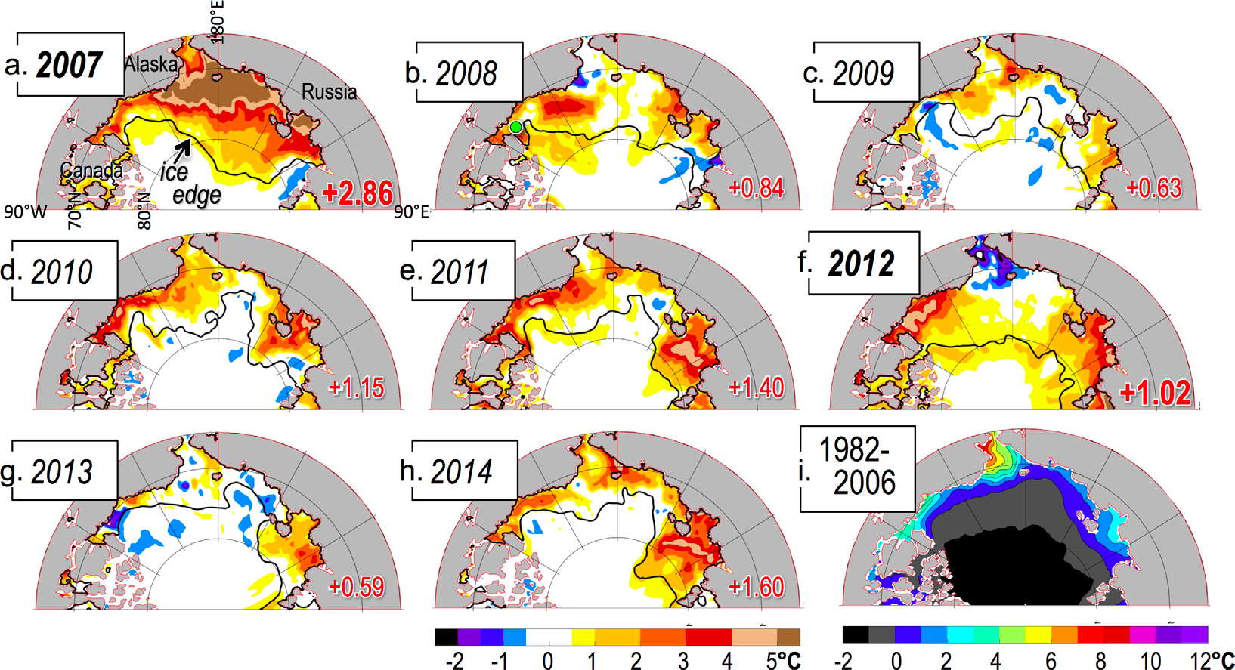
SST update!
Steele & Dickinson (JGR, 2016)
SST: dOISST (AVHRR only)
Ice edge: 15% concentration (NASA Team1)
Mostly warm

Slide 36
SST update!
Steele & Dickinson (JGR, 2016)
~ 3 times warmer!
SST: dOISST (AVHRR only)
Ice edge: 15% concentration (NASA Team1)

Slide 37
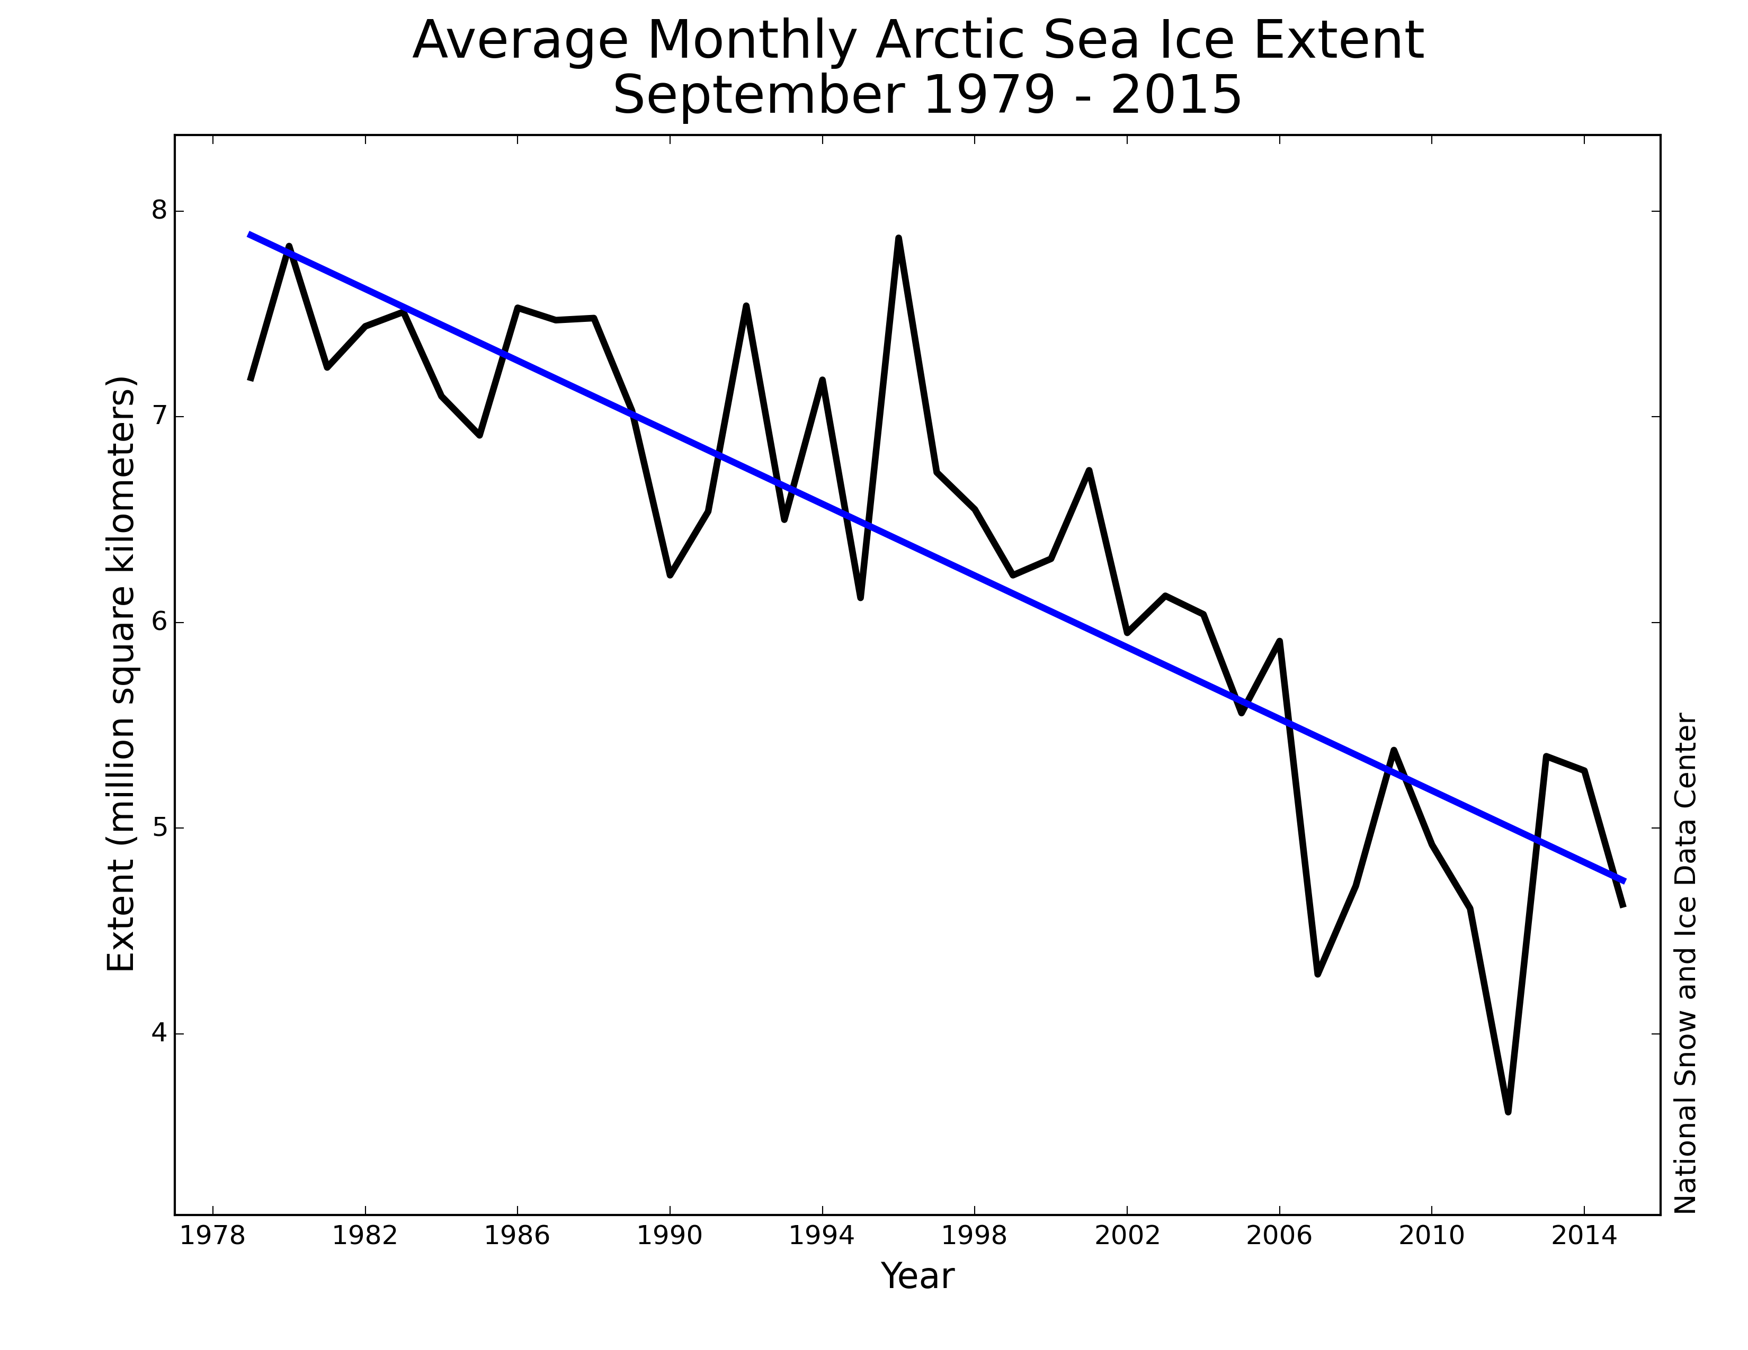
SST update!
Steele & Dickinson (JGR, 2016)
~ 3 times warmer!
Why?
8
7
6
5
4
Extent (Mkm²)
2007
2012
1980 1990 2000 2010 ²⁰¹⁴
SST: dOISST (AVHRR only)
Ice edge: 15% concentration (NASA Team1)

Slide 38
SST update!
Steele & Dickinson (JGR, 2016)
~ 3 times warmer!
Why?
Laptev
E. Beaufort
3 regions:
Chukchi
E. Beaufort + Laptev
Interior
SST: dOISST (AVHRR only)
Ice edge: 15% concentration (NASA Team1)

Slide 39
The “phenology” of SST warming
1982-2014
(NASA Team1 PMW 25 km)
ICE
Date of Opening
95%
Date of Retreat
15%

Slide 40
The “phenology” of SST warming
1982-2014
ICE
Date of Opening
Date of Retreat
(dOISST AVHRR 0.25°)
SST
Date of T_{max}
T_{max} ~ mid-late August

Slide 41
The “phenology” of SST warming
1982-2014
ICE
Date of Opening
Date of Retreat
SST
Date of T_{max}
(MERRA1)
Q_{net}
Q_{net} > 0
Date of Q_{net} > 0
Date of max Q_{net}
Date of Q_{net} < 0

Slide 42
The “phenology” of SST warming
1982-2014
Date of Retreat
DOR > DOQ
☞ Open water appears only after Q_{net} has started to decline!
Date of max Q_{net}

Slide 43
DOR vs. SSTmax
1982-2014
Date of Retreat
very
early
early
late
early
August 1

Slide 44
DOR vs. SSTmax
1982-2014
Date of Retreat
Early retreat ➔ warmer SSTmax
Also: variance, correlation

Slide 45
DOR vs. SSTmax
1982-2014
Date of Retreat
Early retreat ➔ warmer SSTmax
…but ONLY when DOR is near DOQ!!!
Date of max Q_{net}

Slide 46
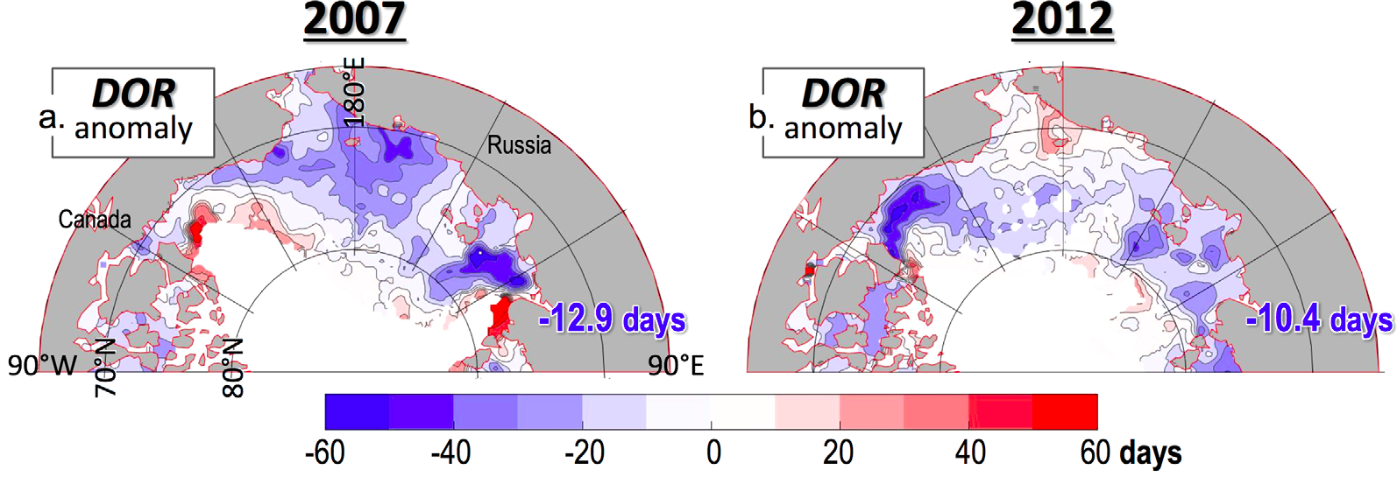
It’s about the timing of ice retreat
Early retreat
DOR ~ DOQ
(June/July)
“Early” retreat…but
DOR >> DOQ
(Aug/Sep)
Warm SSTs
Cold SSTs

Slide 47
US Agencies with Arctic Marine Interest
NSF: National Science Foundation
Office of Polar Programs, Arctic Section
…no deadlines
ANS: Arctic Natural Sciences disciplinary studies
ARCSS: ARCtic System Science interdisciplinary studies
…MOSAIC
…max 2 proposals at a time
AON: Arctic Observing Network climate observing
…commitment to long-term monitoring?
…pressure to save $$

Slide 48
US Agencies with Arctic Marine Interest
NSF: National Science Foundation
Office of Polar Programs, Arctic Section
…no deadlines
ANS: Arctic Natural Sciences disciplinary studies
ARCSS: ARCtic System Science interdisciplinary studies
…MOSAIC
…max 2 proposals at a time / scientist
AON: Arctic Observing Network climate observing

Slide 49
US Agencies with Arctic Marine Interest
NSF: National Science Foundation
Office of Polar Programs, Arctic Section
…no deadlines
ANS: Arctic Natural Sciences disciplinary studies
ARCSS: ARCtic System Science interdisciplinary studies
…MOSAIC
…max 2 proposals at a time
AON: Arctic Observing Network climate observing
…commitment to long-term monitoring?
…pressure to save $$

Slide 50
US Agencies with Arctic Marine Interest
NASA: National Air and Space Administration
Technology (developing the sensors/spacecraft)
I.T. (making data sets)
Science (using the data)

Slide 51
US Agencies with Arctic Marine Interest
NASA: National Air and Space Administration
Technology (developing the sensors/spacecraft)
I.T. (making data sets)
Science (using the data)
Cryosphere
…traditional home for arctic
Physical Oceanography
…recent interest in the arctic
Biology & biogeochemistry
…same
Etc.

Slide 52
US Agencies with Arctic Marine Interest
NASA: National Air and Space Administration
Technology (developing the sensors/spacecraft)
I.T. (making data sets)
Science (using the data)
Cryosphere
…traditional home for arctic
Physical Oceanography
…recent interest in the arctic
Biology & biogeochemistry
…same
Etc.

Slide 53
US Agencies with Arctic Marine Interest
ONR: Office of Naval Research
Arctic & Global Prediction program
☞ Physics of sea ice and upper ocean
…obs, models, remote sensing

Slide 54
US Agencies with Arctic Marine Interest
ONR: Office of Naval Research
Arctic & Global Prediction program
☞ Physics of sea ice and upper ocean
…obs, models, remote sensing
“Core”
…miscellaneous, including “SIZRS” = Seasonal Ice Zone Reconnaissance Surveys

Slide 55
US Agencies with Arctic Marine Interest
ONR: Office of Naval Research
Arctic & Global Prediction program
☞ Physics of sea ice and upper ocean
…obs, models, remote sensing
“Core”
…miscellaneous, including “SIZRS” = Seasonal Ice Zone Reconnaissance Surveys
DRIs: Directed Research Initiatives
…all in the Chukchi/Beaufort
…a series of ongoing field campaigns:
surface waves & floe models,
mixing,
autonomous sensing & observing networks

Slide 56
US Agencies with Arctic Marine Interest
NOAA: National Oceanographic & Atmospheric Administration
Arctic Program
Forecasting
Fisheries
…Alaskan waters only

Slide 57
US Agencies with Arctic Marine Interest
NOAA: National Oceanographic & Atmospheric Administration
Arctic Program
Forecasting
Fisheries
…Alaskan waters only
Mostly: government labs
Some: university funding
…New this year: Observing networks! ..and “fewer process studies”

Slide 58
US Agencies with Arctic Marine Interest
ETC.
DHS/CG: Dept of Homeland Security / Coast Guard
…coastal protection
BOEM: Bureau Of Energy Management
…oil, etc.
Summary:
Observing Networks
Prediction
Focus on Alaskan waters

Slide 59
Blue
Action!
The
League
Of
Climate
Superheroes

Slide 60
Blue
Action!
The
League
Of
Climate
Superheroes
Daniela
Steffen

Slide 61
Blue
Action!
The
League
Of
Climate
Superheroes
Thank
you
Daniela
Steffen

Slide 62
Daily ice retreat
Steele & Ermold (JGR, 2015)
Daily 15% ice concentration contour
= "ice edge"
SSM/I-SSMIS (NASA Team algorithm)
Alaska
slow
Russia
slow: “Loitering”
180°E
Loitering ice edge:
≤ 8 km/day*
≥ 4 days in a 25 km pixel
Canada
90°W
90°E
85°N
0°E
80°N
*Ave ice speed 8-12 km/day
Spreen et al. (GRL, 2011)
Olason & Notz (JGR, 2014)
Greenland
75°N
70°N
2012
March 13 – September 23
65°N

Slide 63
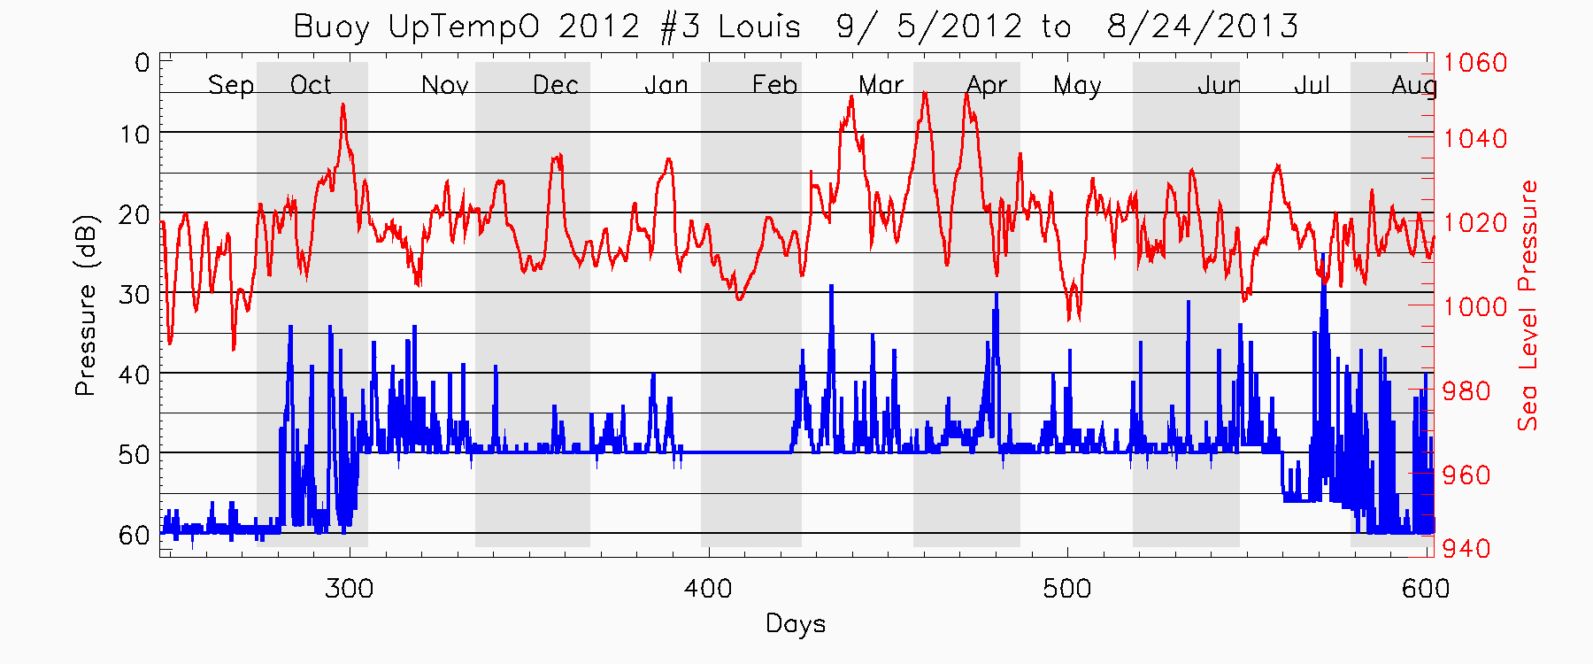
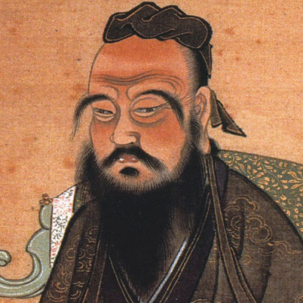
The UpTempO buoy
→ response to ice ridging ←
Confucius: “The green reed that bends in the wind is stronger than the mighty oak that breaks in a storm.”
pressure (dbar)
ice motion
ridging/rafting
upper T's < freezing
release

