Slide 1
Task 3.2 : Arctic warming impacts : role of air-sea coupling
CNRS, NERSC, MPI

Slide 2
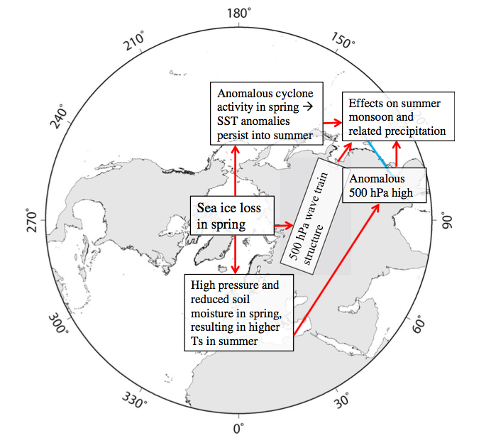
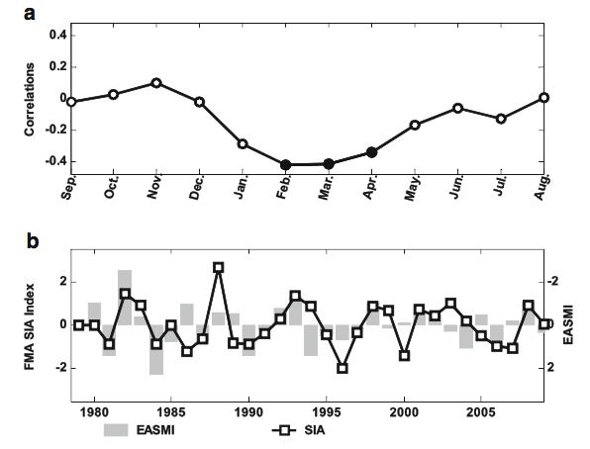
Link with Summer Asian Monsoon
Guo et al. 2014
Review of Vihma et al. 2014

Slide 3
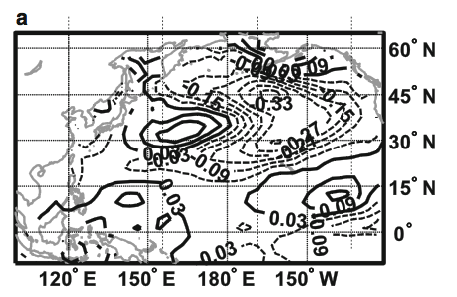
Mechanism brindging Arctic impacts in Northern Hemisphere
Through North Pacific SST?
SST changes in AOGCM caused by sea ice reduction prescibed in Arctic
Guo et al. 2014

Slide 4
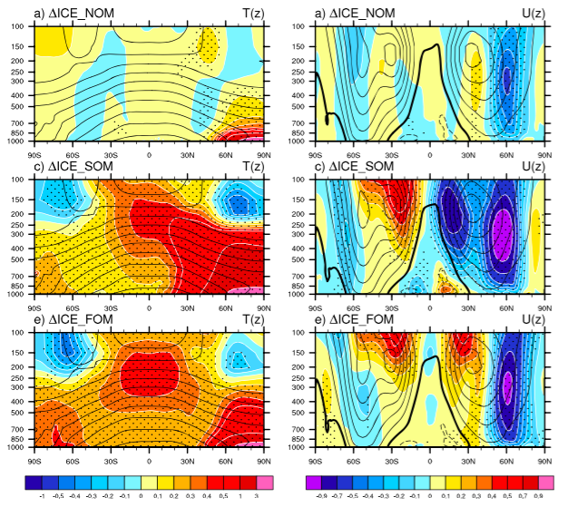
Coupled simulation at equilibrium where Arctic sea ice reduction is imposed
AGCM
Slab coupled to AGCM
Full AOGCM
Deser et al. 2016, GRL

Slide 5
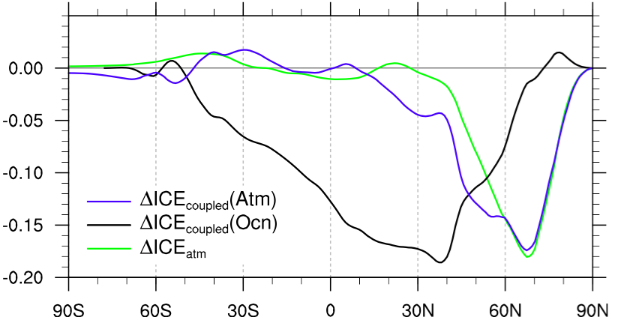
Merdional energy transport
Arctic warming -> albedo reduced in the North Pole -> less energy transported northward. With coupling feedbacks:
Ocean dynamical change : transport heat equatorward => mini global warming caused by equatorial warming and water vapor feedbacks.
Thermodynamical feedback => interhemispheric changes
AGCM
AOGCM
atm
AOGCM
oce
Deser et al. 2015

Slide 6
Outstanding question:
  Where do the coupled feedback occur? What are the relative importance of the Altantic and Pacific?
  What is the robustness of the coupled processes given the model uncertainties?
  What are the time adjustement and time scale for these feedbacks? Intra-seasonal? Decades?
  Description of work for Task 3.2 :
  The amplification/damping effect of active air-sea coupling in establishing the Arctic warming impact on the […] northern continents will be investigated using […] coordinated coupled model experiments. To represent the observed Arctic warming, we will restore the surface heat flux/sea surface temperature in the Arctic Ocean to the observations (AO-Exp1).
  The coordinated experiments will enable us to investigate the role of ocean-atmosphere coupling in amplifying or damping the Arctic warming impact [..] and in affecting the ocean circulation […].

Slide 7
Methods : AO-Exp1
Models/groups participating : NorESM, IPSL-CM6, MPI-ESM
External forcing from CMIP6.
Include a heating term in Arctic to melt to restore the sea-ice toward the observation :
- Prescribe a single pattern of Arctic warming based on obserations? Or observed SIC and SST daily/monthly variab?
- SST restoring as in Kug et al. (2015), relax time scale of 1 day?
- Include heat flux anomalies?
Ensemble size: 30 or more
Duration : 1979 to present

Slide 8
Description of work:
Additional experiments will distinguish between the role of the […] Atlantic and Pacific oceans by prescribing an AMO phase in the Atlantic (AO-Exp2) or an IPO phase in the Pacific (AO-Exp3) […].
Methods : AO-Exp2 and AO-Exp3
Models/groups participating : NorESM, IPSL-CM6, MPI-ESM
Same as AO-Exp1, but Atlantic and Pacific state imposed.

Slide 9
1st method:
Using Pacemaker experiment methodology.
Prescribed SST/SIC monthly/daily variab.
- Atlantic Pacemaker
- Pacific Pacemaker
-> nice for intra-seasonal variability and comparison with obs., but small signal.
2nd method:
Use a single ‘’warm Arctic’’ pattern.
Freeze SST in the Atl. or Pac. while Arctic warm (Atl. / Pac. Controls)
Using the idealized IPO and AMO pattern :
- AMO+ and AMO- including Arctic warming.
- IPO+ and IPO- including Arctic warming.
-> nice to study the AMO and IPO atmospheric impacts… But more idealized.

Slide 10
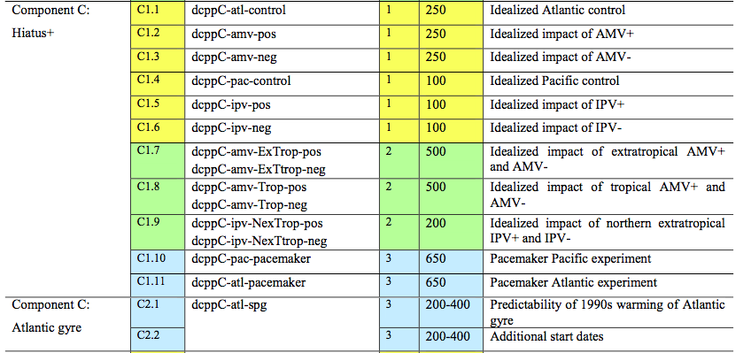
DCPP experiments
Boer et al. 2016, Geosci. Model Dev.

Slide 11
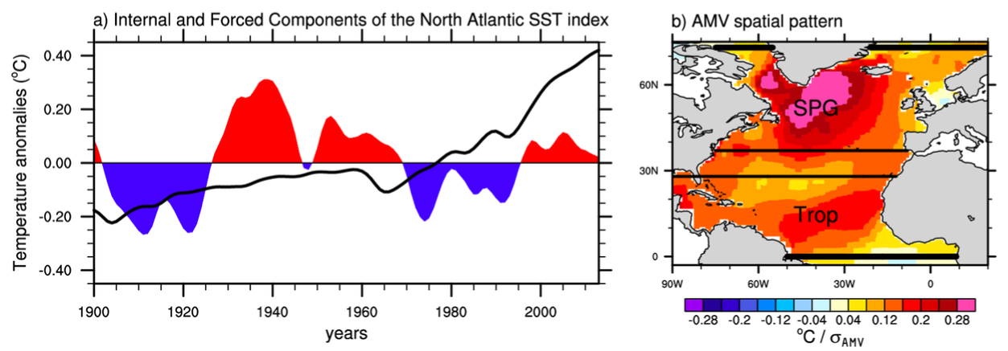
Idealized AMO pattern and time series
Ruprich-Robert et al. 2016, J. Clim.

Slide 12
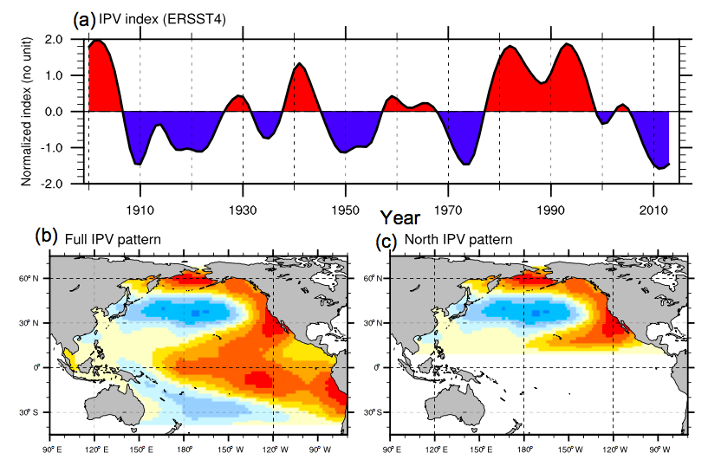
Idealized IPO time series
Boer et al. 2016, Geosci. Model Dev.

Slide 13
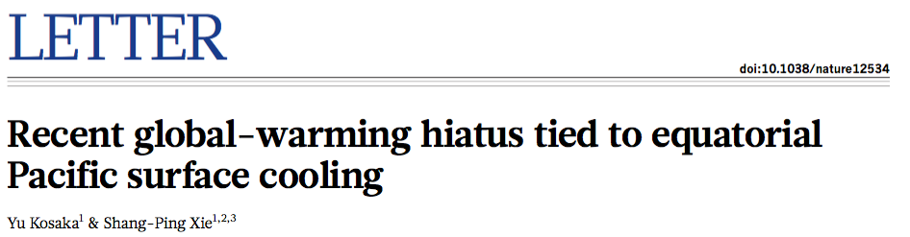
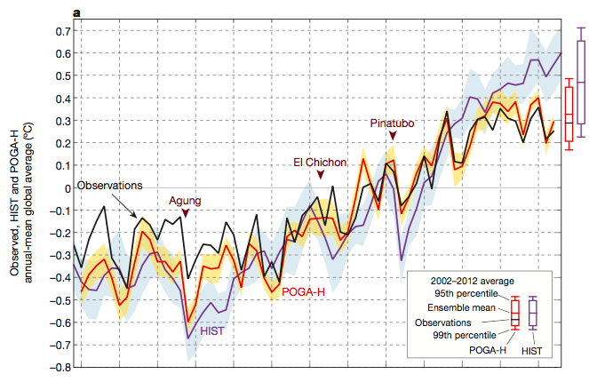
Pacemaker experiments

Slide 14
Deliverable
Deliverable D3.3
Role of ocean- atmosphere coupling in bridging the Arctic warming over lower latitudes
Lead: CNRS
Report, Public. Due date : Mth 36

Slide 15
Continental snow impacts
Compare snow impacts in coupled climate models and AGCM… GREENICE experiments

