Slide 1
Skillful Arctic climate predictions
Wilco Hazeleger
www.esciencecenter.nl

Slide 2
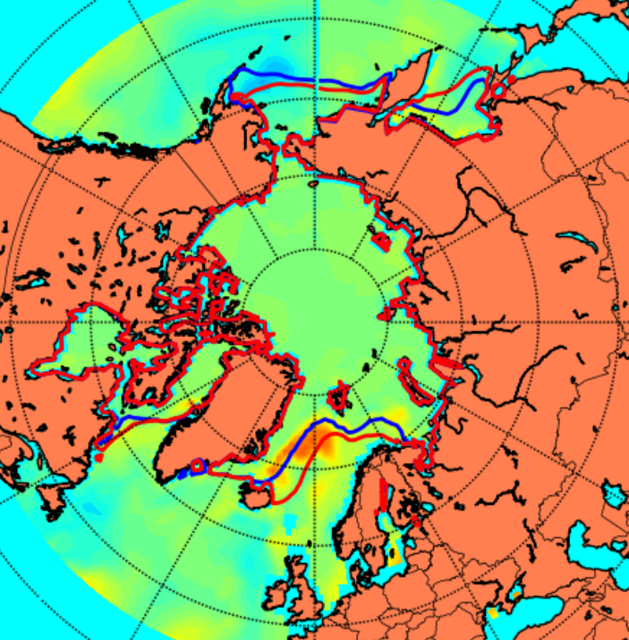
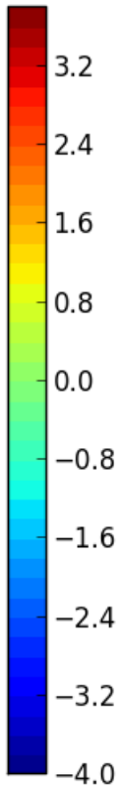
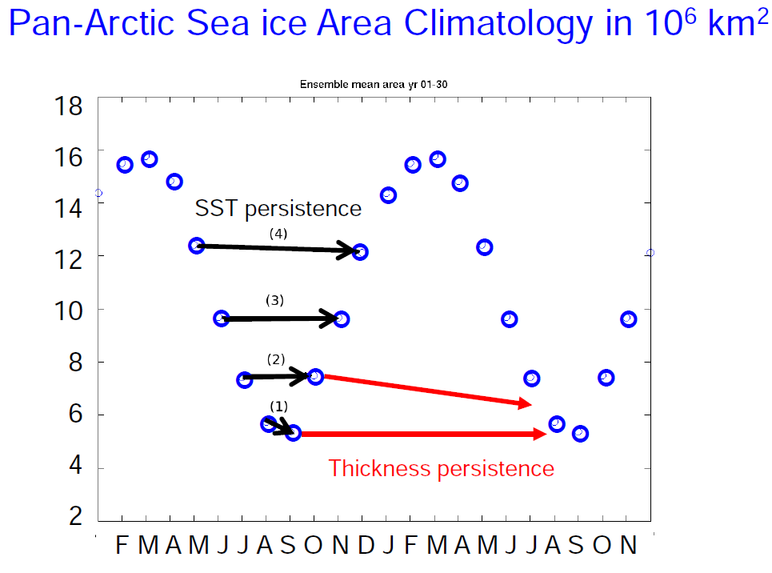
Surface ocean relates to sea ice variability
Results – Lagged correlation
SST anomaly December (K)
Climatology May sea ice edge
May sea ice edge
Cecilia Bitz

Slide 3
e-Folding time scale sea ice extent
Guemas et al 2016

Slide 4
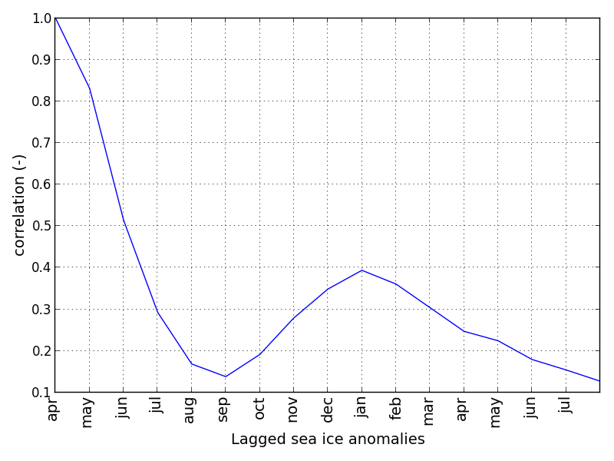
Persistence and re-emergence of sea ice extent (CMIP5 models)
Results – Lagged correlation
CMIP5 mean Arctic sea ice area lagged correlation
April sea ice lagged correlation
Cecilia Bitz
Krikken et al Journal of Climate 2015

Slide 5
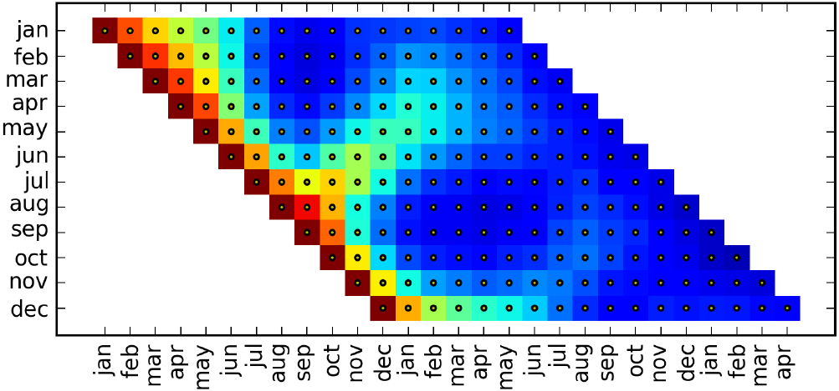

Persistence and re-emergence
Results – Lagged correlation
CMIP5 mean Arctic sea ice area lagged correlation
Blanchard-Wrigglesworth et al 2011
Day et al 2014
….
April sea ice anomaly lagged correlation
Cecilia Bitz
Krikken et al Journal of Climate 2015

Slide 6
Longer time scales
Ocean heat transport leads decadal variability
In Barents Sea by 15 yrs
Van der Linden et al Climate Dynamics 2016

Slide 7
Warmer upper ocean water masses advects into Arctic in warmer climate contributing to higher gyre heat transport (100-400m temperature)
van der Linden et al Climate Dynamics 2016

Slide 8
Mechanisms predictability
Persistence: 2-5 months (area) up to 12 months (thickness)
Re-emergence 2-12 months:
  Melt → growth season: SST persistence along edge
  Growth → melt season: thickness anomaly persistence
  (Blanchard-Wrigglesworth et al 2011 and later studies)
Meridional heat transport
  Atmosphere on weekly to seasonal scales
  Ocean on interannual to decadal time scales

Slide 9
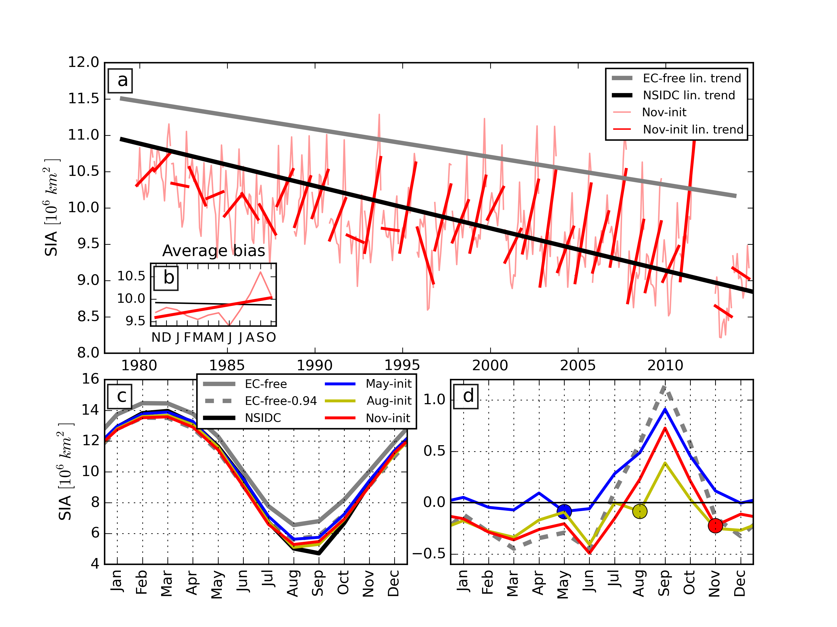
Initialised sea ice forecasts
Arctic sea ice area (SIA) trends and model drift
Krikken et al, GRL 2016

Slide 10
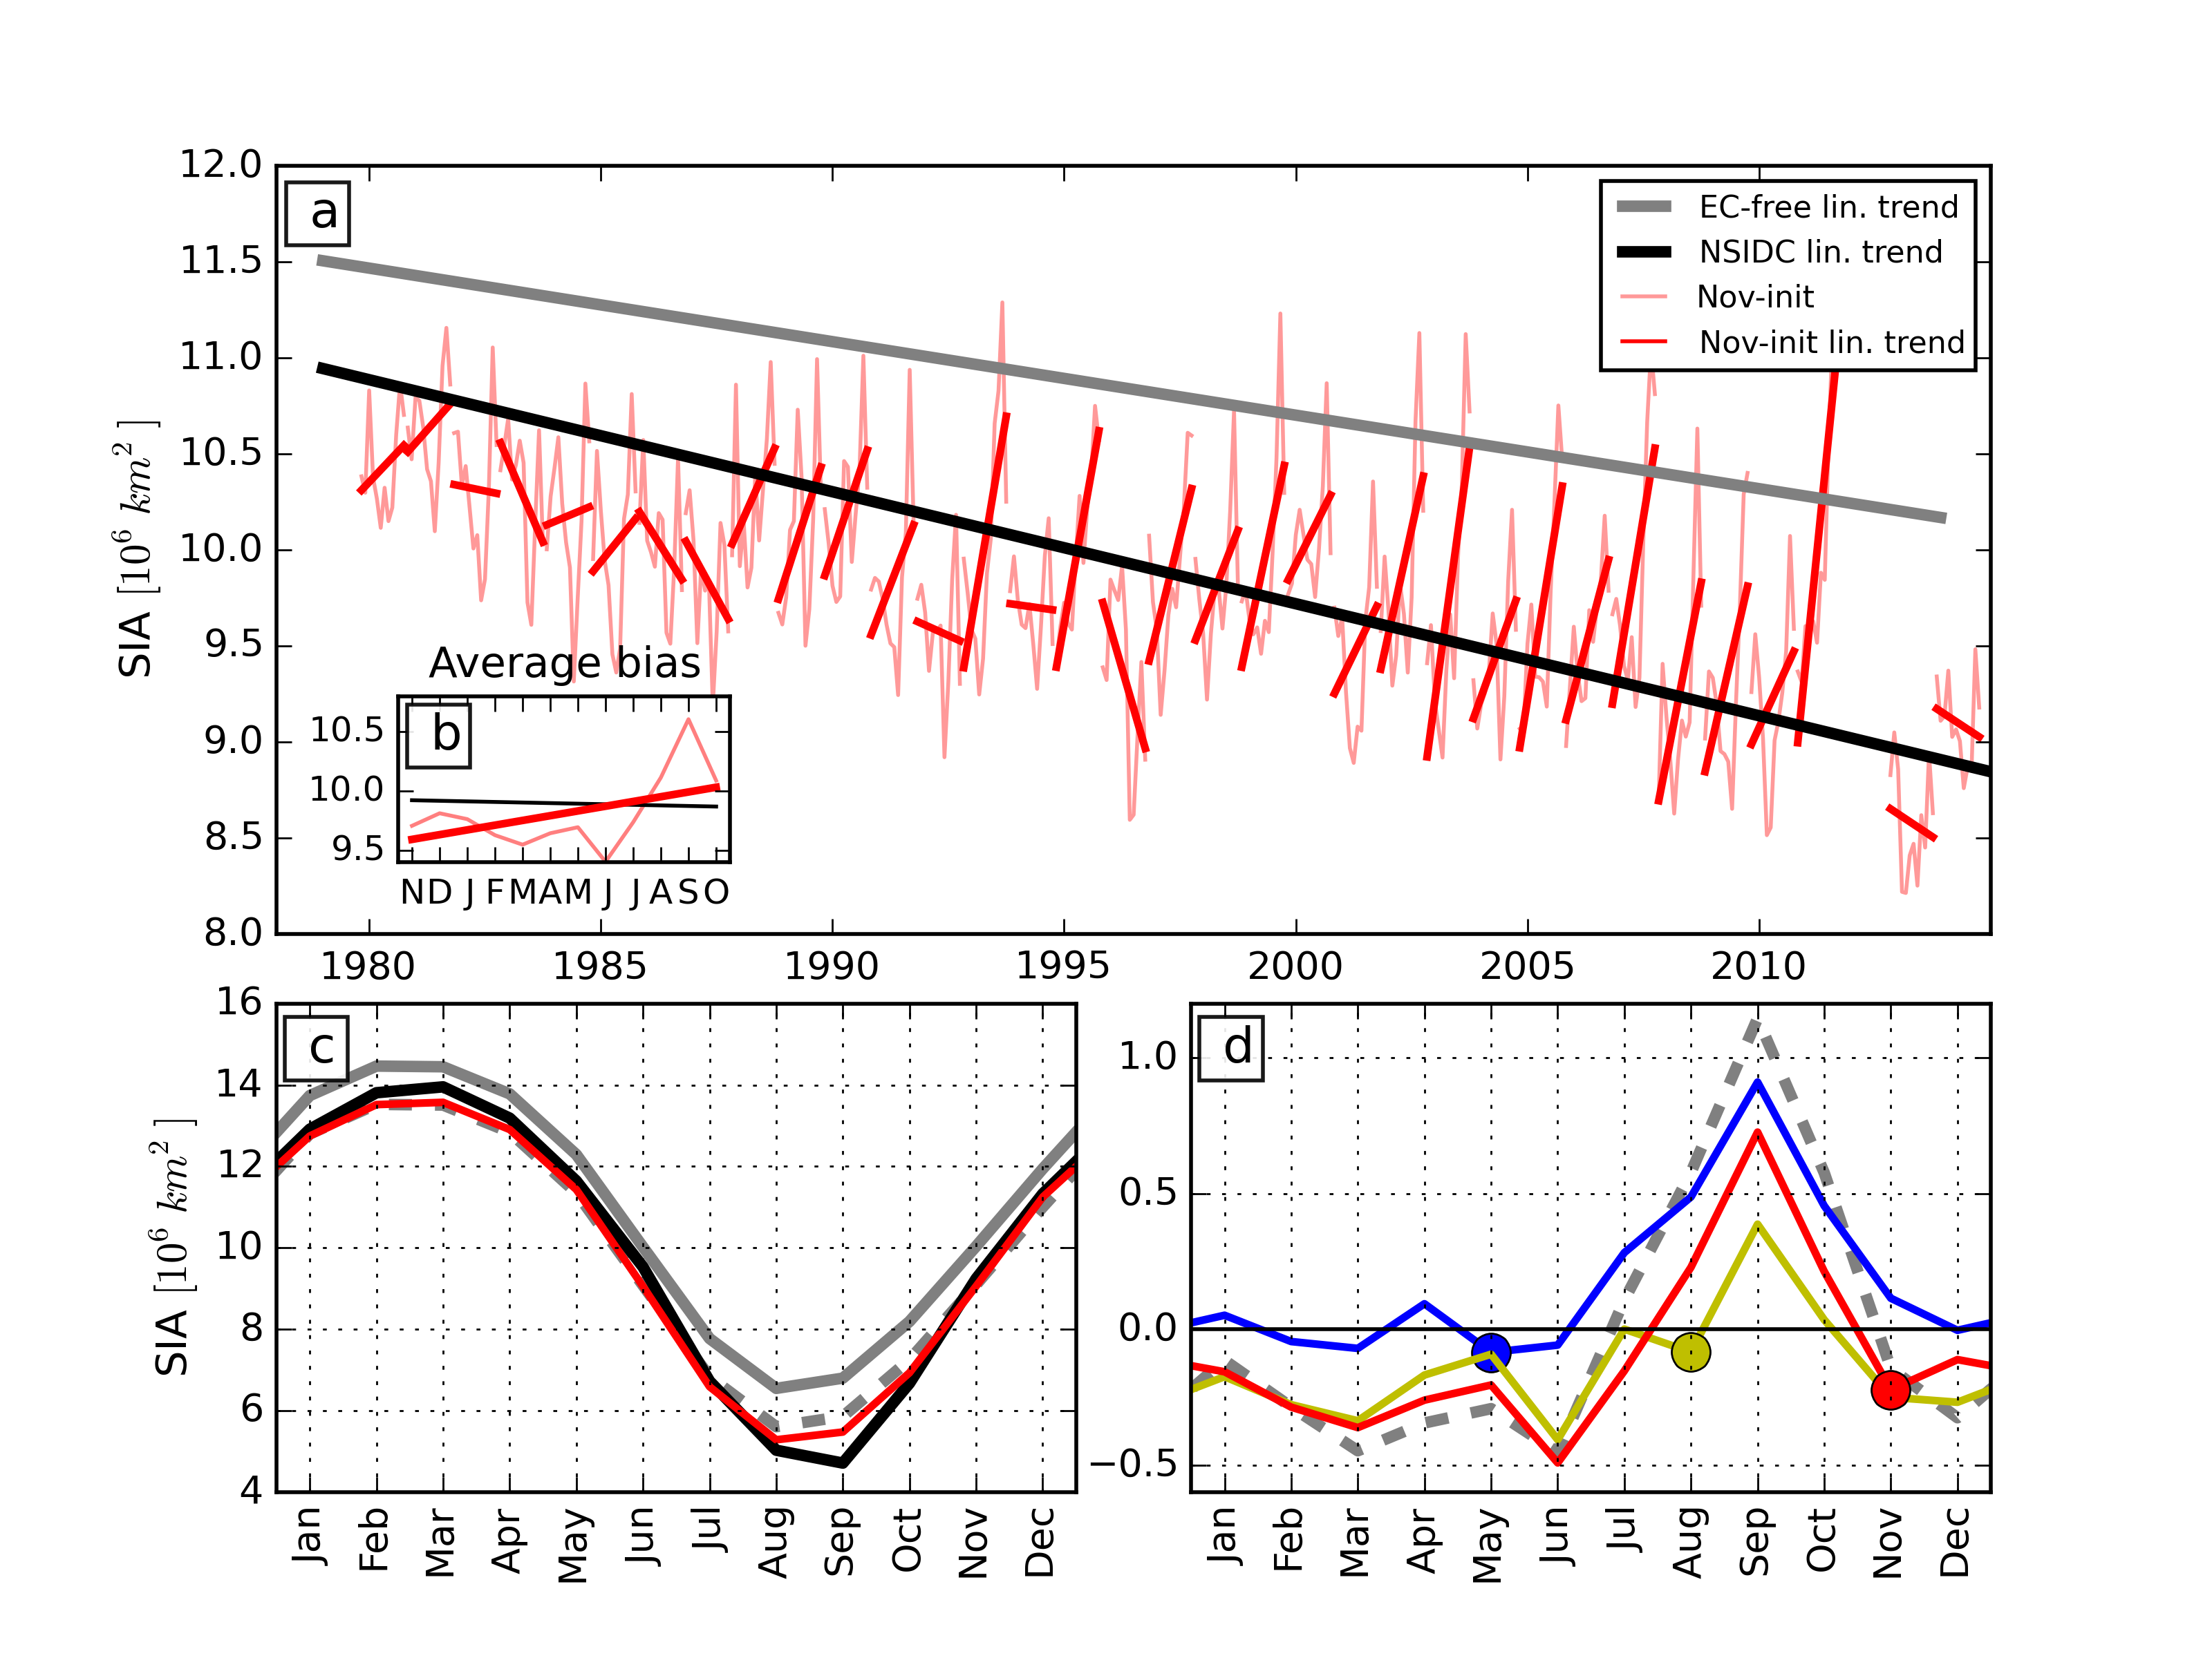
Biases in sea ice extent
Results – SIA seasonal cycle
EC-free
NSIDC
May init.
EC-free – 0.94
Nov init.
Aug init.
Krikken et al, GRL 2016

Slide 11
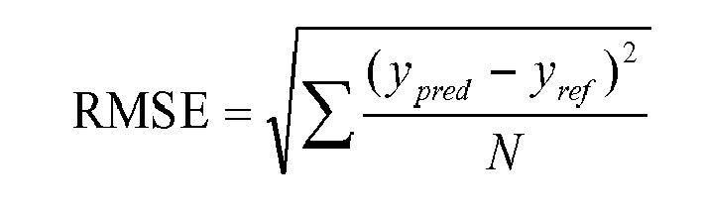
Metrics for forecast quality
Root mean square error
Continuous ranked probability score
  Cumulative distribution ensemble forecasts difference with observations
NB always compare to a simple statistical model (e.g. damped persistence, climatology); always cross validate!

Slide 12
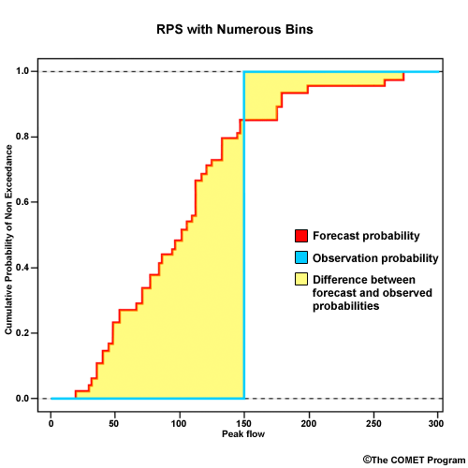
Continuous ranked probability skill score
1) CRPS is the summed difference (yellow) between the forecasted cumulative probability (red) and the observed cumulative probabity (blue).
2) CRPSS is the CRPS of a forecast relative to a reference forecast, e.g. climatology or enhanced persistence. Values >0 indicate better performance than reference forecast, <0 vice versa

Slide 13
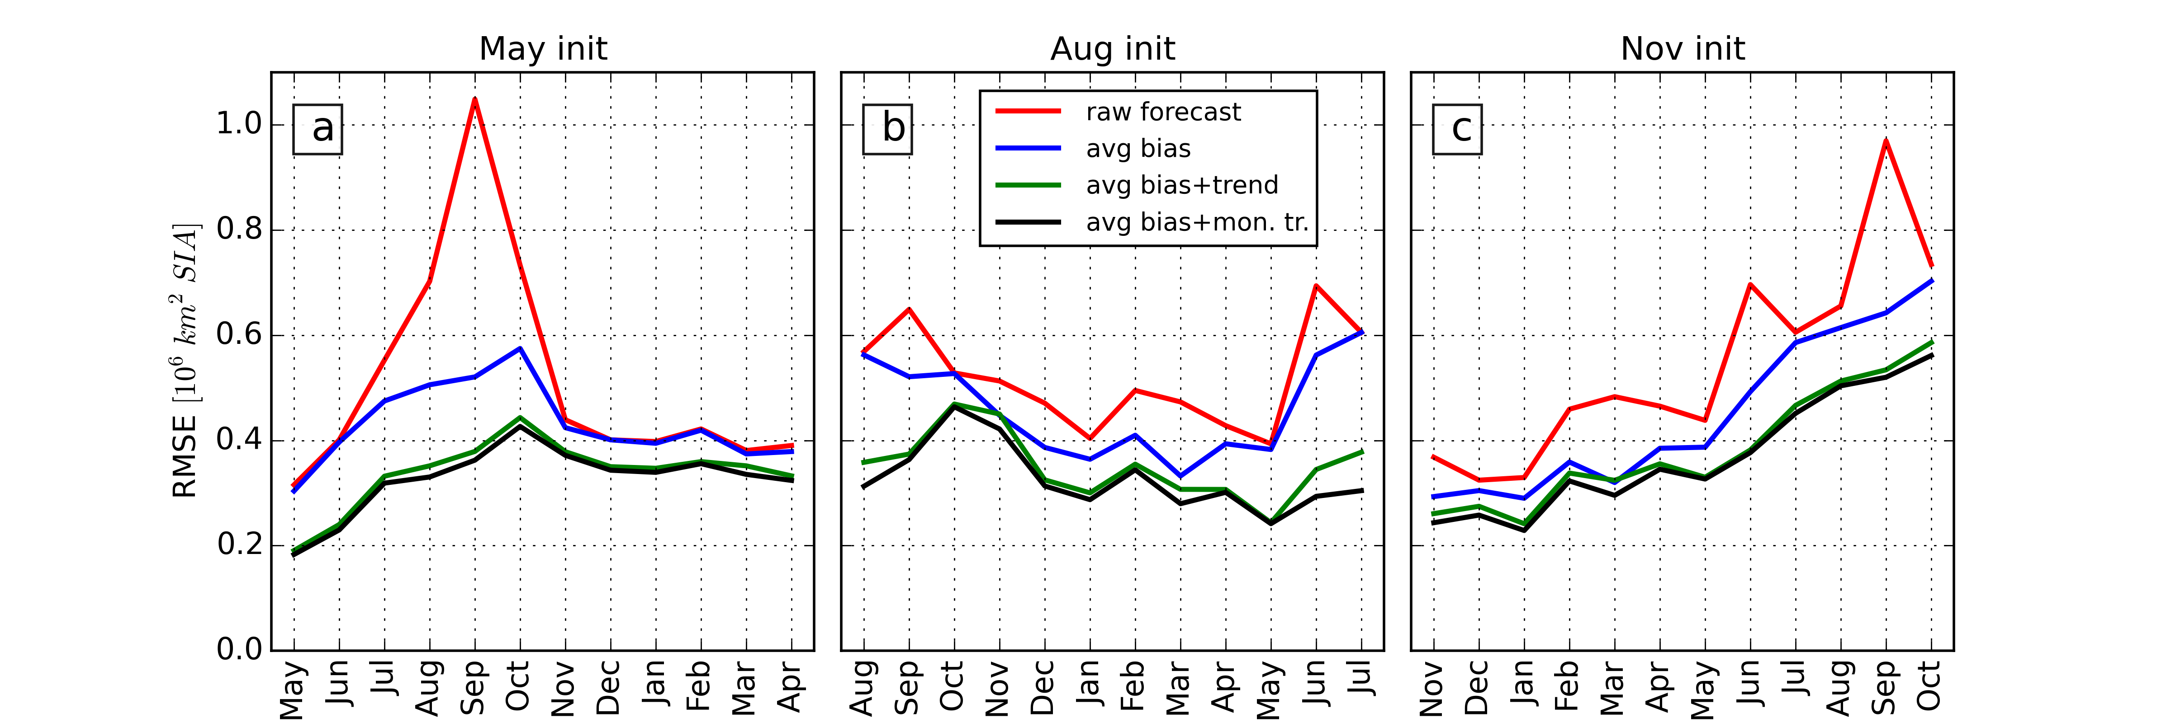
Bias correcting forecasts
RMSE total sea ice area; forecasts initialized in May
Raw forecast
Average bias correction
Avg bias + annual linear trend correction
Avg bias + monthly linear trend correction
Leadtime
Krikken et al, GRL 2016

Slide 14
Results – bias correction
RMSE total sea ice area - All initializations

Slide 15
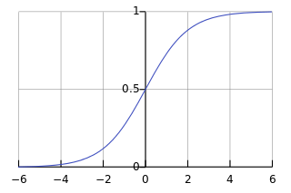
Forecast ensemble calibration
Extended logistic regression, ELR (Wilks, 2009); heteroscedastic ELR (Messner 2014)
σ = scale parameter - ensemble spread
σ = constant
Or
σ = a₃+X₃*a₄
μ = location parameter - ensemble mean
μ = a₀+X₁*a₁ + X₂*a₂

Slide 16
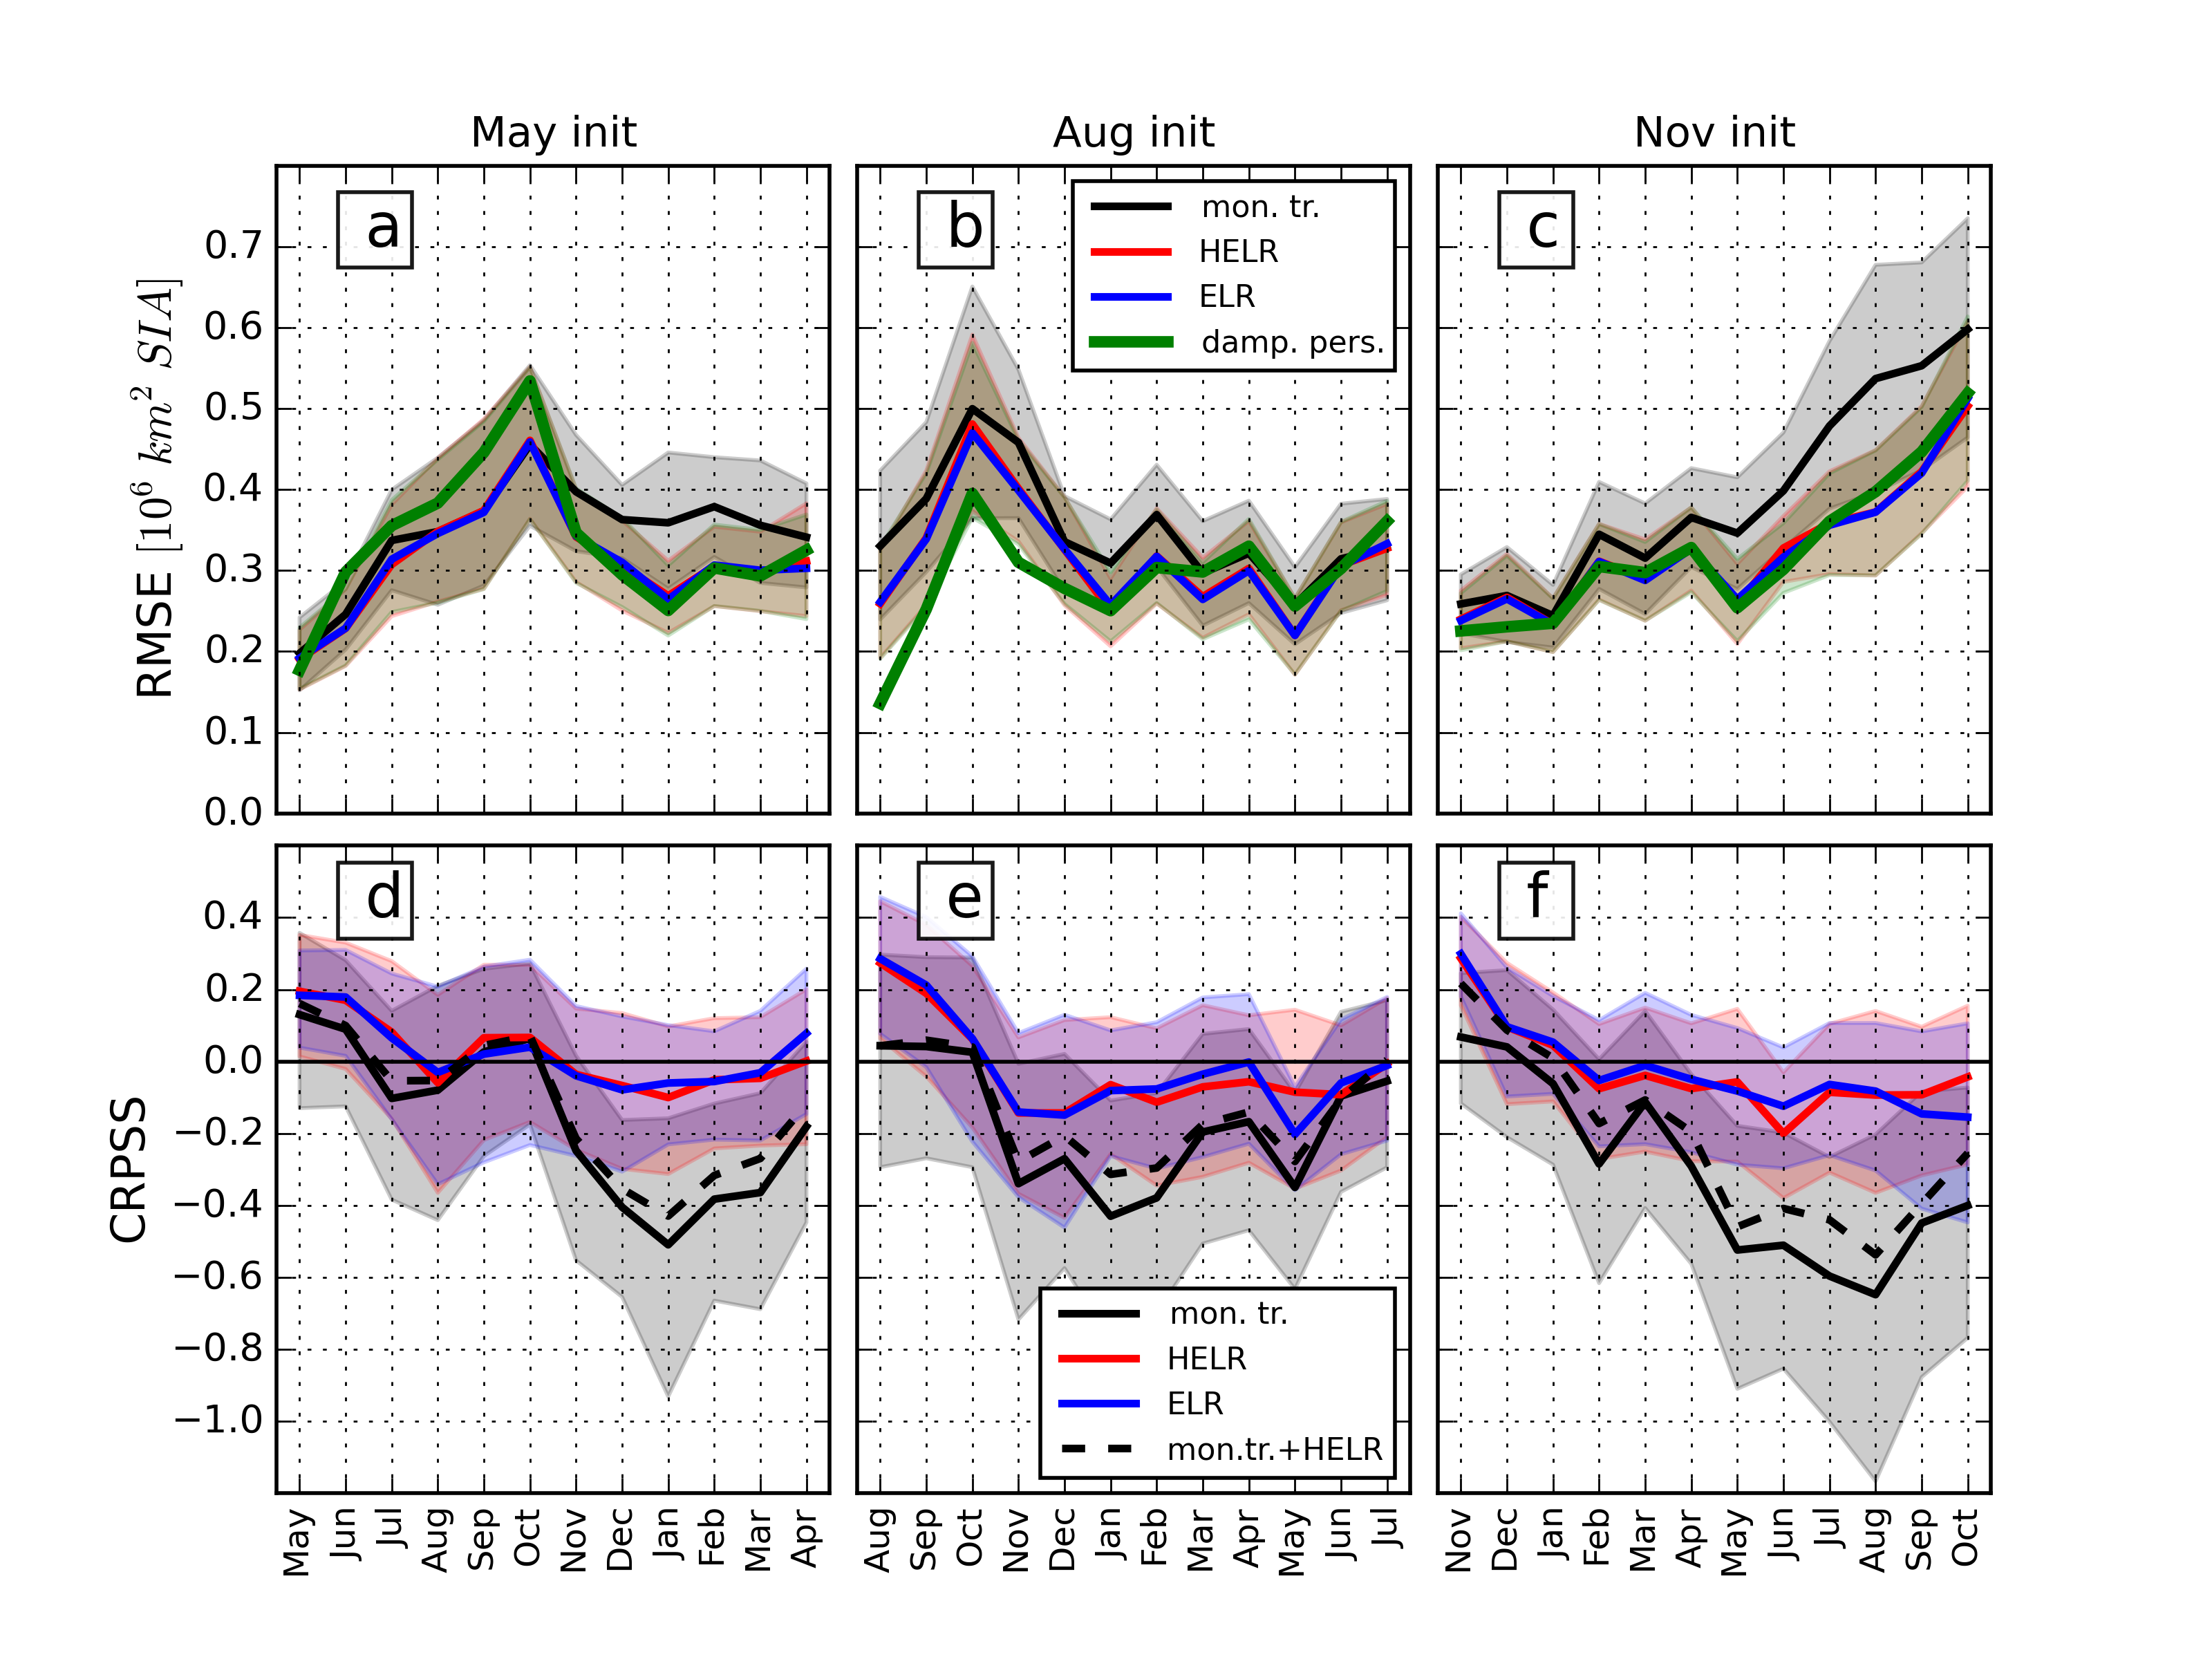
Skill scores Arctic wide
CRPSS – trend corrected climatology as reference
mon. trend corrected
Skill
ELR
HELR
No skill
mon. tr. + HELR

Slide 17
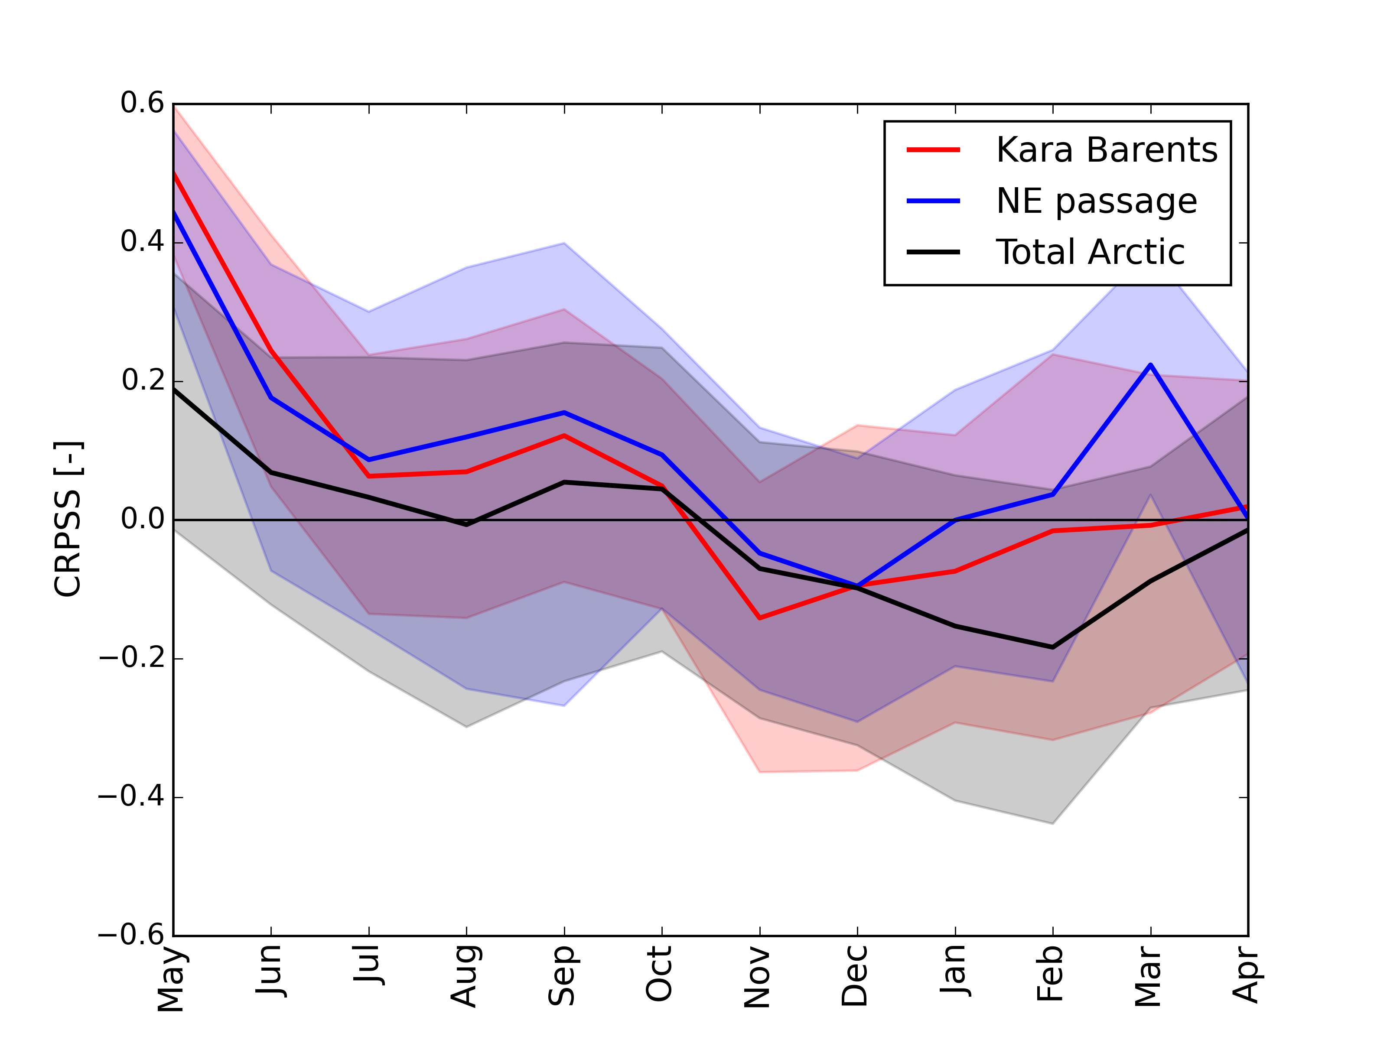
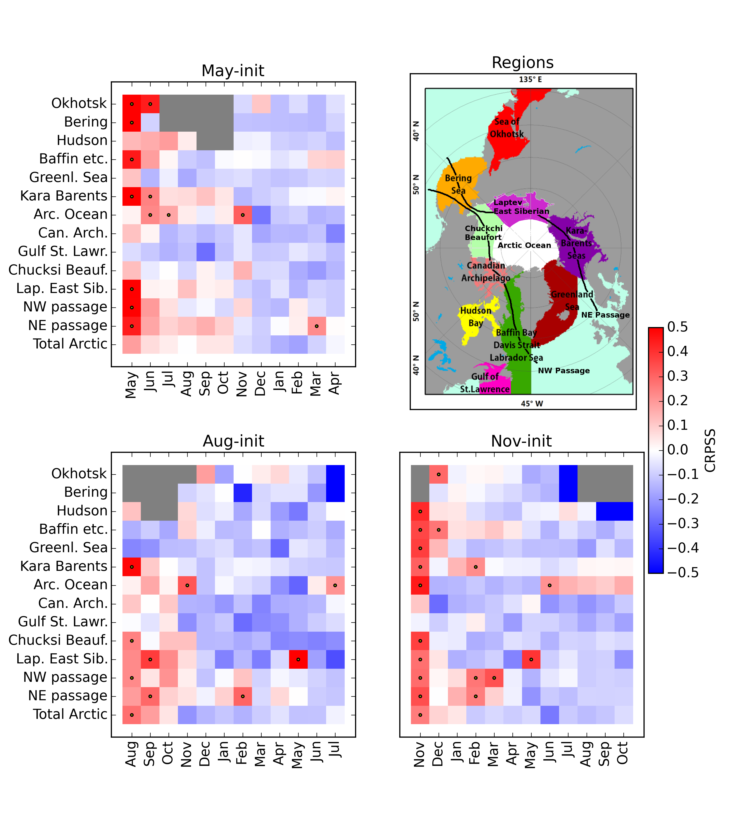
Regional skill scores
CRPSS – trend corrected climatology as reference
Krikken et al, GRL 2016

Slide 18
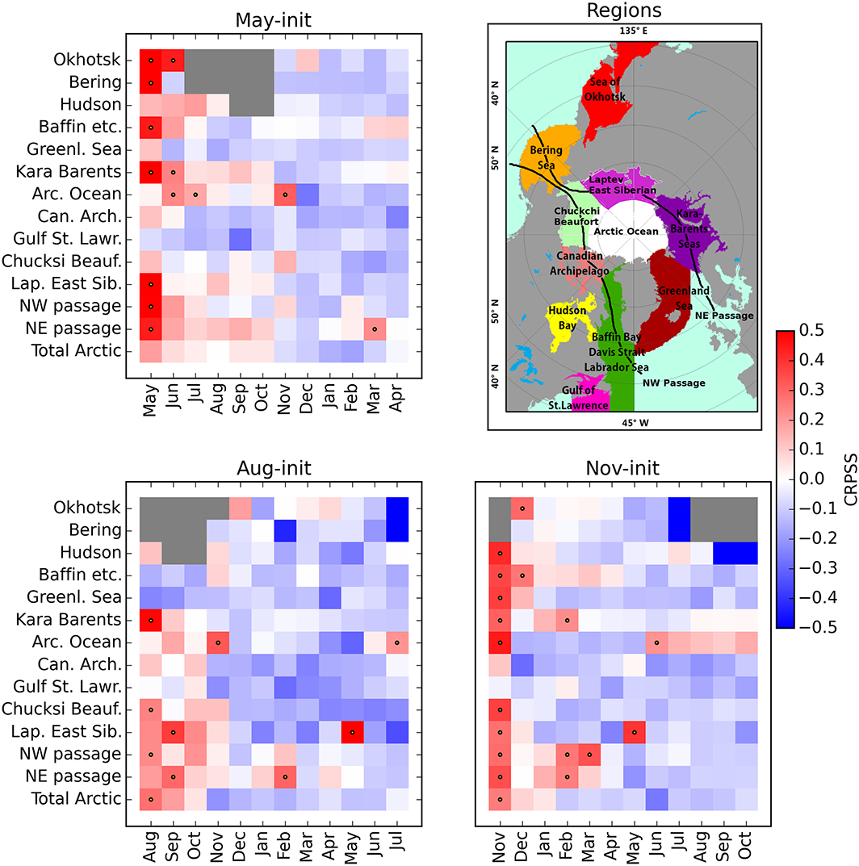
Regional skill scores
Notes:
(top right) The regional seas of the Arctic, provided by NSIDC, used in the computation of the regional CRPSS. The Northwest and Northeast passages are constructed by only accounting for the different seas the routes pass through, indicated by the black lines. Further plots show the SIA CRPSS of HELR for May‐init, Aug‐init, and Nov‐init for the different lead times. The dots indicate significant skill (5% bootstrapped confidence level > 0), and gray pixels indicate months with no sea ice.
IF THIS IMAGE HAS BEEN PROVIDED BY OR IS OWNED BY A THIRD PARTY, AS INDICATED IN THE CAPTION LINE, THEN FURTHER PERMISSION MAY BE NEEDED BEFORE ANY FURTHER USE. PLEASE CONTACT WILEY'S PERMISSIONS DEPARTMENT ON PERMISSIONS@WILEY.COM OR USE THE RIGHTSLINK SERVICE BY CLICKING ON THE 'REQUEST PERMISSIONS' LINK ACCOMPANYING THIS ARTICLE. WILEY OR AUTHOR OWNED IMAGES MAY BE USED FOR NON-COMMERCIAL PURPOSES, SUBJECT TO PROPER CITATION OF THE ARTICLE, AUTHOR, AND PUBLISHER.

Slide 19
Summary
Take home messages
Potential for skillful predictions
Large errors in seasonal forecasts of Arctic sea ice because of bias in simulated seasonal cycle
Ensemble calibration improves skill of dynamical seasonal Arctic sea ice forecasts relative to standard bias correction.
Skillful forecasts of sea ice up to 6 months in Northeast passage and Kara and Barents Sea.
Krikken et al, Geoph. Res. Lett. 2016

Slide 20
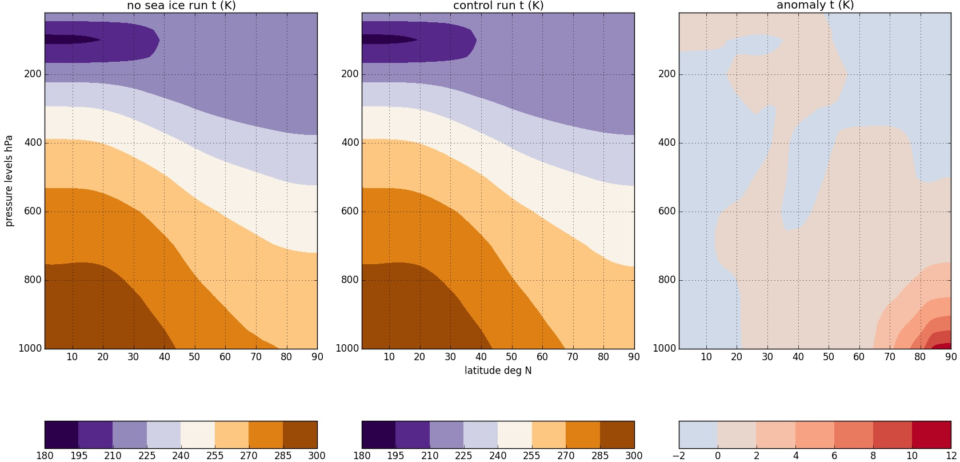
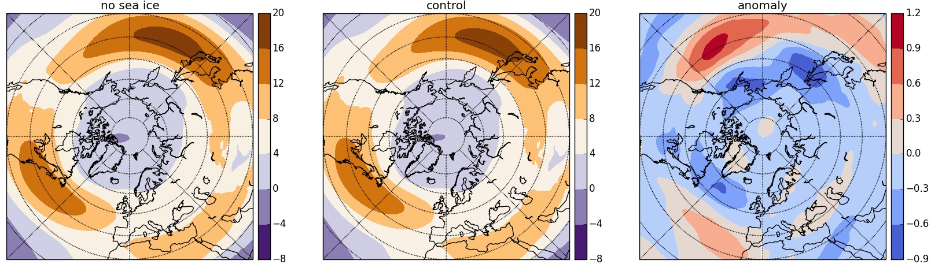
Will it affect remote regions
Andry et al, in preparation

Slide 21
Results – Ensemble calibration
CRPSS – trend corrected climatology as reference
May-init
Aug-init
Nov-init

Slide 22
Results – ensemble calibration
RMSE total sea ice area - All initializations
Cecilia Bitz

