Slide 1




Developing a climate prediction model for the Arctic: NorCPM
Noel Keenlyside
Francois Counillon, Ingo Bethke, Yiguo Wang,
Mao-Lin Shen, Madlen Kimmritz,
Marius Årthun, Tor Eldevik, Stephanie Gleixner,
Helene Langehaug, Anne Britt Sandø,
Lea Svendsen, Yongqi Gao

Slide 2
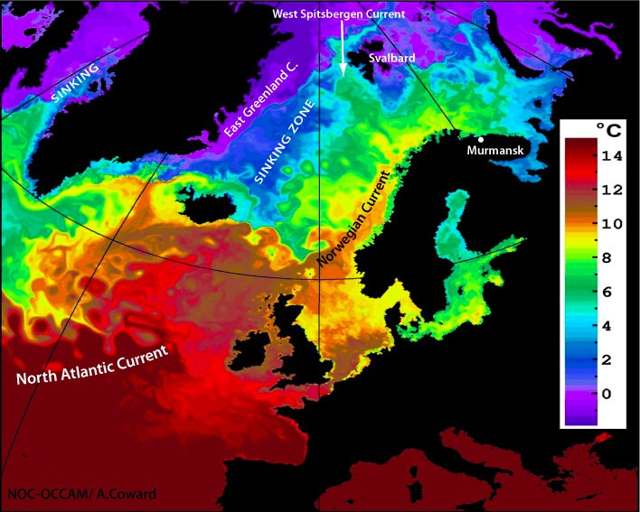
Physical Basis for Climate Prediction in the Nordic Seas and the Arctic (Årthun et al. submitted)
The Norwegian Climate Prediction Model (NorCPM)
Notes:
Convince you of 3 things..

Slide 3
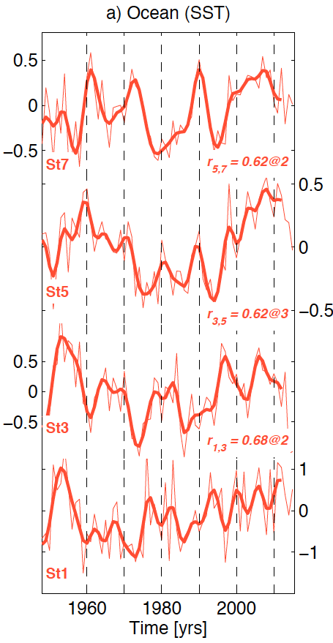
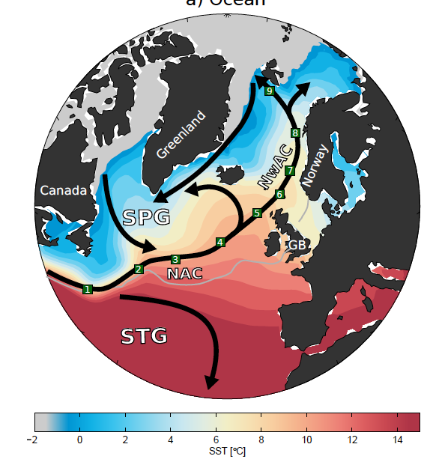
Circulation of ocean heat anomalies
ARCTIC
t = 0
NAC-NwAC
Årthun et al. submitted
Notes:
Corr and lags similar for Filt + unfilt

Slide 4
Circulation of ocean heat anomalies
ARCTIC
t = 2 yr
NAC-NwAC
Årthun et al. submitted

Slide 5
Circulation of ocean heat anomalies
ARCTIC
t = 5 yr
NAC-NwAC
Årthun et al. submitted

Slide 6
Circulation of ocean heat anomalies
ARCTIC
t = 7 yr
NAC-NwAC
Årthun et al. submitted

Slide 7
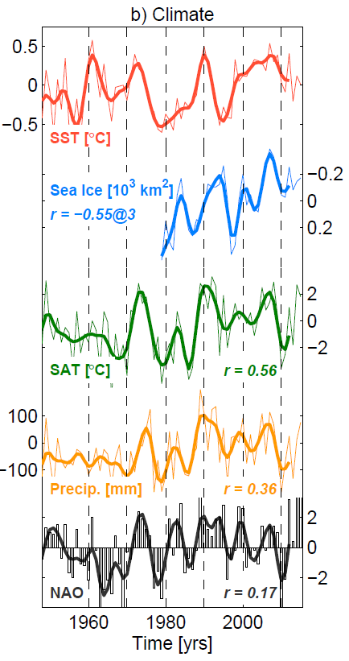
Oceanic influence on Arctic-Atlantic climate
Norwegian SAT, precipitation, and Arctic sea ice co-vary with Norwegian Sea SST.
Climate impacts associated with regional SST anomalies are complementary to those of the NAO.
Årthun et al. submitted
Notes:
Unfiltered power spectrum

Slide 8
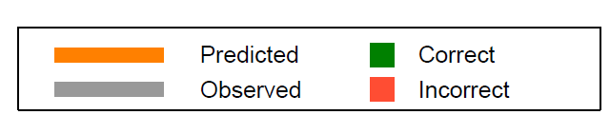
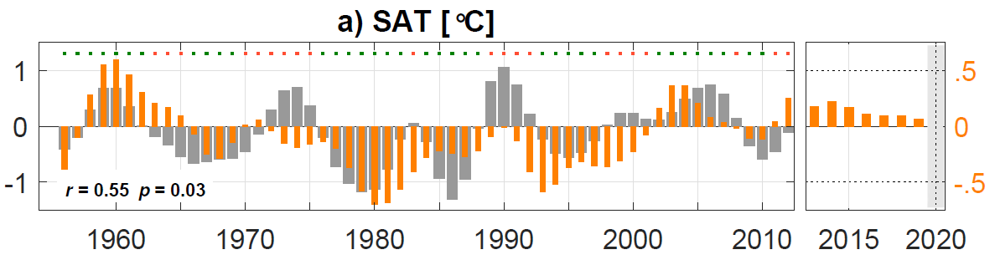
Statistical prediction of pentadal tendency
Norwegian surface air temperature, 7 years lead
7 years lead
r = 0.55
Sign of prediction correct 67% of the time
More skillful than random chance and climatology predictions
Temperatures above long-term average toward 2020
Årthun et al. submitted

Slide 9
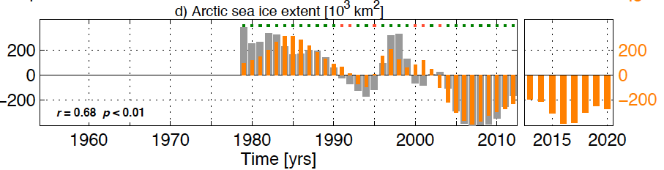
Statistical prediction of pentadal tendency
Arctic sea ice extent, 10 years lead
10 years lead
r = 0.68
More skillful than random chance and climatology predictions
Increased ice cover toward 2020
Increased sea ice cover toward 2020 related to weaker AMOC and colder SPG (Yeager et al., 2015)
Årthun et al. submitted

Slide 10
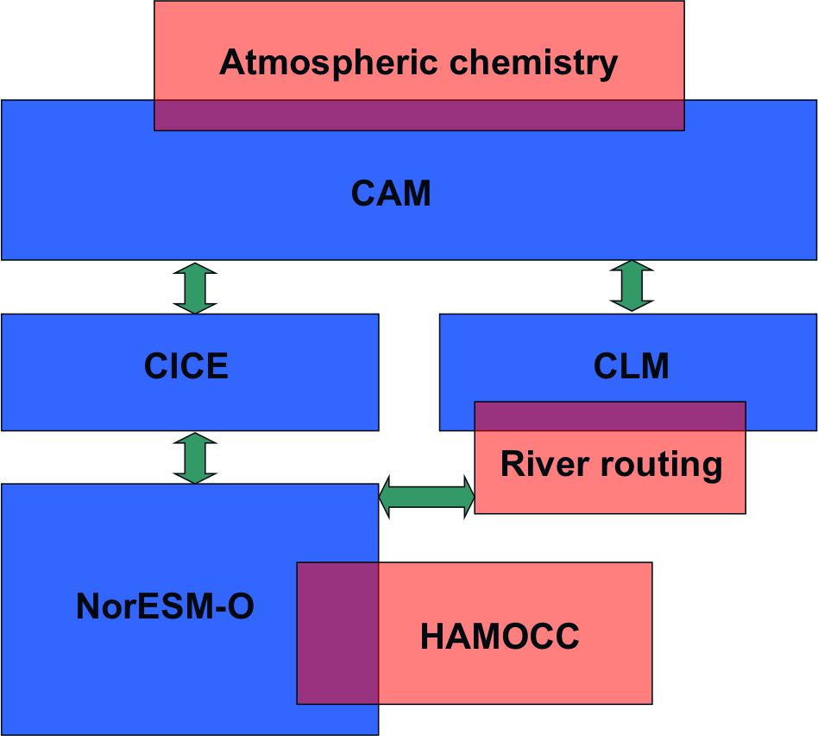
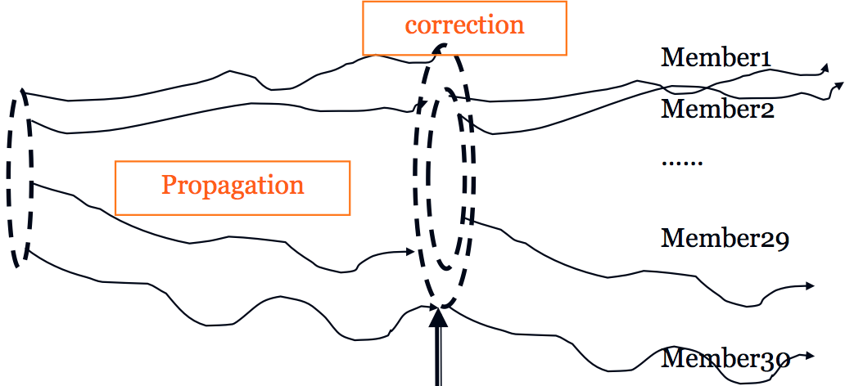
Norwegian Climate Prediction Model (NorCPM) V1
Earth System model (NorESM1-M)
Data assimilation (EnKF)
30 members
atm 2°; ocean+ice 1°
Stochastic observations
HadISST2
  Potential for long term reanalysis
  (1850 – present)
    Here from 1950-2010 !
Counillon et al. 2016
Notes:
Add some information on resolution

Slide 11
SST assimilation constrains large-scale North Atlantic Ocean circulation
Subpolar gyre index based on SSH
Weak SPG
Strong SPG
Atlantic Meridional Overturning Circulation index
Good match with independent observation for AMOC and SPG
Potential to reconstruct North Atlantic variability from 1850-present

Slide 12
Seasonal prediction skill matching other systems, but initialised only with SST
Anomaly Correlation Sea Surface Temperature for Niño 3.4 index
1985-2010; 4 starts per year; 9 ensemble members
NorCPM
North American
Multi-model Ensemble
LEAD MONTH
Courtesy: Steffi Gleixner
Notes:
NorCPM has skill similar to the best state-of-the-art models

Slide 13
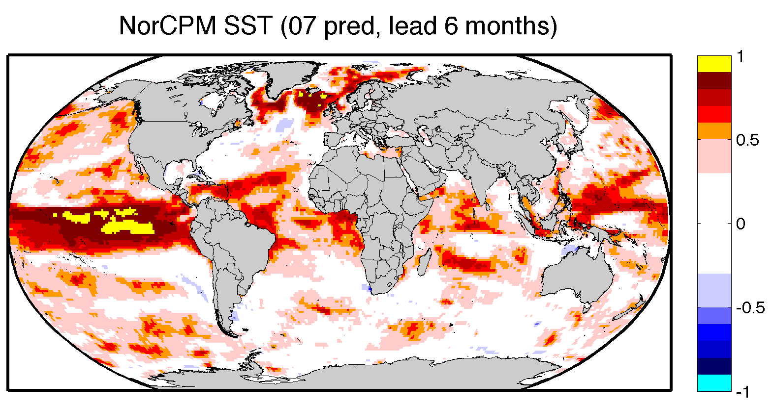
Seasonal prediction skill high in Nordic Seas
Anomaly Correlation for Sea Surface Temperature with observations
Period 1985-2010, 9 ensemble members
6 months in to the future from 1st of August
Stephanie Gleixner

Slide 14
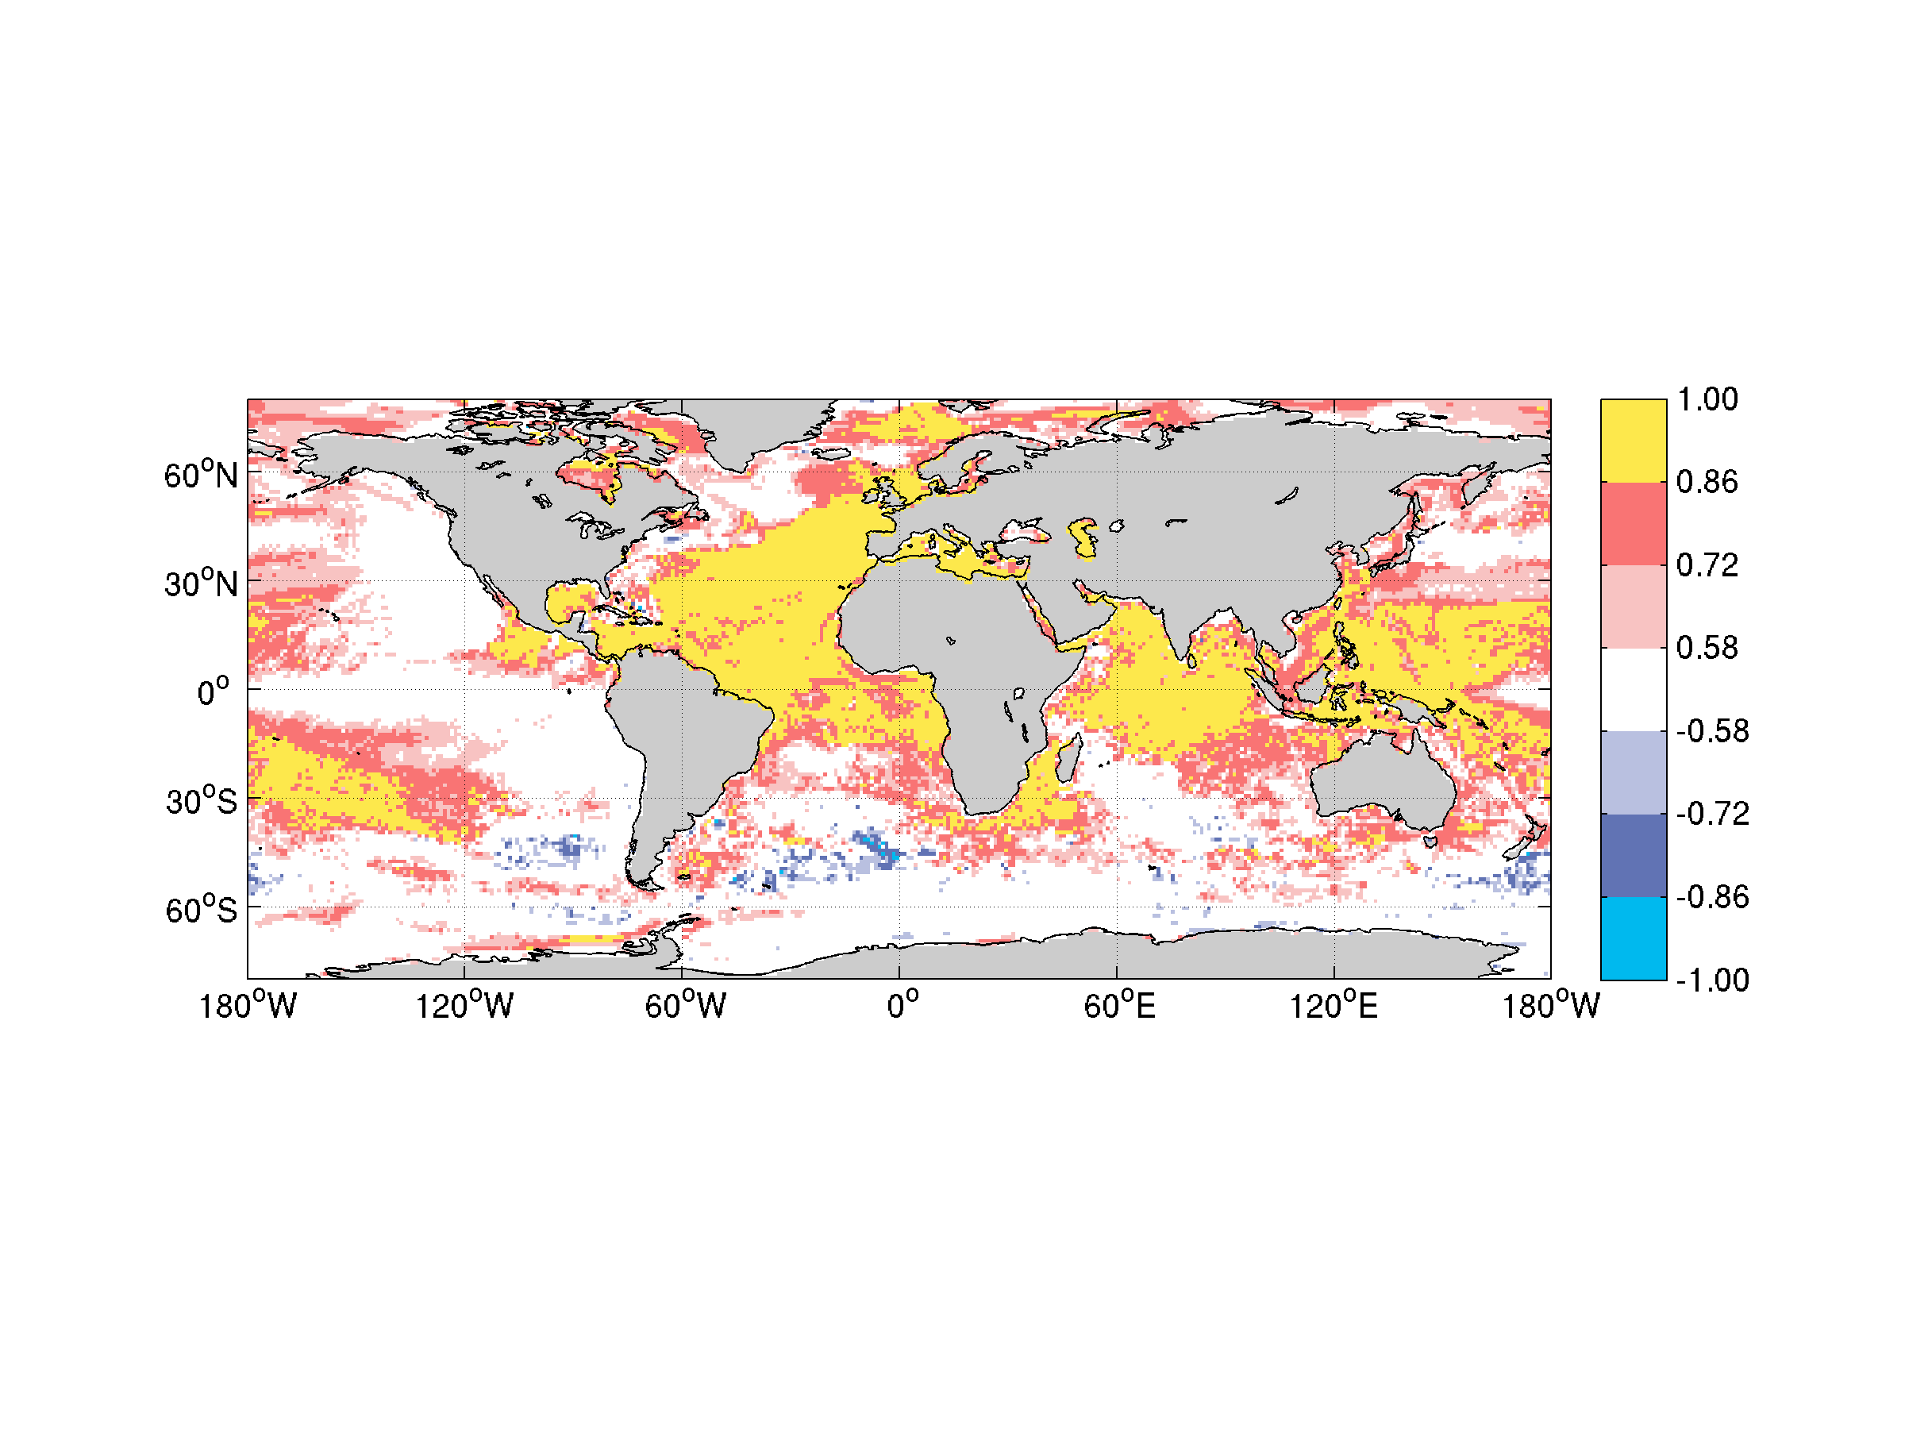
NorCPM: Correlation skill for Sea Surface Temperature
1-10 year mean
1960-2004, every 2nd year, 20 member ensembles
Francois Counillon

Slide 15
NorCPM: ongoing developments
Earth System model (NorESM1-M)
Nudging: atm reana (except in BL)
Assim: SST, T-S, SSH
Ice concentration & thickness
validated
Development and testing continues to determine optimal configuration
in testing
In devel
Notes:
Add some information on resolution

Slide 16
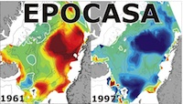








Development of a climate prediction system for high-latitudes
Physical Basis for Climate Prediction in the Nordic Seas and the Arctic (Årthun et al. submitted)
-> Poleward advection of heat from the North Atlantic
The Norwegian Climate prediction model
-> NorESM + EnKF advanced data assimilation scheme
-> Using only observed SST anomalies we achieve skill comparable to other state-of-the-art systems
-> System is being extended to use more data
Thank you for your attention

Slide 18
Circulation of ocean heat anomalies
Track SST anomalies along NAC-NwAC pathway
Winter-spring (Dec-May) SST from HadISST
Anomalies wrt 1981-2010
Årthun et al. submitted
Notes:
Corr and lags similar for Filt + unfilt

Slide 19
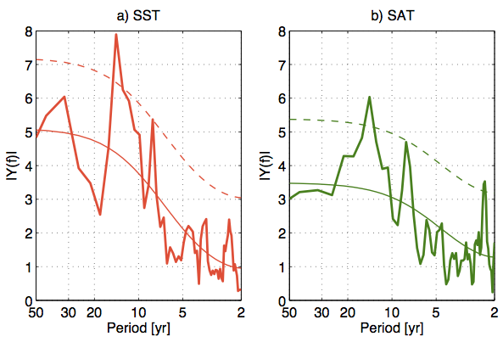
Influence on Arctic-Atlantic climate
14yr
➔
➔
→
8yr
→
SST
SAT
14-yr timescale ➔ ocean advection
8-yr timescale ➔ NAO
E.g., Moron et al. 1998; Häkkinen 2000; Marshall et al. 2001; Reintges et al. 2016.
Notes:
Unfiltered power spectrum

Slide 20
Translating ocean-atmosphere co-variability into statistical predictions of northern climate
Predictions of annual Norwegian SAT and winter Arctic sea ice extent based on subpolar North Atlantic SST (#2,3)
Linear regression models based on time series between 1948 and 2012
Forecast horizon: 7 & 10 years
Future predictions -> 2020
5-yr low-pass filter -> pentadal tendencies
Robustness assessed by cross-validation
Årthun et al. submitted

Slide 21
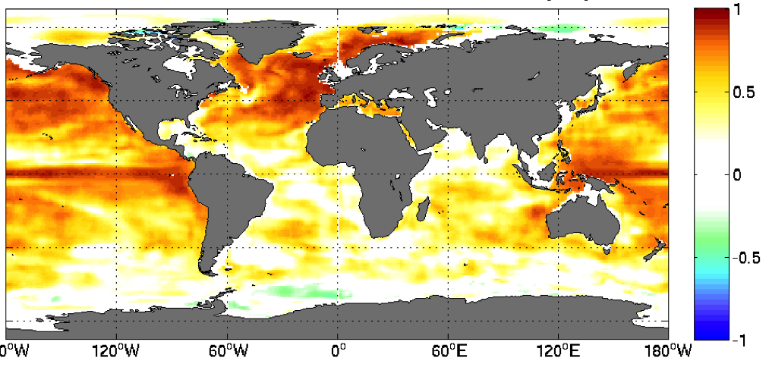
SST assimilation captures upper ocean heat content variability over large parts of the globe
Correlation with 0-200m Heat Content, EN4 objective analysis, yearly
Upper ocean salinity content variability also partly reproduced over North Atlantic subpolar gyre and part of the equatorial Pacific

Slide 22
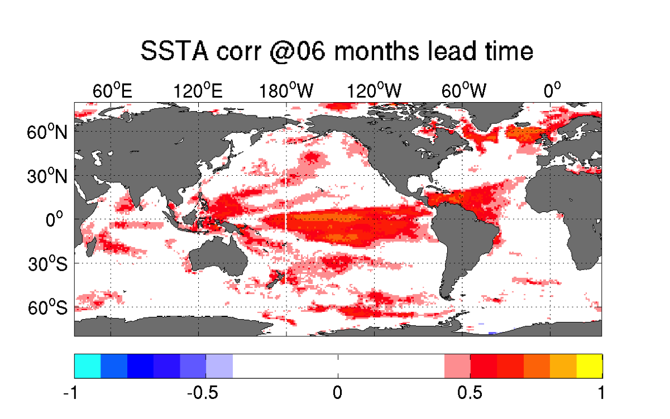
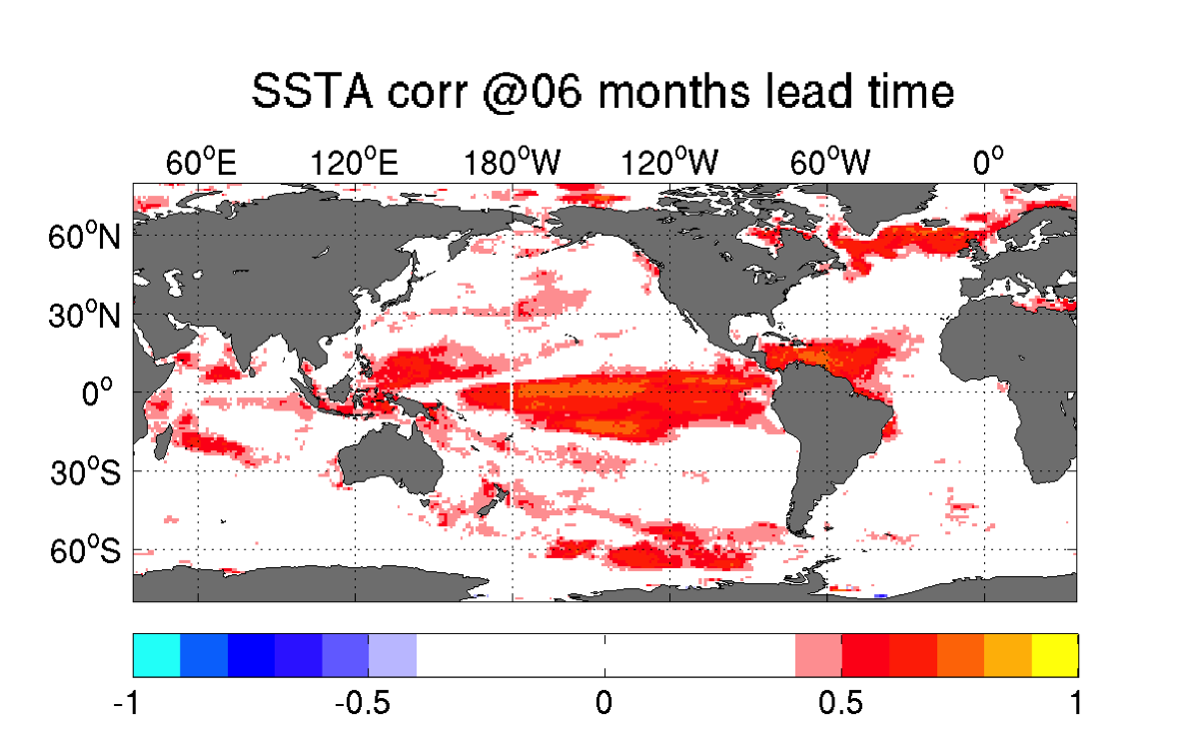
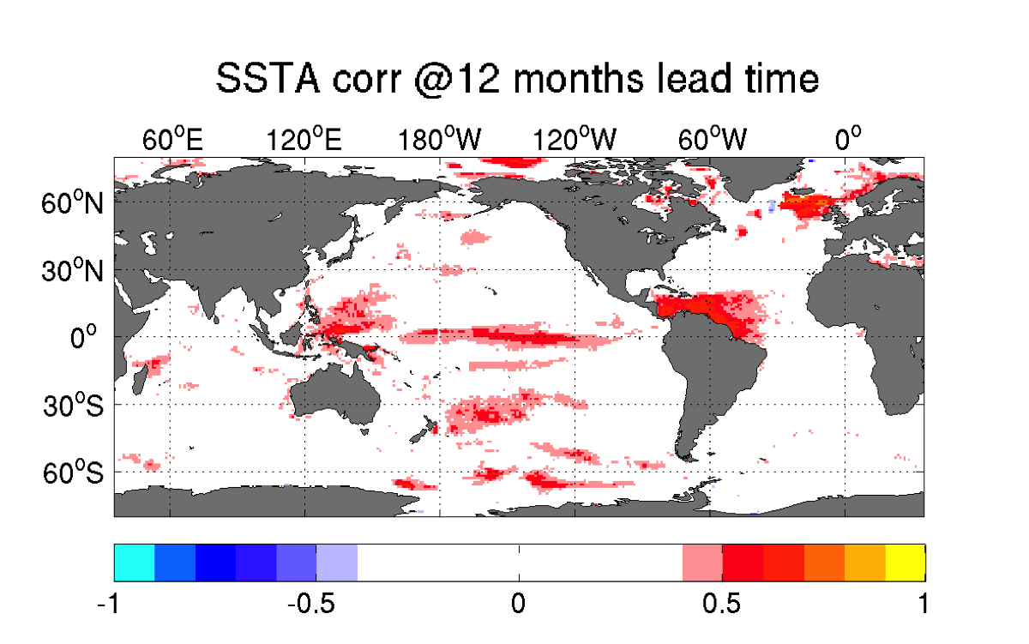
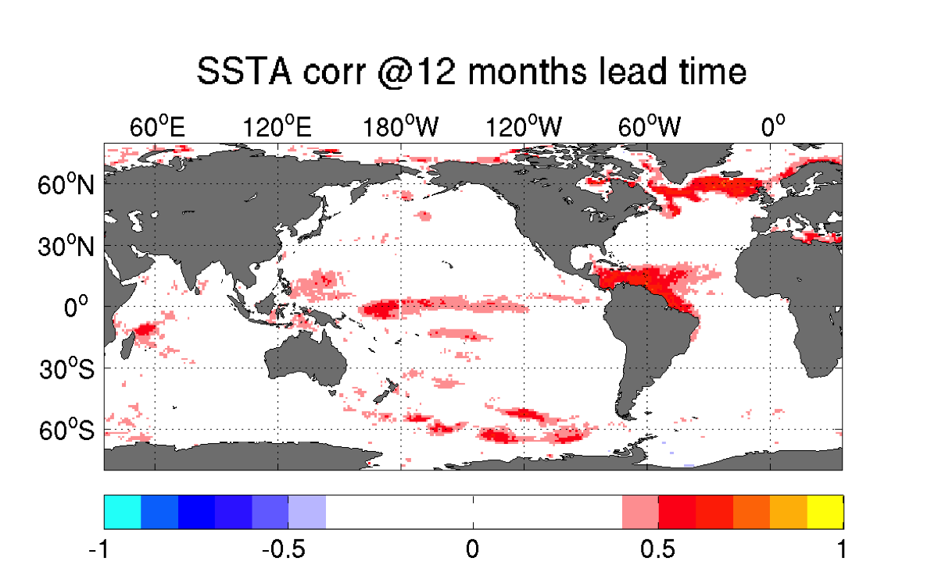
Assessing the benefit of T-S data in Seasonal prediction skills (SSTA)
Initialisation with SSTA
Initialisation with SSTA and T-S anomalies
Lead month 06
Lead month 12
Yiguo Wang

Slide 23
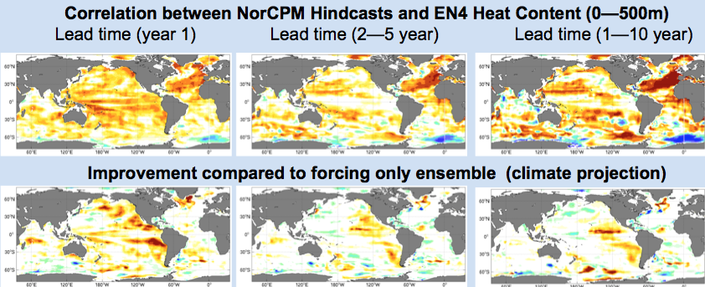
Correlation skill for Ocean Heat content (500 m)
Initialization improves the prediction skill of heat content at all lead time.
Almost no degradation compared to climate projection (blue on line 2)

