Slide 1
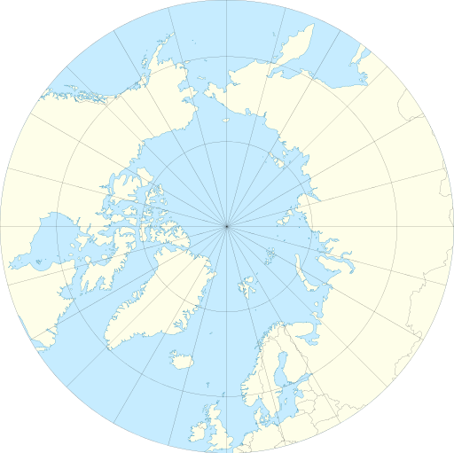
WP 8 Communication & Dissemination Plan & Activities
Raeanne Miller (SRSL / SAMS)
Peter Vangsbo (Climate-KIC)
By Tentotwo [CC BY-SA 3.0 (http://creativecommons.org/licenses/by-sa/3.0)]

Slide 2
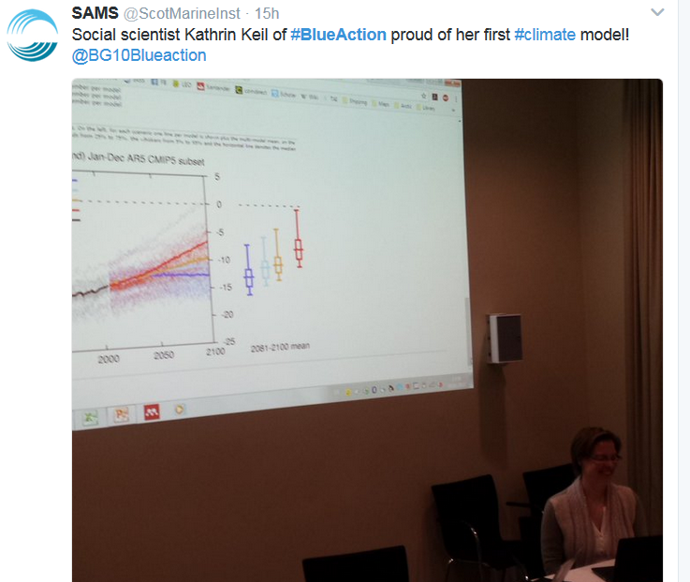
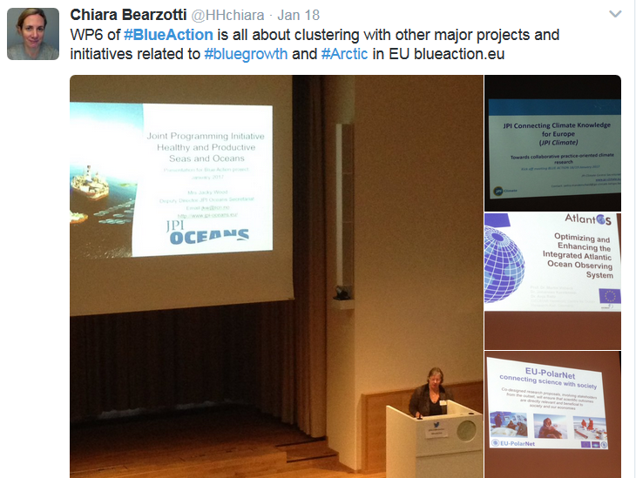
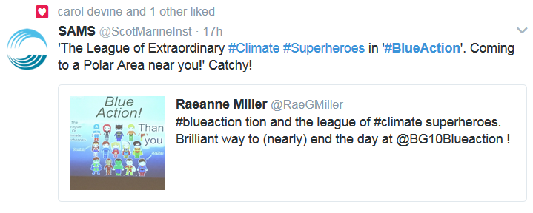
Social Media
@BG10BlueAction
#BlueAction
#ModellingMondays?

Slide 3
Blue Action - Engagement
WP8
WP8 – Dissemination, Amplification, Larger Audience (Policymakers, Citizens, Industry, Stakeholder Engagement)
WP6 – Research Clusters – share best practise & information
WP5 – Case studies – co-design of climate services with stakeholder groups
WP6
WP5

Slide 4
Blue Action - Engagement
WP8
WP 1-4
WP6
WP5

Slide 5
Our Plan – First 3 Months
Internal communication
Intranet for internal communication & project management – RedMine
Document storage
Project Management

Slide 6
Next 3 Months
Develop Communication & Dissemination Plan
Who needs to know about our science and other activities?
How will they use it?
Business growth
Policymaking
Awareness
Further research
Learning – higher education
On what timeframe?

Slide 7
Target Audiences
Who | Why | How
Project Partners | Ensure an effective & integrated project, keep all partners actively involved | Intranet, meetings, webinars, etc.
European & international initiatives (YOPP, Copernicus, EU PolarNet) | Share resources, address open science questions, develop shared understanding & collaboration | Joint-activities & seminars, contribution to deliverables
Higher education & training | Ensure knowledge is passed on, improve professional skills | Training sessions, webinars, summer schools, existing networks
Public & wider society | Project visibility, ensure societal benefit, raise awareness | Social media, website, lectures, press, media

Slide 8
Target Audiences
Who | Why | How
Governments, policymakers, EC services | Inform policy, provide tools for greater understanding of Arctic climate & weather | Policy briefings, face-to-face contact through existing groups
Indigenous communities | Dialogue, feedback, ensure societal benefit, raise awareness | Societal Engagement Group
Environmental NGOs | Dialogue, encouraging uptake of results for societal action | Societal Engagement Group
Business sector end users | Ensure outcomes are relevant and useable and can be taken up as products & services | Case studies, reports, meetings, reports, protection of IP – more from Peter!

Slide 9
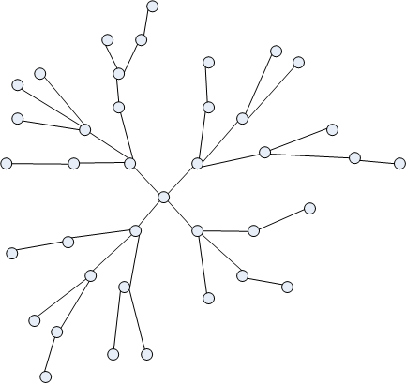
Next 3 Months
Develop Communication & Dissemination Plan
Map our network
Other initiatives
Think tanks
Steering groups
Associations
etc

Slide 10
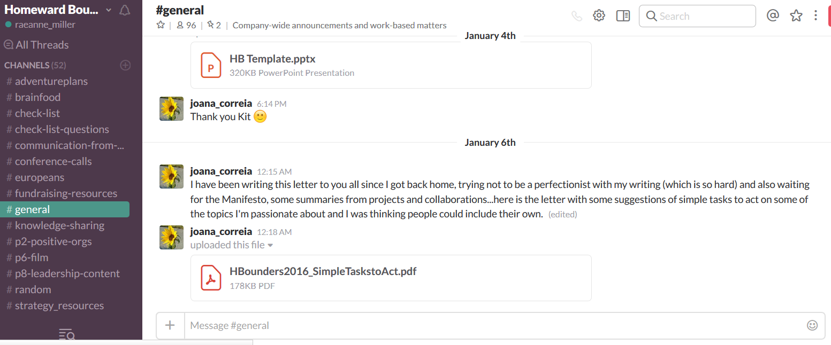
WP Communication - ideas
WP Communications – Slack? Other tools?
Blog – short, punchy contributions
Network – pieces in other newsletters (e.g. WOC, other science programmes)

Slide 11
Business, stakeholder engagement, & economic growth: Climate KIC

