Slide 1
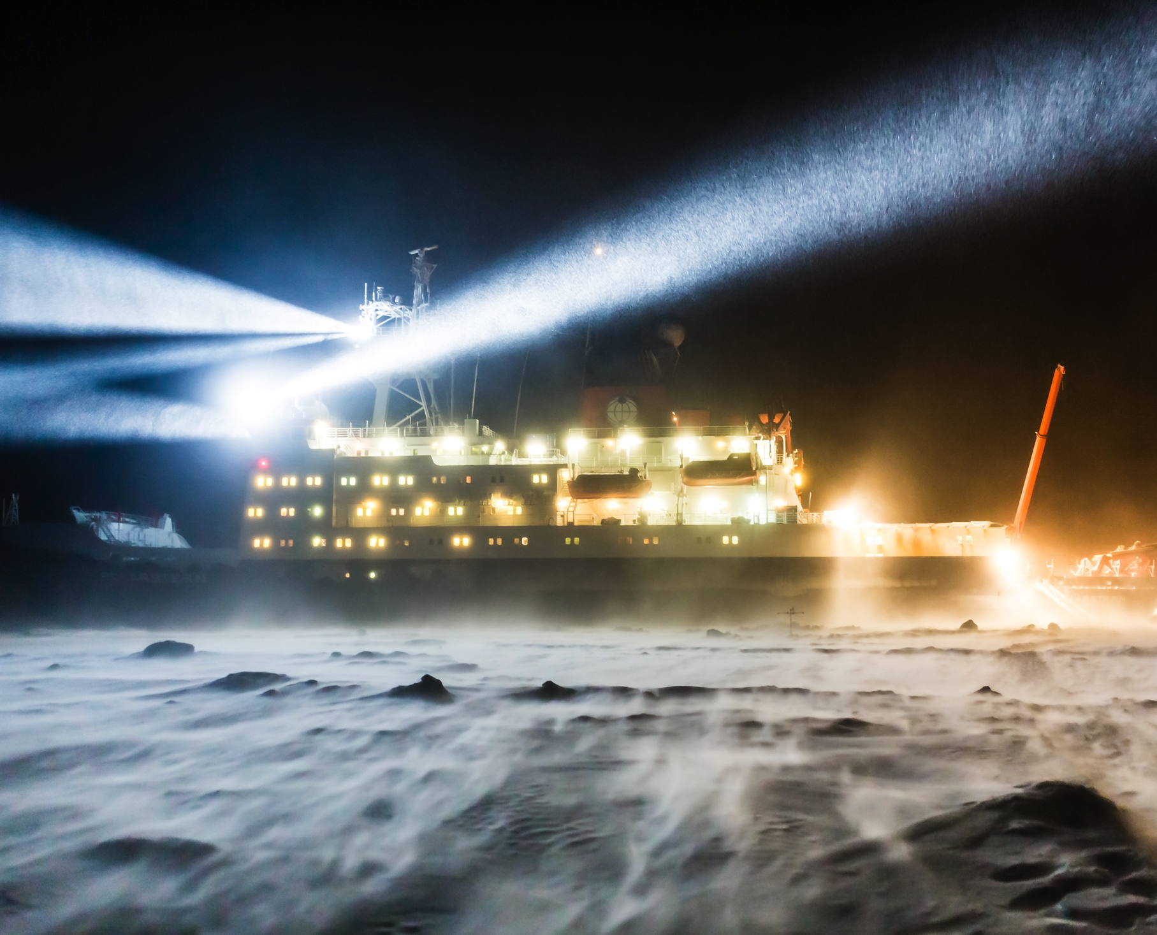
Year of Polar Prediction (YOPP)
Photo: S. Hendricks, AWI
Thomas Jung
Chair of the Polar Prediction Project
Alfred Wegener Institute, Germany
Blue-Action Kick-off Meeting, 18–20 January 2017,Berlin, Germany

Slide 2
Background
In the late 2000s several aspects came together
  Discussion on the legacy of the International Polar Year (IPY, 2007-2008)
  Discussion of the future of the World Weather Research Programme (WWRP)
  Arctic climate was changing rapidly
Polar prediction moved into the focus
WWRP decided to launch the Polar Prediction Project
Notes:
- Two aspects that reflect a change of WWRP:
Environmental prediction, not just weather, e.g. sea ice
Beyond the medium range -> bridge to WCRP
Kind of legacy of both (i) the International Polar Year (IPY; 2007/2008) though more focussed on prediction and (ii) THe Observing system Research and Predictability Experiment (THORPEX)
Apart from carrying on momentum from IPY and THORPEX, why PPP? -> next slide
Suppl. info:
October 2009: CAS recommends the establishment of a THORPEX Polar Research project
November 2010: EC-PORS formulates plans for GIPPS, of which PPP is the component up to seasonal and PCPI is the component beyond seasonal

Slide 3
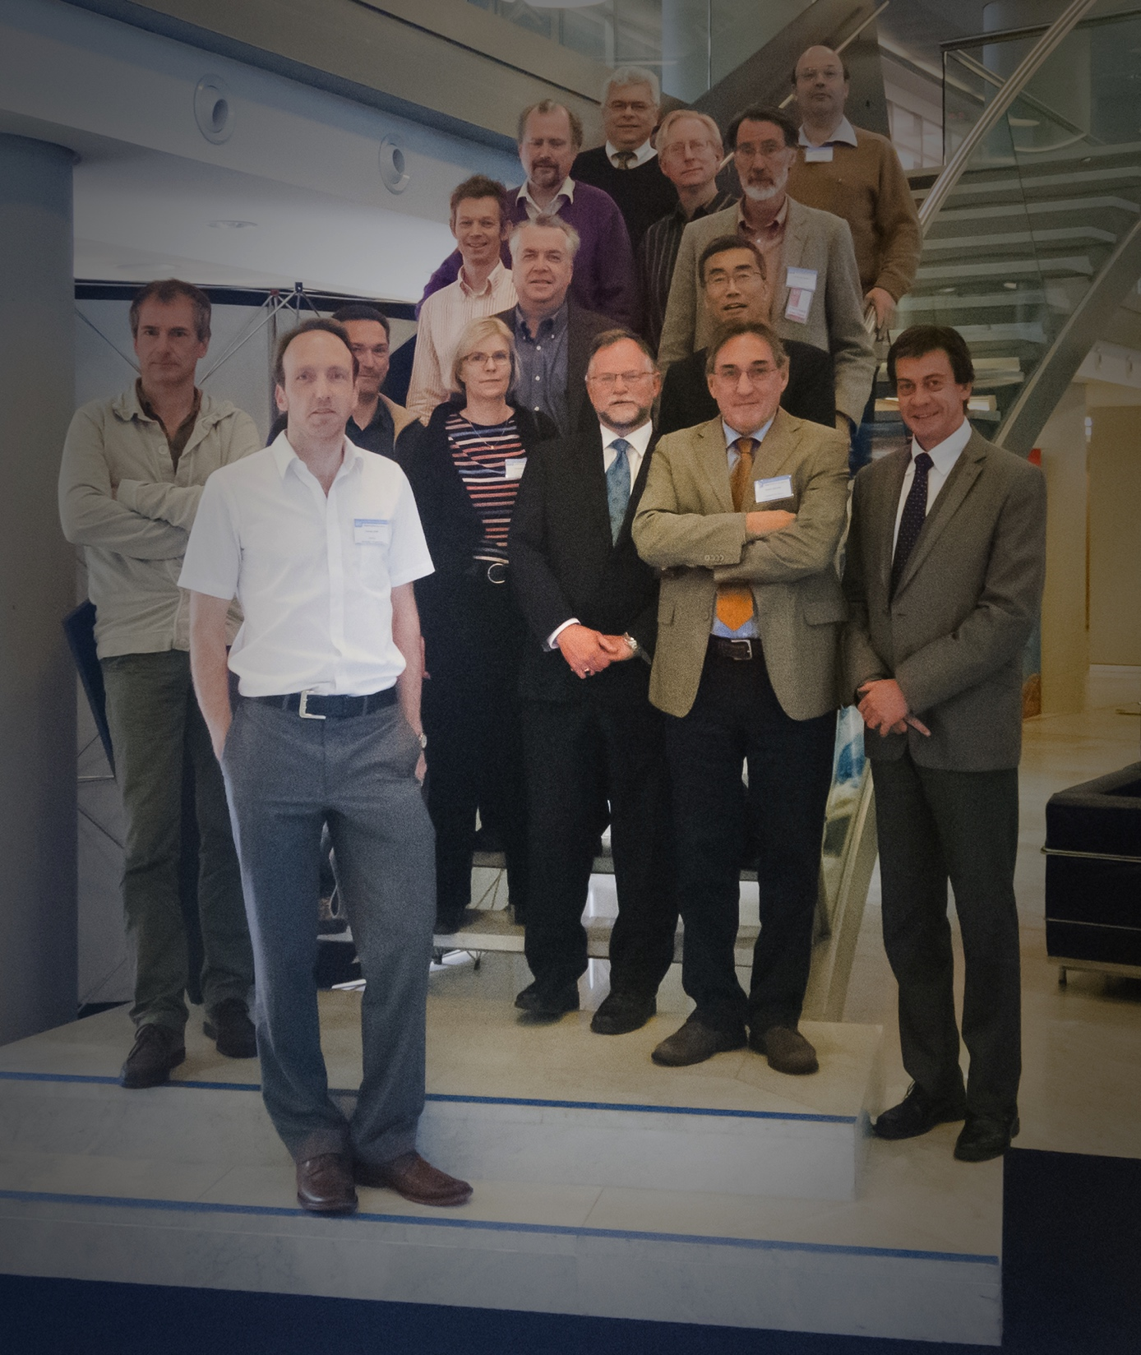
Background
1st meeting of the PPP steering group at WMO in 2011:
  Formulate project goals and activities (2013-2022)
Year of Polar Prediction (YOPP) was born!
PPP Steering Group, Geneva 2011
Polar Prediction Project (PPP):
Promote cooperative international research enabling development of improved weather and environmental prediction services for the polar regions, on time scales from hourly to seasonal
Notes:
- Two aspects that reflect a change of WWRP:
Environmental prediction, not just weather, e.g. sea ice
Beyond the medium range -> bridge to WCRP
Kind of legacy of both (i) the International Polar Year (IPY; 2007/2008) though more focussed on prediction and (ii) THe Observing system Research and Predictability Experiment (THORPEX)
Apart from carrying on momentum from IPY and THORPEX, why PPP? -> next slide
Suppl. info:
October 2009: CAS recommends the establishment of a THORPEX Polar Research project
November 2010: EC-PORS formulates plans for GIPPS, of which PPP is the component up to seasonal and PCPI is the component beyond seasonal

Slide 4
Background
1st meeting of the PPP steering group at WMO in 2011:
  Formulate project goals and activities (2013-2022)
Year of Polar Prediction (YOPP) was born!
Year of Polar Prediction:
Enable a significant improvement in environmental prediction capabilities for the polar regions and beyond, by coordinating a period of intensive observing, modelling, prediction, verification, user-engagement and education activities.
PPP Steering Group, Geneva 2011
Notes:
- Two aspects that reflect a change of WWRP:
Environmental prediction, not just weather, e.g. sea ice
Beyond the medium range -> bridge to WCRP
Kind of legacy of both (i) the International Polar Year (IPY; 2007/2008) though more focussed on prediction and (ii) THe Observing system Research and Predictability Experiment (THORPEX)
Apart from carrying on momentum from IPY and THORPEX, why PPP? -> next slide
Suppl. info:
October 2009: CAS recommends the establishment of a THORPEX Polar Research project
November 2010: EC-PORS formulates plans for GIPPS, of which PPP is the component up to seasonal and PCPI is the component beyond seasonal

Slide 5
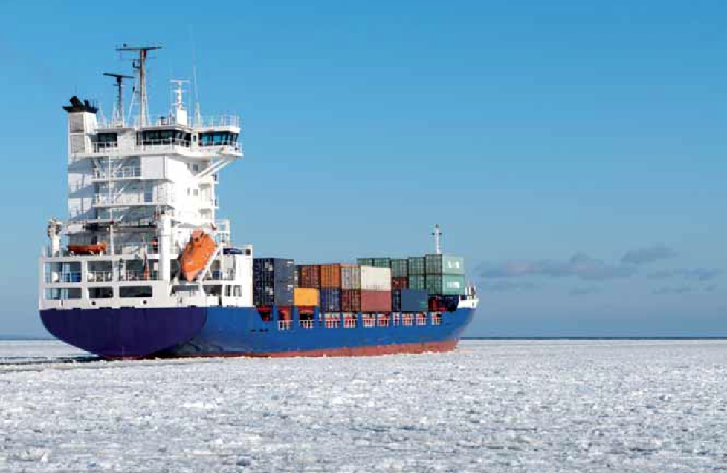
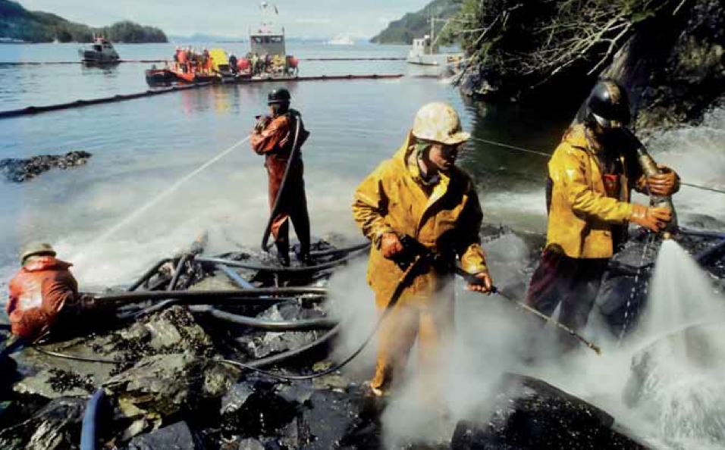
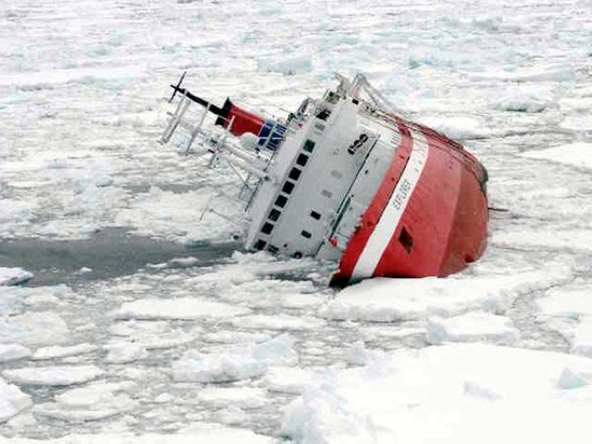
Why?
Arctic amplification of climate change
Climate change comes
with opportunities ...
Photo from Llodys report
... and risks!
Photo by Chilean Navy/Reuters
Notes:
- Two aspects that reflect a change of WWRP:
Environmental prediction, not just weather, e.g. sea ice
Beyond the medium range -> bridge to WCRP
Kind of legacy of both (i) the International Polar Year (IPY; 2007/2008) though more focussed on prediction and (ii) THe Observing system Research and Predictability Experiment (THORPEX)
Apart from carrying on momentum from IPY and THORPEX, why PPP? -> next slide
Suppl. info:
October 2009: CAS recommends the establishment of a THORPEX Polar Research project
November 2010: EC-PORS formulates plans for GIPPS, of which PPP is the component up to seasonal and PCPI is the component beyond seasonal

Slide 6
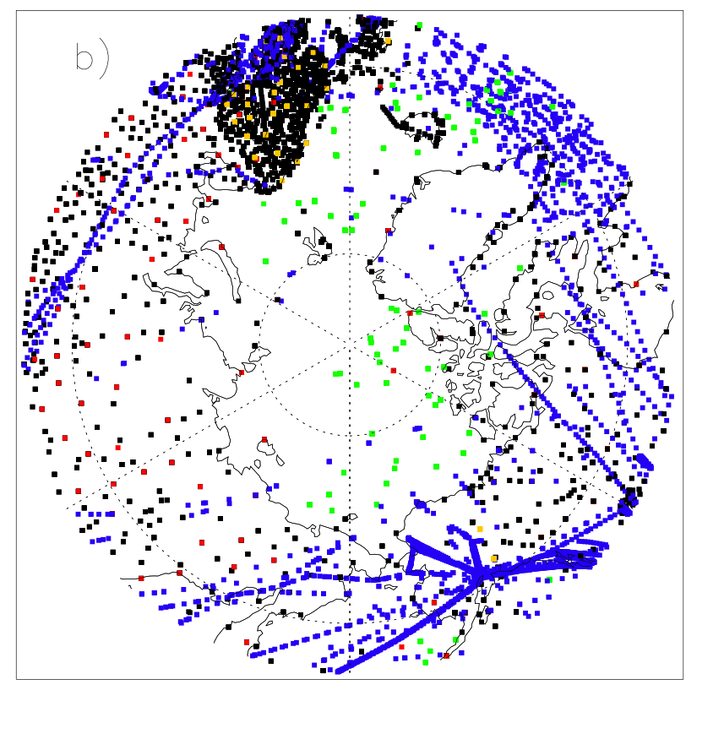
Why?
Relatively poor observational coverage
Synop
AIREP
DRIBU
TEMP
PILOT
Polar data coverage of conventional observations in the ECMWF operational analysis on 1 January 2012
  P. Bauer (ECMWF)
Notes:
Akademikh Shokalskiy, December 2013

Slide 7
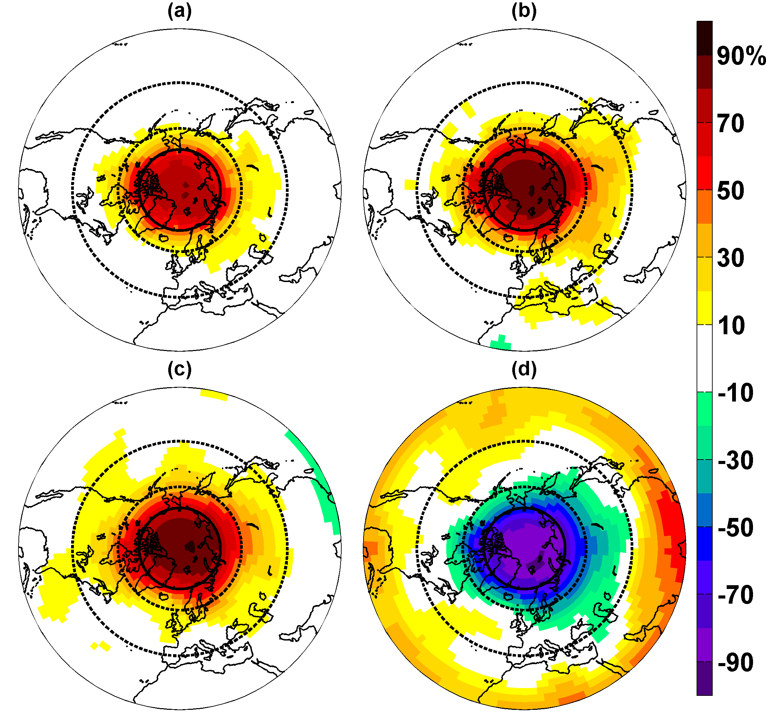
Why?
Implications for predictions in lower latitudes
Day 1-5
Day 6-10
Day 11-30
Jung et al. (2014), Geophys. Res. Lett.
Notes:
Akademikh Shokalskiy, December 2013

Slide 8
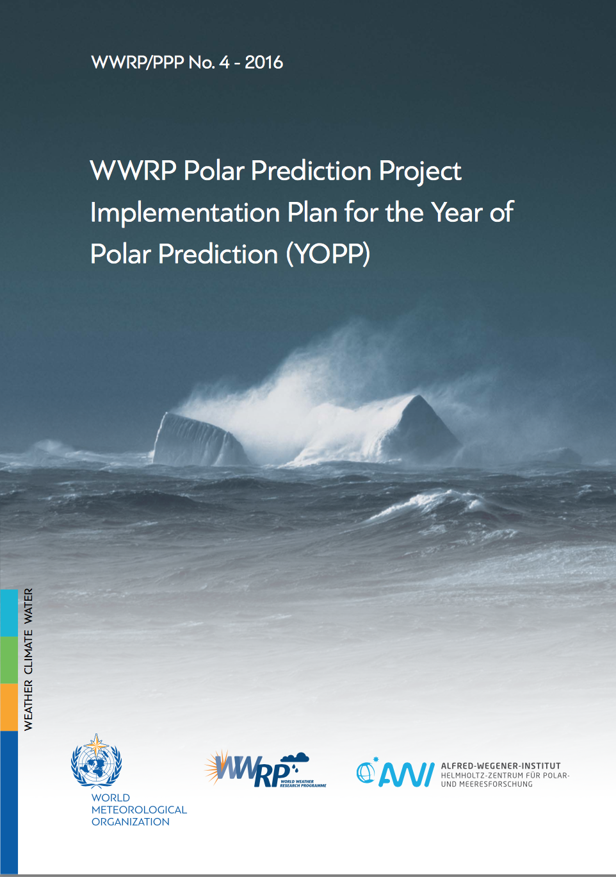
How?
http://polarprediction.net
Notes:
We don‘t need to start from scratch
For more details, see these implementation plans, available at the PPP website

Slide 9
What?
Improve the polar observing system to provide better coverage of high-quality observations in a cost-effective manner.
Gather additional observations through field programmes aimed at improving understanding of key polar processes.
Improve representation of key-processes in uncoupled and coupled models used for prediction.
Develop improved data assimilation systems that account for challenges in polar regions (e.g. sparse data, steep orography).
Explore the predictability of the atmosphere-cryosphere-ocean system, with a focus on sea ice, on time scales from days to a season.
Notes:
- Two aspects that reflect a change of WWRP:
Environmental prediction, not just weather, e.g. sea ice
Beyond the medium range -> bridge to WCRP
Kind of legacy of both (i) the International Polar Year (IPY; 2007/2008) though more focussed on prediction and (ii) THe Observing system Research and Predictability Experiment (THORPEX)
Apart from carrying on momentum from IPY and THORPEX, why PPP? -> next slide
Suppl. info:
October 2009: CAS recommends the establishment of a THORPEX Polar Research project
November 2010: EC-PORS formulates plans for GIPPS, of which PPP is the component up to seasonal and PCPI is the component beyond seasonal

Slide 10
What?
Improve understanding of linkages between polar regions and lower latitudes and assess skill of models representing theses.
Improve verification of polar weather and environment predictions to obtain quantitative knowledge on model performance, and on the skill of operational forecasting systems for user-relevant parameters; and efficiently monitor progress.
Improve understanding of the benefits of using prediction information and services in the polar regions, differentiated across the spectrum of user types and benefit areas.
Provide training opportunities to generate a sound knowledge base on polar prediction related issues.
Notes:
- Two aspects that reflect a change of WWRP:
Environmental prediction, not just weather, e.g. sea ice
Beyond the medium range -> bridge to WCRP
Kind of legacy of both (i) the International Polar Year (IPY; 2007/2008) though more focussed on prediction and (ii) THe Observing system Research and Predictability Experiment (THORPEX)
Apart from carrying on momentum from IPY and THORPEX, why PPP? -> next slide
Suppl. info:
October 2009: CAS recommends the establishment of a THORPEX Polar Research project
November 2010: EC-PORS formulates plans for GIPPS, of which PPP is the component up to seasonal and PCPI is the component beyond seasonal

Slide 11
Year of Polar Prediction
Jung et al. 2016, BAMS
Notes:
- Long year ☺; core period from mid-2017 to mid-2019
- Example 1: Intensive observing periods: (i) more observations needed in general, additional value having them in the same time
(ii) snapshot for higher-quality REANALYSIS (ERA-YOPP) -> useful for verification, process understanding, ...
(iii) enables judgement upon value of certain obs for forecasting (OSEs, ie data denial experiments)
(iv) aligned with planned MOSAiC campaign (where Polarstern drifts through Arctic)
Example 2: Dedicated model experiments: OSSEs / OSEs; in NWP context OSSEs are common practice for satellite planning; autonomous gliders under sea ice could be a target in the context of YOPP
Example 3: Verification effort: baseline skill comparison between current operational 7-day sea-ice forecasts (US Navy; Env. Can.; MyOcean (Europe)) currently being discussed

Slide 12
YOPP Planning – Arctic
Satellite snapshots
Extra modelling
Field campaigns
Extensive buoy coverage
Special observing periods
SOP1
SOP2
SOP3
Feb-Mar
Jul-Sep
Feb-Mar
Core modelling & prediction
Core modelling & prediction
MOSAiC
2017
2018
2019
2020
YOPP Preparation Phase
YOPP Core Phase
YOPP Consolidation Phase
Notes:
- Two aspects that reflect a change of WWRP:
Environmental prediction, not just weather, e.g. sea ice
Beyond the medium range -> bridge to WCRP
Kind of legacy of both (i) the International Polar Year (IPY; 2007/2008) though more focussed on prediction and (ii) THe Observing system Research and Predictability Experiment (THORPEX)
Apart from carrying on momentum from IPY and THORPEX, why PPP? -> next slide
Suppl. info:
October 2009: CAS recommends the establishment of a THORPEX Polar Research project
November 2010: EC-PORS formulates plans for GIPPS, of which PPP is the component up to seasonal and PCPI is the component beyond seasonal

Slide 13
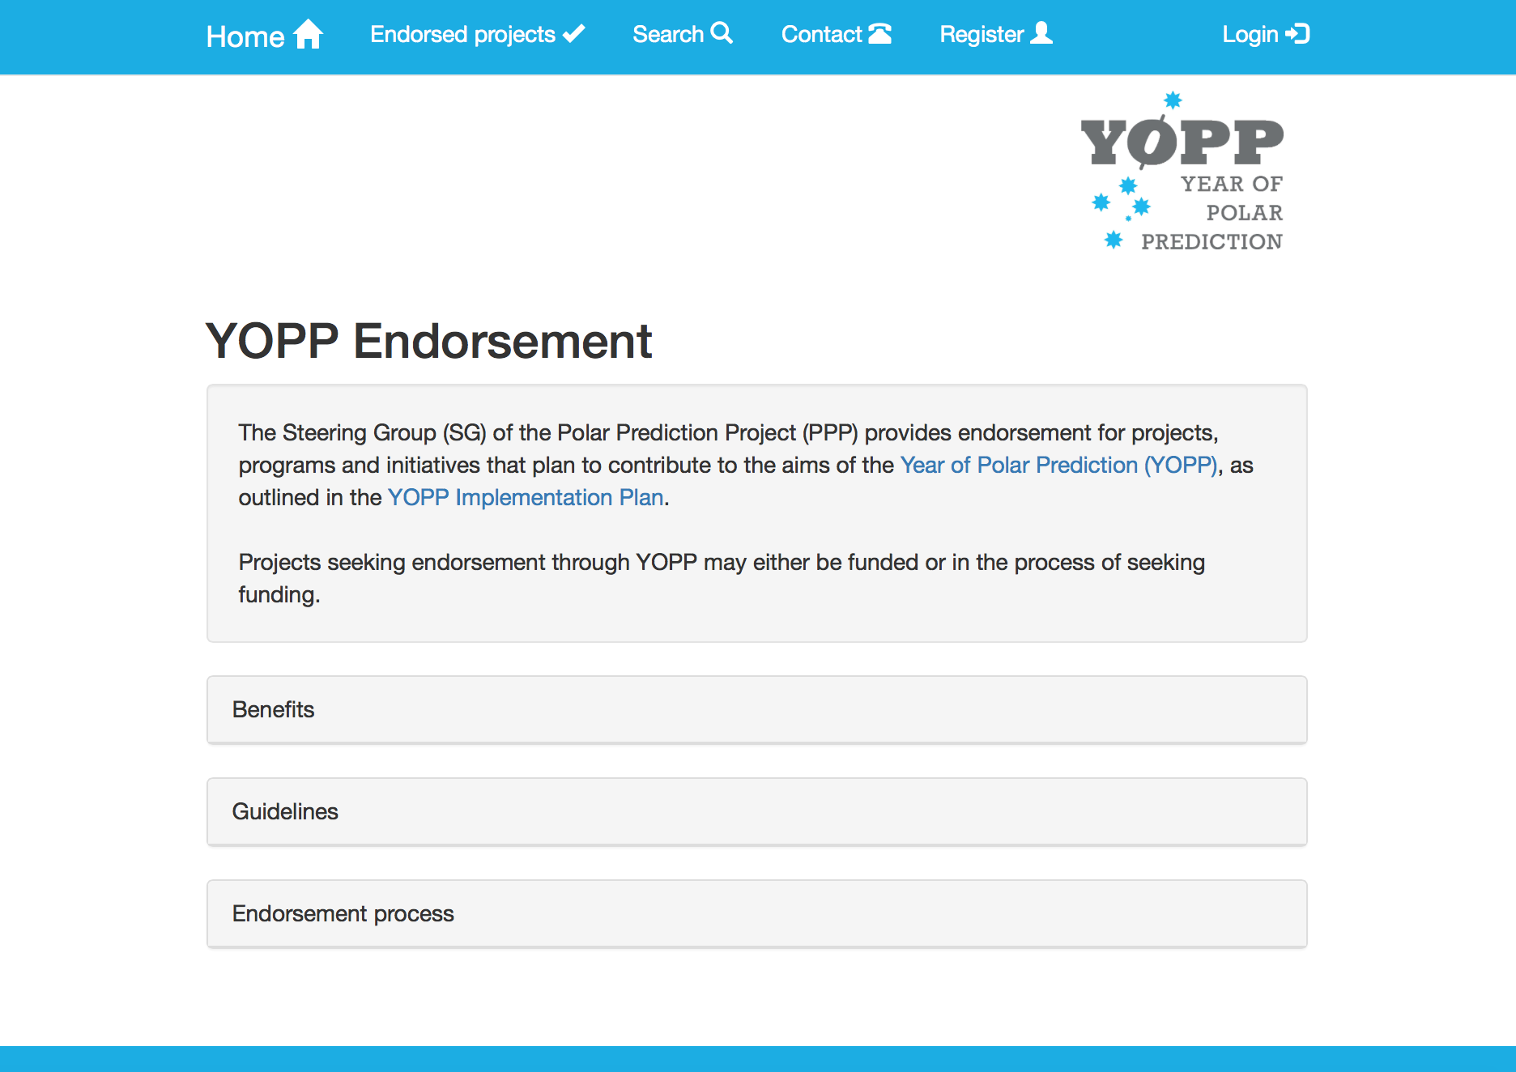
YOPP Endorsement
http://apps3.awi.de/YPP/
Notes:
- Two aspects that reflect a change of WWRP:
Environmental prediction, not just weather, e.g. sea ice
Beyond the medium range -> bridge to WCRP
Kind of legacy of both (i) the International Polar Year (IPY; 2007/2008) though more focussed on prediction and (ii) THe Observing system Research and Predictability Experiment (THORPEX)
Apart from carrying on momentum from IPY and THORPEX, why PPP? -> next slide
Suppl. info:
October 2009: CAS recommends the establishment of a THORPEX Polar Research project
November 2010: EC-PORS formulates plans for GIPPS, of which PPP is the component up to seasonal and PCPI is the component beyond seasonal

Slide 14
YOPP Endorsement
46 endorsed projects (19. January 2017)
Notes:
- Two aspects that reflect a change of WWRP:
Environmental prediction, not just weather, e.g. sea ice
Beyond the medium range -> bridge to WCRP
Kind of legacy of both (i) the International Polar Year (IPY; 2007/2008) though more focussed on prediction and (ii) THe Observing system Research and Predictability Experiment (THORPEX)
Apart from carrying on momentum from IPY and THORPEX, why PPP? -> next slide
Suppl. info:
October 2009: CAS recommends the establishment of a THORPEX Polar Research project
November 2010: EC-PORS formulates plans for GIPPS, of which PPP is the component up to seasonal and PCPI is the component beyond seasonal

Slide 15
Time line of the YOPP core phase
Notes:
- Two aspects that reflect a change of WWRP:
Environmental prediction, not just weather, e.g. sea ice
Beyond the medium range -> bridge to WCRP
Kind of legacy of both (i) the International Polar Year (IPY; 2007/2008) though more focussed on prediction and (ii) THe Observing system Research and Predictability Experiment (THORPEX)
Apart from carrying on momentum from IPY and THORPEX, why PPP? -> next slide
Suppl. info:
October 2009: CAS recommends the establishment of a THORPEX Polar Research project
November 2010: EC-PORS formulates plans for GIPPS, of which PPP is the component up to seasonal and PCPI is the component beyond seasonal

Slide 16
YOPP Modelling Plan
Notes:
- Two aspects that reflect a change of WWRP:
Environmental prediction, not just weather, e.g. sea ice
Beyond the medium range -> bridge to WCRP
Kind of legacy of both (i) the International Polar Year (IPY; 2007/2008) though more focussed on prediction and (ii) THe Observing system Research and Predictability Experiment (THORPEX)
Apart from carrying on momentum from IPY and THORPEX, why PPP? -> next slide
Suppl. info:
October 2009: CAS recommends the establishment of a THORPEX Polar Research project
November 2010: EC-PORS formulates plans for GIPPS, of which PPP is the component up to seasonal and PCPI is the component beyond seasonal

Slide 17
Summary
YOPP is an international activity that aims to advance predictive capacity in polar regions and beyond
YOPP is relevant and timely
YOPP has gained considerable visibility
Blue Action is well positioned to make substantial contributions to YOPP
  Arctic-midlatitude linkages
  Prediction studies
  Provide input to the YOPP Modelling Plan (Blue Action representative joining the YOPP Modelling Task Team?)
Notes:
- Two aspects that reflect a change of WWRP:
Environmental prediction, not just weather, e.g. sea ice
Beyond the medium range -> bridge to WCRP
Kind of legacy of both (i) the International Polar Year (IPY; 2007/2008) though more focussed on prediction and (ii) THe Observing system Research and Predictability Experiment (THORPEX)
Apart from carrying on momentum from IPY and THORPEX, why PPP? -> next slide
Suppl. info:
October 2009: CAS recommends the establishment of a THORPEX Polar Research project
November 2010: EC-PORS formulates plans for GIPPS, of which PPP is the component up to seasonal and PCPI is the component beyond seasonal

